Slide 1
FY17 Summary of Proposed Changes
June 14, 2016
AEG Team

Slide 2
FY17 Summary of proposed changes
FY17 Draft CRA and Budget
  CRA Straw Proposal
  NJCEP Budget
Draft Compliance Filings
  Applied Energy Group
  Utilities
  Office of Clean Energy
Draft Protocols
  NJCEP Protocol Updates

Slide 3
FY17 proposed budget

Slide 4
FY17 proposed budget

Slide 5
Fy17 proposed budget

Slide 6
FY17 Summary of proposed changes
Strategic Plan
  Short-term Changes
    Multifamily
    Combined Heat & Power
  Longer-term Changes

Slide 7
New Program Components under development
Multi-family
Develop a single multi-family program that serves all customer sectors
Direct Install
Develop a Direct Install financing component
Customer-Tailored C&I Energy Efficiency Pilot
Program intent is to better serve customers whose usage is too large for Direct Install but do not qualify for Large Energy Users Program. AEG Team will evaluate opportunities to:
  Remove existing program participation barriers
  Employ direct customer Account Management
  Design a streamlined yet flexible process and incentive structure
Learned lessons and data collected will be utilized for FY18 - FY21 strategic C&I program models

Slide 8
Enhanced outreach plan
Enhanced Outreach Plan Summary
  Improve NJCEP participation throughout the State by building off “best in class” experience and expertise
  Incorporates recommendations from the Process Evaluation Study completed by ERS
  Implement reasonable and solid structure with flexibility as individual programs evolve
  Maximize energy efficiency program participation through outbound communications
Program-wide themes and outreach
  Account Management Outreach
    Distributed geographically and cross trained on all NJCEP programs
  Coordination and Planning with BPU Ombudsman's Office and Office of State Energy Services
  Enhanced Coordination with Sustainable Jersey
  Enhanced Coordination with Utilities
  NJIT Clean Energy Learning Center Coordination

Slide 9
Enhanced outreach plan
Core Program focuses on inbound communication to the Team from customers and Trade Allies
Key to maximizing energy efficiency program participation is outbound communications through an Account Management team with daily ground level contact
Account Managers
  Support Commercial and Industrial (C&I), Renewable and Residential programs
  Proactively conduct person-to-person communication with potential applicants and Trade Allies encouraging participation
  Being deployed come from within the various energy efficient industries
Build off of existing relationships with various organizations, large and small customers and Trade Allies to enhance outreach

Slide 10
Enhanced outreach plan
C&I and Renewable Programs
  Crosswalk all C&I and Renewable Programs
  Account Managers focus on outreach to customers, industry groups, and associations to build relationships, identify leads and projects and transition into program participants
  Sector focus includes:
    Property Management
    Healthcare
    Hospitality
    Municipal, County and State Government
    Education – K-12, Colleges, Universities
    Retail
    Industrial – Manufacturing, Warehousing, Food Preparation, Pharmaceutical
    Data Centers
    Key Stakeholders – Architects, Engineers, Contractors, Distributors, Manufacturers and ESCOs

Slide 11
Enhanced outreach plan
C&I and Renewable Programs
  Trade Ally network engagement is the backbone for marketplace engagement
    Proactive outbound communication generally stronger than reactive inbound communication
  Continuous coordination with NJBPU Office of the Ombudsman to identify opportunities for event participation, speaking engagements, new memberships and trainings
  Facilitate stronger relationships with utilities through regular meetings
  Coordination required with Direct Install (DI) and Pay for Performance (P4P) contractors to promote training, gather program feedback and track completed projects per partner
  Conduct direct outreach to Benchmarking and Local Government Energy Audit (LGEA) participants regarding program participation and track EE measure implementation and energy savings
  Coordinate with core program implementation team members regarding in field and technical assistance roles to maximize effectiveness

Slide 12
Enhanced outreach plan
Residential Programs
  Initial outreach conducted with Sustainable Jersey, the NJ Utilities, realtors and local trade and business associations
  Implement enhanced coordination with Sustainable Jersey to identify strategy for incentivizing towns in FY 2017 based on completed “whole house” energy efficiency projects
  Establish a Trade Ally Advisory Committee to obtain community “buy in” to NJCEP programs and guide change
  Account Managers
    Resource for market information, case studies, and tips to upsell higher efficiency products
    Cross trained and be Technical Field Reps specifically for Home Performance and HVAC
    Focus on supply chains and manufacturers
  Train and engage Realtors with collateral materials for Realtors to share with customers
    Logical time for renovations is when first moving in
    Potential spill over to entire Real Estate community by creating green designations, insurance discounts and linking with green mortgage lenders

Slide 13
Enhanced outreach plan
Residential Programs
  Develop new partnerships/memberships with various NJ building, government and community organizations to develop speaking opportunities, program education and event participation
    Builder Associations
    Eastern Heating and Cooling Council
    NJ Department of Community Affairs
    NJ Property Owners Association
    NJ League of Municipalities
    NJ Conference of Mayors
    NJ Association of Counties
    Creative Lighting Partners
    Chambers of Commerce
    Southern NJ Development Council
    Association of NJ Environmental Commissions
  Expanded event Outreach such as attending environmental/green events and employer/employee fairs

Slide 14
FY17 Summary of proposed changes
Residential Programs
Residential HVAC (COOLAdvantage/WARMAdvantage)
Home Performance with ENERGY STAR®
Residential New Construction
Energy Efficient Products

Slide 15
FY17 Summary of proposed changes –
HVAC, Home Perf., Res. New Construction
HVAC
  A few proposed incentive changes and technical alignment with residential programs
Home Performance with ENERGY STAR®
  No incentive changes
  Some minor technical requirement changes
Residential New Construction
  No incentive changes
  Continue to implement program requirements and incentive changes approved by the Board in March 2016
  Start committing funds again on July 1, 2016

Slide 16
FY17 summary of proposed changes –
HVAC Program
Launched customer and contractor portals
Program Requirement Changes to harmonize technical requirements across residential programs:
  COOLAdvantage & WARMAdvantage
    Collect Permit Number or a copy of the Permit Application
  WARMAdvantage
    Manual J load calculations for heating systems must be submitted with applications
    Equipment must be selected in accordance with ACCA Manual S
    Copy of AHRI certificate must be submitted with applications
Notes:
Program changes to harmonize installation standards with the COOLAdvantage Program, NJNG SaveGreen, and Residential New Construction Programs, as well as Home Performance with ENERGY STAR ®.
Looking into a grace to implement the changes. Coordinating with the Utilities and getting their feedback as well.

Slide 17
FY17 summary of proposed changes –
HVAC Program
HVAC Incentive Changes
  Remove Steam Boiler Rebate
    Minimal savings associated with this measure
  Reduce Domestic Hot Water (DHW) rebate by $200
    To align with lower incremental cost of the measure
  Reduce Combo Units to reflect the lower DHW rebate
  Increase Mini-split rebate by $200
    To align with higher incremental cost and savings benefits
Notes:
Remove the Steam Boiler rebate: minimum efficiency available in the market for oil boiler with steam heating is 82% and for natural gas is 81% which yields minimal savings compared to other eligible measures available through the program. Of the 161 natural gas fueled units listed on AHRI website, 85% of the listed units meet the 82% minimum requirement.
Reduce the Domestic Hot Water rebates: to align with the incremental cost of purchasing these more energy efficiency units
Reduce Combo (Heating System plus Domestic Hot Water) and Combi-boiler rebates: to reflect the proposed reduced rebates for Domestic Hot Water (see Table 1).
Increase the Mini-Split rebate: to appropriately incentivize this equipment’s incremental cost and the savings benefits that it provides (See Table 1). There is a great market potential in New Jersey for the mini-split systems.

Slide 18
FY17 summary of proposed changes –
HVAC Program
HVAC Incentives Changes
Equipment | Current Incentive | Proposed FY17 Incentives
Steam Boiler | $300 | $0 (incentive no longer available)
Domestic Hot Water Power Vented On-Demand | $500 | $300
Combination Tier 1 Gas Furnace + Domestic Hot Water Tier 2 Gas Furnace + Domestic Hot Water | $900 $1,000 | $700 $950
Combi-Boiler | $900 | $700
Mini-Split SEER 20 | $300 | $500
Notes:
Tier 2 Gas Furnace + DHW – there is a mistake in summary of changes document – it says $800. The right number is $950 and was included in the compliance filing.

Slide 19
FY17 summary of proposed changes –
Home Performance with energy star
  Coordinate with utilities on incentive offerings and marketing
  Recruit new contractors and work with existing contractors to increase participation in single and multifamily projects
  Engage with Sustainable Jersey to increase coordination efforts that result in additional program participation
  New technical requirements:
    Equipment must be selected in accordance with ACCA Manual S
    Due to adoption of IECC 2015, attic insulation requirement increases from R-38 to R-49
Notes:
Utilities: monthly coordination meetings to discuss program offerings, potential changes, etc.
Sustainable Jersey: participation in task force, RFP to find contractors offering audits, etc.
Manual S: To align with HVAC Program, the Program will require that equipment selection be in accordance with ACCA Manual S procedures for all HPwES projects.
Attic Insulation: With the adoption of IECC 2015, the attic insulation level requirement will increase from R-38 to R-49.

Slide 20
FY17 summary of proposed changes –
residential new construction
Launched portal for raters to submit their projects electronically and manage their project pipeline
Update to User Defined Referenced Home (UDRH) based on IECC 2015
Engage raters and builders in Zero Energy Ready Homes
  On-going meetings with DOE
  Coordinating a meeting with DOE, participating raters and builders (to be scheduled soon)
Notes:
UDRH: develop new User Defined Reference Homes (UDRH), which are used to estimate savings for homes that receive permits under the new code and incorporate them in the NJ Protocols. These new UDRHs will be developed over the first two quarters of FY17.
ZERH: work in close collaboration with the U.S. Department of Energy (DOE) to identify the challenges of participating in the Zero Energy Ready Homes (ZERH). Understanding the challenges that builders face will allow the Team to develop program initiatives to increase participation in that segment of the program. Meeting with raters/builders in the June timeframe.

Slide 21
FY17 summary of proposed changes –
residential new construction
Implement newly approved program rules on July 1, 2016:
  Single family projects expire after one year
  Multi-single, low-rise multifamily and multifamily high-rise projects expire after two years
  All applicants must submit a valid permit and permitted set of plans with the enrollment application
  Single Family projects must complete a pre-drywall inspection within 60 days of enrollment date; a potential one time 60-day extension possible if notified prior to expiration date
  Low-rise and high-rise multifamily projects may be granted one extension of enrollment period if projects have successfully completed the pre-drywall inspection phase prior to the expiration date
  If any of the above requirements are not met within the timeframes, the project’s commitment amount may be re-allocated for other projects
Note: Expiration dates are based on the original project enrollment date

Slide 22
FY17 summary of proposed changes –
residential new construction
Start committing funds for all submitted projects on July 1st, 2016
  Projects that were enrolled between Sept. 1, 2015 and June 30, 2016 and did not receive a commitment will now be eligible to be granted a commitment based on their initial enrollment date provided they submitted a valid permit with the application
Establish an expiration date for all legacy multifamily projects
  Multi-single, low-rise multifamily and multifamily high-rise projects which did not previously receive an expiration date will be granted an enrollment date of July 1, 2016 and will expire in two years
Notes:
Commitments: Projects that did not receive a commitment will now be granted a commitment based on their initial enrollment date provided they submitted a valid permit with the application.
UDRH: develop new User Defined Reference Homes (UDRH), which are used to estimate savings for homes that receive permits under the new code and incorporate them in the NJ Protocols. These new UDRHs will be developed over the first two quarters of FY17.
ZERH: work in close collaboration with the U.S. Department of Energy (DOE) to identify the challenges of participating in the Zero Energy Ready Homes (ZERH). Understanding the challenges that builders face will allow the Team to develop program initiatives to increase participation in that segment of the program.

Slide 23
FY17 summary of proposed changes – Energy efficient products
Energy Efficient Products Program Consists of:
Appliance and Consumer Electronics
Appliance Recycling
Lighting Promotions

Slide 24
FY17 summary of proposed changes – Energy efficient products
Appliance and Consumer Electronics
Participation in the ENERGY STAR Retail Products Platform (RPP) Pilot
    Midstream promotion model will accelerate stocking and sales of certain ENERGY STAR product categories with Sears, Home Depot and Best Buy
    Allows every sale to be captured rather than depend on the customer to submit a rebate
    RPP proposal currently includes ENERGY STAR certified:
      Air Purifiers, Air Conditioners, Freezers and Entertainment Sound Bars
      Product offering mix likely to be expanded in 2017
  Remove set top boxes from the portfolio while we review program design

Slide 25
FY17 summary of proposed changes – Energy efficient products
Appliance Recycling
  Continuation of partnership with ARCA to schedule free pick-up of refrigerators and freezers with a $50 incentive
  Expansion to include room air conditioners and dehumidifiers (at the same appointment) with a $25 incentive
  NJCEP will become an EPA Responsible Appliance Disposal (RAD) partner which signifies that all units are recycled in a manner that meets EPA standards

Slide 26
FY17 summary of proposed changes – Energy efficient products
Lighting Promotions
Continuation of Creative Outreach and Lighting Markdown promotions with retailers with the following changes:
  Rely only on LEDs and eliminate incentives for CFLs
  Provide an upper limit on LED incentives due to lower prices in the market – an upper limit of $5 per bulb and $8 per fixture
  Include “value” A-Line LEDs as an optional element in the lighting portfolio in the event that value LEDs become dominant in the retail market during FY17
Retailer Support
Continuation of retailer marketing and training support
Addition of lighting promotional events

Slide 27
FY17 summary of proposed changes – Distributed Energy Resources
New Distributed Energy Resources Budget Category
  Combined Heat & Power (CHP)
  Fuel Cells with Heat Recovery
  Renewable Electric Storage
Incentives for Biopower CHP systems
  100% renewable-fuel or mixed fuel systems
Provide clear program definitions around CHP and WHP (Waste Heat to Power) projects

Slide 28
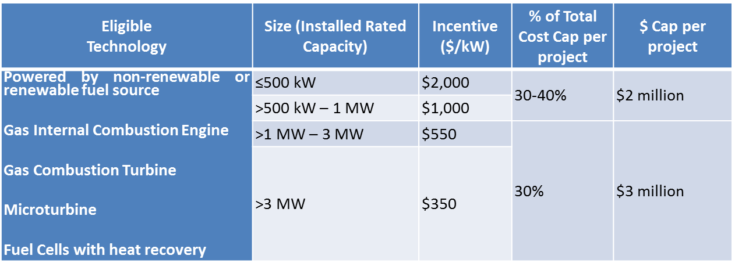
FY17 summary of proposed changes – combined heat and power - fuel cells
Suspend incentives for Fuel Cells without Heat Recovery pending further analysis
Technology-neutral incentive levels
Pay for Performance (P4P) and comprehensive energy efficiency project adders and enhanced project caps eliminated

Slide 29
FY17 summary of proposed changes – combined heat and power – fuel cells
30/50/20 Incentive payment
  30% when equipment purchased
  50% when system installed
  20% upon acceptance and confirmation that the project is achieving the required performance thresholds based on 12 months of continuous operating data submitted within 24 months of installation
All new projects must pass a cost-effectiveness test
  10 year simple payback or less
  Inclusive of federal tax benefits and program incentive
All new projects must contain cost-data for islanding capabilities, regardless of whether the project has islanding capabilities or not

Slide 30
FY17 summary of proposed changes – Renewable Electric Storage
Renewable Electric Storage
$3 million incentive budget
Rutgers University (RU) Laboratory of Energy Smart Systems (LESS) to release their evaluation results shortly
Staff will review the RU LESS evaluation, along with stakeholder input, results from FY15 solicitation and FY16 open enrollment to inform and influence FY17 program design
Proposed program to be submitted to the Board in early FY17

Slide 31
FY17 summary of proposed changes – Commercial & industrial programs
Commercial & Industrial Programs
FY16 C&I Program Changes
FY17 C&I Proposed Program Modifications
  SmartStart – Retrofit/New Construction
  Pay for Performance – New Construction
  Direct Install
  Customer Tailored Pilot

Slide 32
FY17 summary of proposed changes – Commercial & industrial programs
FY16 Program Changes
Local Government Energy Audit Program
New program approved by BPU on 03/18/16
TRC now performing energy audits
Direct Install
BPU approved program structure and RFPs released May 24, 2016
Code Impact
On 09/21/2015 NJ adopted a new energy efficiency code, with ASHRAE 90.1-2013 sub-code replacing ASHRAE 90.1-2007. The code change carried a six-month grace period which ended on 03/21/16.
  “Bridge” program changes to reflect 2013 code approved by BPU on 04/27/16; FY17 program proposals include more comprehensive changes

Slide 33
FY17 summary of proposed changes – SmartStart Buildings
FY17 Program Changes
  Custom Measures
  Project must exceed ASHRAE 90.1-2013 efficiency by at least 2%, where applicable, to qualify
  Prescriptive Lighting
  Incentives for LED screw-in/plug-in style lamps will be reduced from $10 to $5/lamp. Affected lamp styles include A15, A19, A21, BR30, BR40, R40, B13, BA10, F15, MRX16
  Performance Lighting
    Project must exceed ASHRAE 90.1-2013 lighting baseline requirements to qualify

Slide 34
FY17 summary of proposed changes – SmartStart Buildings
  Electric Chillers
    Incentives for existing and new construction buildings separated to reflect energy code change (ASHRAE 90.1-2013)
    For water-cooled centrifugal chillers <150 tons, base incentive increased from $12 to $24/ton; performance incentive reduced from $4.00 to $2.75
    Unitary HVAC
    Former incentive structure, size ranges and efficiency levels revised to reflect categories defined by ASHRAE 90.1-2013
    Tier 1 and Tier 2 incentives proposed for all equipment types except Package Terminal equipment
    New equipment types include Single Package Vertical Air Conditioners and Single Package Vertical Heat Pumps

Slide 35
FY17 summary of proposed changes – SmartStart Buildings
Ground Source Heat Pump
    Equipment categories and efficiencies revised to align with the new energy code; Overall incentives reduced
    Equipment must meet both EER and COP efficiency requirements to qualify for incentives
    Tier 1 and Tier 2 incentives proposed for all equipment types
Gas Water Heating
    Tank-style incentives and efficiency structured revised to reflect new energy code. Equipment capacity and efficiency must be documented by manufacturer’s published ratings or AHRI certificate.

Slide 36
FY17 summary of proposed changes – SmartStart Buildings
VFDs
    Incentive structure reformatted with some minor incentive revisions
    For all VFDs except air compressors, maximum controlled threshold per VFD is 50HP. VFDs controlling more than 50HP, except air compressors, will be reviewed through the custom path
    For new air compressors with VFDs, prescriptive incentives offered for units up to 200HP. Units exceeding 200HP will be reviewed through the custom path.

Slide 37
FY17 summary of proposed changes –
Pay for performance New construction
Modeling
Two modeling compliance paths:
Proposed design model following ASHRAE Building Energy Quotient (bEQ) As-Designed; measures modeled down to ASHRAE 90.1-2013 baseline.
ASHRAE 90.1-2013, Appendix G modified by Addendum BM baseline model; measures modeled incrementally from baseline.
ASHRAE 90.1-2007, Appendix G baseline model
Measures modeled incrementally from baseline
FY16 - CURRENT
FY17 - PROPOSED

Slide 38
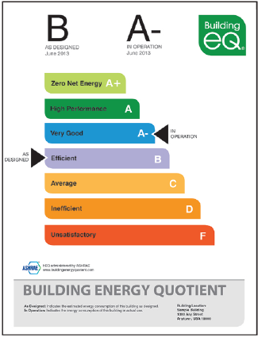
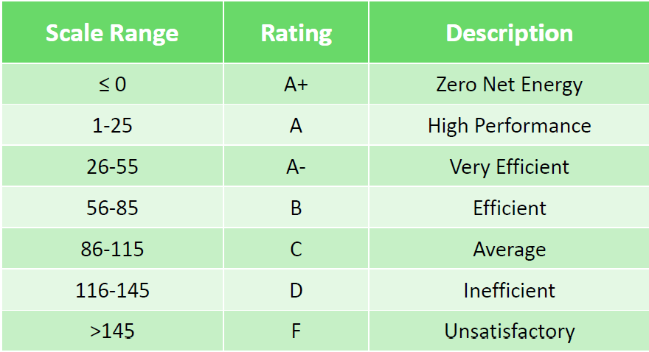
FY17 summary of proposed changes –
Pay for performance New construction
ASHRAE bEQ
Performance Score = (EUI _{design} / EUI _{median}) x 100

Slide 39
FY17 summary of proposed changes –
Pay for performance New construction
Addendum BM
Sets common baseline that will remain the same for ASHRAE 90.1-2013 and future iterations of ASHRAE 90.1.
Roughly equivalent to ASHRAE 90.1-2004
  11-40% energy cost savings from Addendum BM ≈ ASHRAE 90.1-2013 compliance, depending on building type and climate zone.
Technically similar to current program and less challenging than ASHRAE 90.1-2013 Appendix G without Addendum BM
LEED New Construction will incorporate Addendum BM into its modeling requirements
Notes:
Benefits:
- When New Jersey adopts a future version of ASHRAE 90.1 the program does not need to be redesigned. Instead, the minimum performance target to be eligible for incentives would be adjusted.
- Simplify modeling rigor
- Reduce program administration and Partner duplicate efforts for projects participating in both P4P and LEED.

Slide 40
FY17 summary of proposed changes –
Pay for performance New construction
Minimum Performance Target
15% energy cost savings from ASHRAE 90.1-2007 Appendix G baseline
5% energy cost savings for C&I and 15% for multifamily buildings from ASHRAE 90.1-2013 baseline.
Equivalent targets for the two modeling compliance paths to be provided in program guidelines (e.g. bEQ performance score of 68; PCI of 0.71).
FY16 - CURRENT
FY17 - PROPOSED
Notes:
Performance Cost Index: Addendum BM establishes a new formula to evaluate building performance called the Performance Cost Index (PCI). PCI is equivalent to 1 - Performance Rating. Under the current P4P NC program, a 15% energy cost savings from ASHRAE 90.1-2007 is equal to 1-.15 = 0.85 PCI. A PCI of 1.0 is equal to baseline of ASHRAE 90.1-2004.
Equivalent target values subject to change.

Slide 41
FY17 summary of proposed changes –
Pay for performance New construction
Measure Requirements
At least one measure addressing each: envelope, heating, cooling, and lighting.
Buildings not heated (e.g. refrigerated warehouse) or not cooled (e.g. warehouse) exempt from measure addressing that system.
Measures defined as components that exceed ASHRAE 90.1-2013.
At least two measures
Lighting measures cannot make up more than 50% of total energy cost savings
FY16 - CURRENT
FY17 - PROPOSED

Slide 42
Incentives
Notes:
Incentives are capped per the table above. All other incentive caps remain unchanged (e.g. $2 million per project assuming both electric and gas measures, $4 million entity cap per program year).

Slide 43
FY17 summary of proposed changes –
Pay for performance New construction
Incentives
Pre-Design Bonus
Projects that are in pre-design or schematic design may be eligible.
Goal is to incentivize Partners and applicants to critically think about building design from an energy efficiency standpoint early in the process where changes are easier to make.
Notes:
More information provided in program guidelines.

Slide 44
FY17 summary of proposed changes –
Pay for performance New construction
Cx Report now part of As-Built ERP submittal /Incentive 2
Support installed equipment and ensure no major outstanding operational issues
Incentive 2 – As-Built ERP
Incentive 3 – Cx Report
FY16 - CURRENT
FY17 - PROPOSED

Slide 45
FY17 summary of proposed changes –
Pay for performance New construction
Incentive #3 - Building Performance (new)
Promote quality construction and energy efficient operation and maintenance practices
Assess the energy performance of the project building based on its first year of operation
Projects must achieve a score of 75 or higher through ENERGY STAR Portfolio Manager and Certification
  Building types not eligible for ENERGY STAR Certification must obtaining ASHRAE Building Energy Quotient (bEQ) In-Operation Certification and receive a score of 68 or less

Slide 46
FY17 summary of proposed changes –
Pay for performance New construction
Core and Shell vs. Tenant Fit-Out Projects
P4P NC projects are required to evaluate the whole building design. Further, if a P4P NC Application is submitted to the program, that same building(s) cannot also submit applications to other programs.
An exception may apply to eligible projects pursuing Core & Shell separate from Tenant fit-out improvements, which may fall into one of two scenarios:

Slide 47
FY17 summary of proposed changes –
Pay for performance New construction
Project Scenario 1: Core & Shell and Tenant Fit-out are combined into a single project. May apply where:
  Developer is funding and constructing both Core & Shell and Tenant fit-out.
  High performance systems are specified and funded for the Tenant space separate from Core & Shell, but the building owner and tenant come to an agreement to include both scopes of work under a single project.
Projects under this scenario will follow all Program Guidelines as typical.

Slide 48
FY17 summary of proposed changes –
Pay for performance New construction
Project Scenario 2: Core & Shell is separate project from Tenant Fit-out. This scenario applies when Core & Shell work is known but the tenant space development is unknown and/or is funded separately.
A building may apply for P4P NC for either Core & Shell or Tenant fit-out(s), not both. The determining factor depends on which scope will include design and construction of the central HVAC system.
  Incentives will apply to all conditioned square footage of the building serviced by the HVAC.
  The project scope applying for P4P NC (e.g. Core & Shell OR Tenant Fit-out) must be able to meet all requirements of program on its own.
Any Tenant fit-out OR Core & Shell work not included in P4P NC, may seek incentives through the SmartStart Prescriptive or Custom Measure programs for eligible equipment.
Modeling Considerations Included in Guidelines

Slide 49
FY17 summary of proposed changes – Direct Install
Direct Install
Requests for Proposal (RFP) issued to obtain updated program pricing for all labor and materials
All material vendors and installation contractors (referred to as Participating Contractors) will be selected via an open and competitive bidding process
Allow customers to use their own contractor - If an applicant wishes to utilize their own contractor, that contractor must meet the program requirements, agree to the established pricing and complete training

Slide 50
FY17 summary of proposed changes – Direct Install
Direct Install RFP Schedule
June 1 – Intent to Bid submission deadline
June 6 – Questions due to TRC
June 17 – Proposals due to TRC
On or about June 30 – Negotiation of program pricing with selected bidders
On or about July 15 – Complete negotiations and contractor services agreements executed

Slide 51
FOR MORE INFORMATION
Visit: NJCleanEnergy.com
Call: 866-NJSMART
Stay Informed: NJCleanEnergy.com/NEWSLETTER

