Slide 1
FY17 NJCEP Program Updates
February 14, 2017
TRC Team

Slide 2
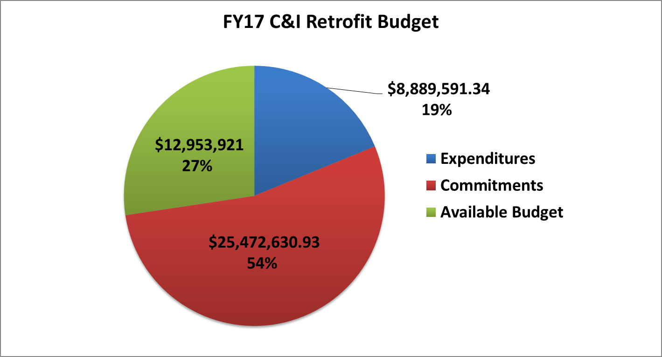
FY17 C&I Program update

Slide 3
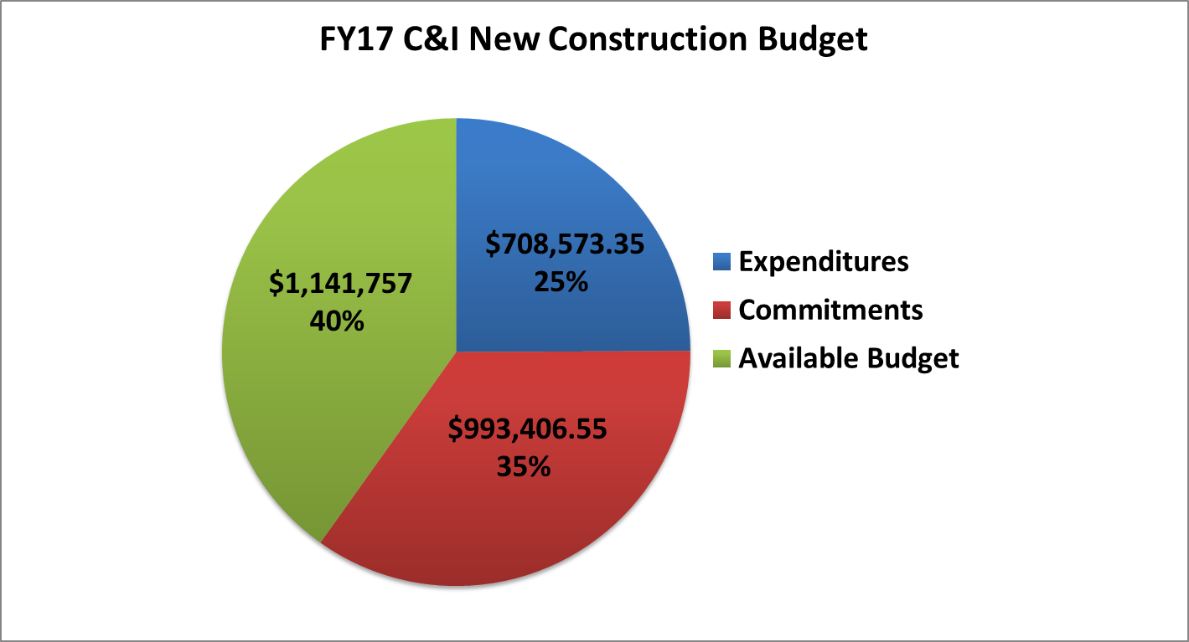
FY17 C&I Program update

Slide 4
FY17 C&I Program update
SmartStart Retrofit & New Construction
Over 1,940 projects approved through December representing ~$14.5M
Installed electric energy savings on target to meet goal
Installed gas savings exceeding goal

Slide 5
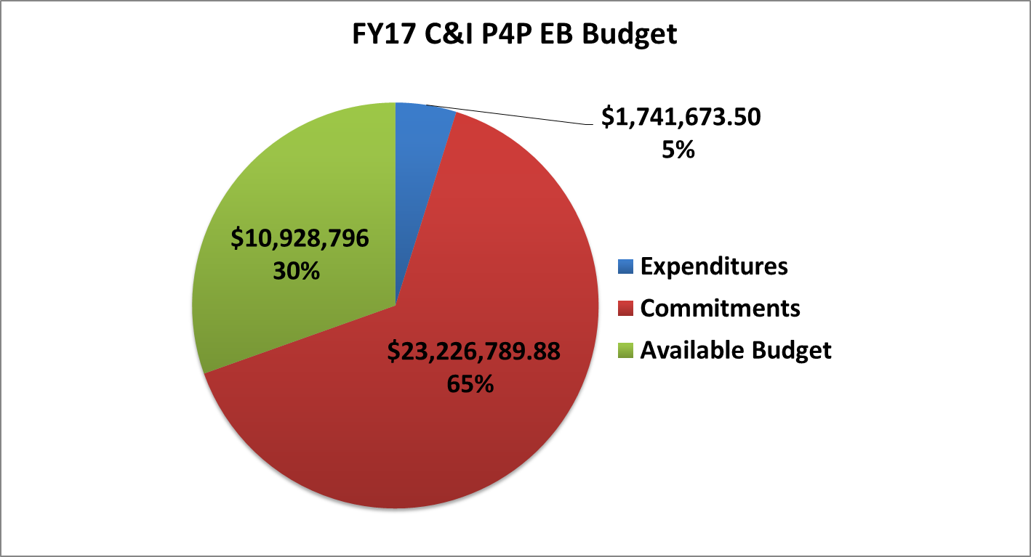
FY17 C&I Program update

Slide 6
FY17 C&I Program update
Pay for Performance Existing Buildings
Volume of ERPs received and approved is trending well but average incentive per project is low resulting in lower than expected rate of commitment of funds
Anticipated surplus funding requested to move to other programs in need
Electric lifetime program savings from installations trending below goal at 34% and
Gas lifetime program savings from installations trending below goal at 39%

Slide 7
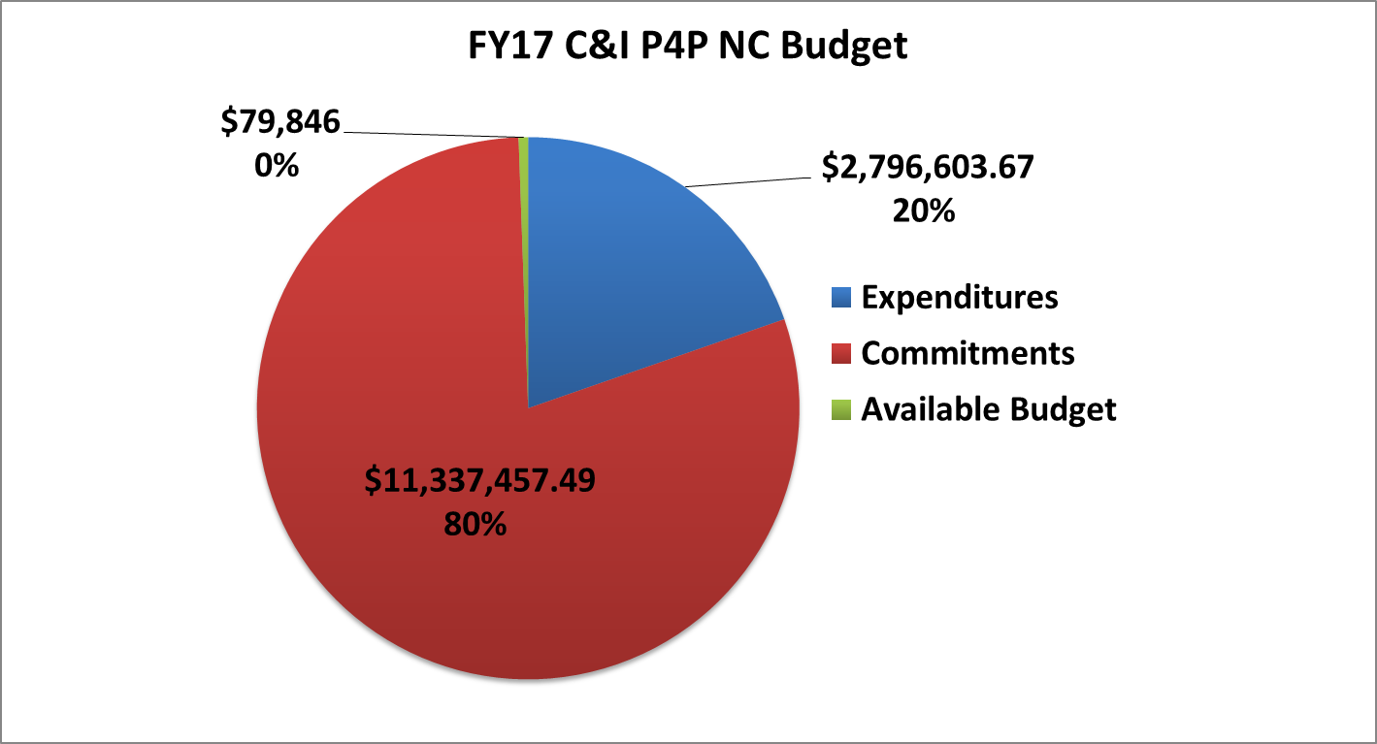
FY17 C&I Program update

Slide 8
FY17 C&I Program update
Pay for Performance New Construction
7 applications received under the new program
Backlog of projects from prior program year(s) have higher than average incentives
Anticipated surplus funding requested to meet demand.
Electric lifetime program savings from installations trending towards goal at 50%
Gas lifetime program savings from installations trending below goal at 39%
Notes:
Old program received 1-2 new applications per month. So 7 applications in 6 months is not bad considering novelty of program.

Slide 9
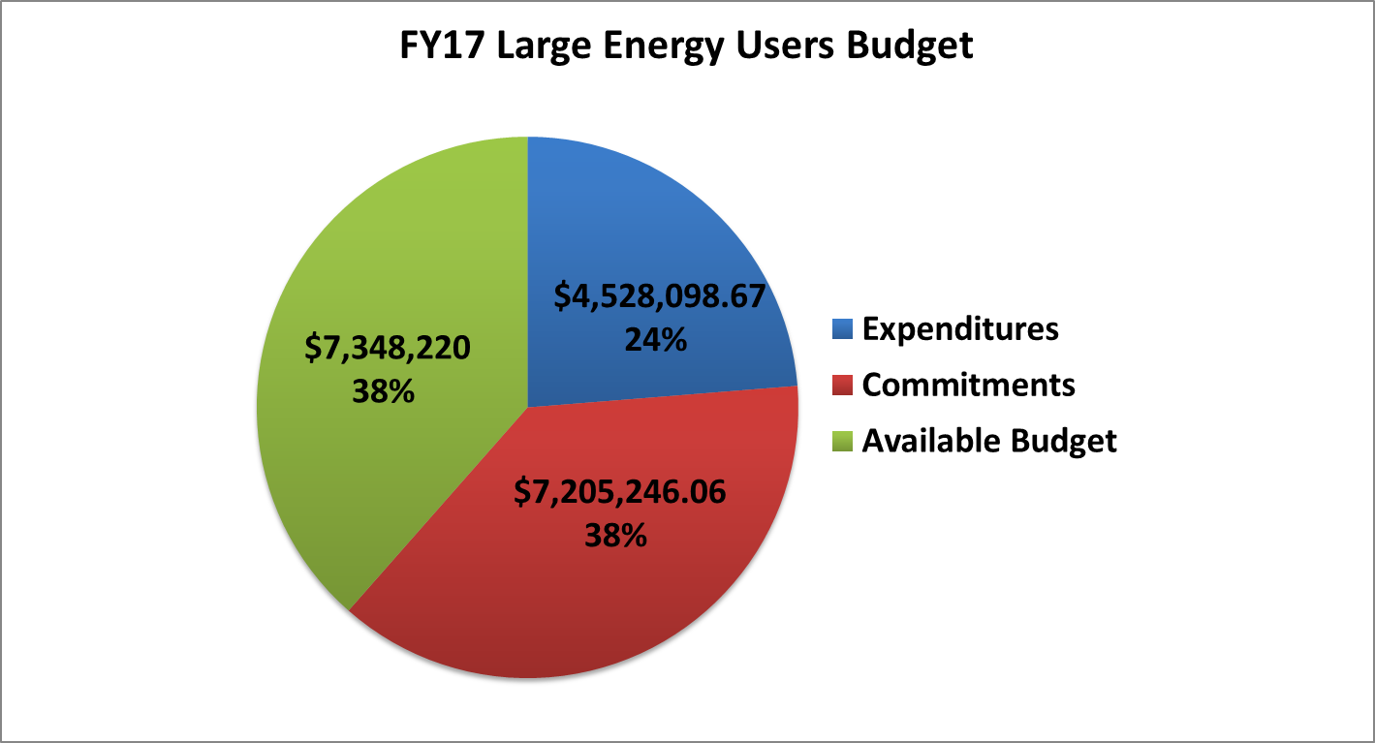
FY17 C&I Program update

Slide 10
FY17 C&I Program update
Large Energy Users
Propose reducing Clean Energy Portion of SBC contribution requirement from $300K to $200K and minimum project incentive from $200k to $100k
FY17 new enrollment submissions trending lower than anticipated
Prior FY project close-outs set to meet electric savings goal
Gas installed savings goal exceeded

Slide 11
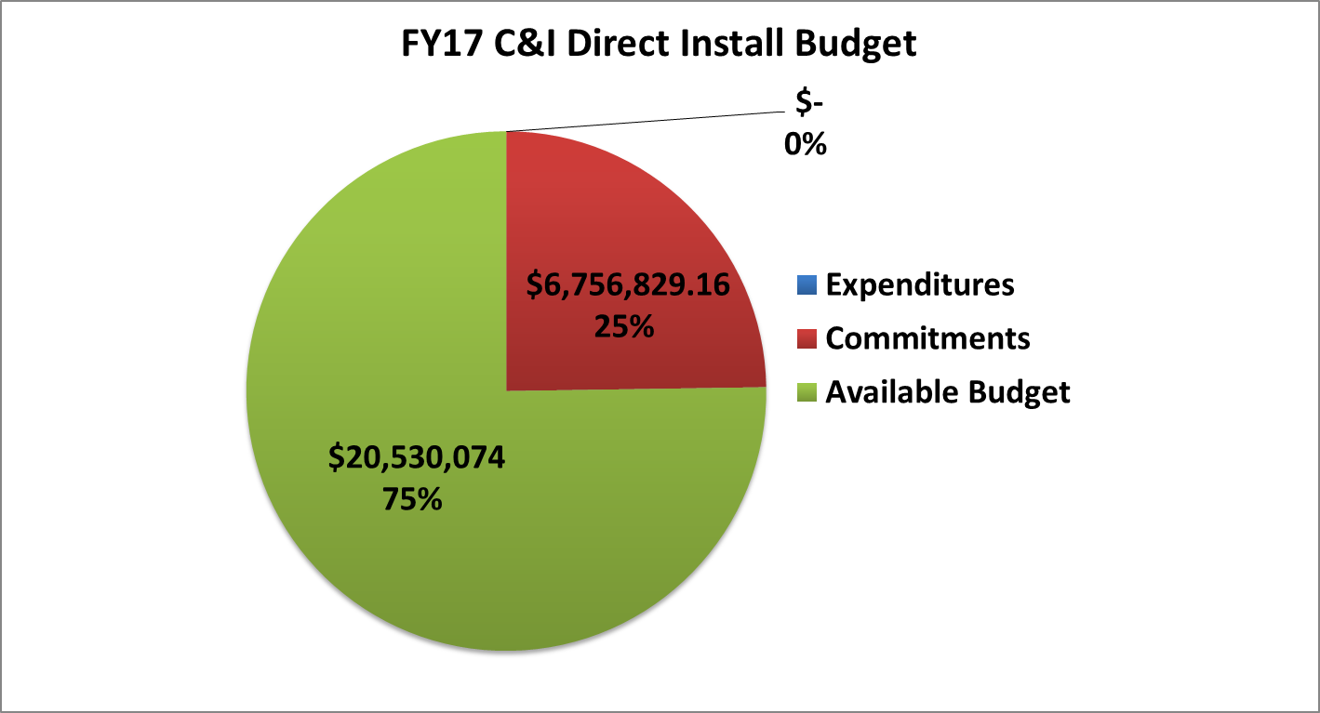
FY17 C&I Program update

Slide 12
FY17 C&I Program update
Direct Install
Program launched September 15th
Received 284 project submittals as of December 31st
231 applications approved - $6,756,829.16 committed
24.8% of Direct Install OCE incentive budget committed
SEP Non-IOU
Funding currently available
Received 7 project submittals as of December 31st
4 applications approved - $101,968.30 committed
24.9% of Direct Install SEP incentive budget committed

Slide 13
FY17 C&I Program update

Slide 14
FY17 C&I Program update
Local Government Energy Audit - Legacy Program
Legacy LGEA program has closed out and approved payment of all applications as of December 2016
Audit reports for 116 buildings/6 entities approved in FY17

Slide 15
FY17 C&I Program update
Local Government Energy Audit w new delivery mechanism
Over 630 apps received*
Represents 72 entities including:
304 apps received in FY17 alone; almost as much as received all of FY16 (396) and FY15 (341)
34 apps w. complete audits / 13 entities
267 apps/26 entities with audits in progress
333 apps/34 entities in pre-audit application review
Additional funding requested to meet demand
34 school districts
12 municipalities
14 non-profits
6 regional authorities/MUAs
4 colleges
2 state agencies
Notes:
*Not including canceled/rejected. 1 application typically equals 1 building.
31 entities (of 72) expressed interest in ESIP
State Agencies Include: Division of Law and Public Safety (i.e. med examiner), Delaware River Basin Commission
Overall we are seeing high participation rates with faster turn-around from application receipt to audit due to elimination of RFP process.

Slide 16
FY17 C&I Program update
Customer Tailored Pilot
Designed for customer projects that are not a good fit for prescriptive approaches or that require multiple applications
Will improve customer experience, be more responsive to non-standard opportunities, and simplify application process
Encourages use of Advanced Lighting Controls

Slide 17
FY17 C&I Program update
Multi Family Program Development Status
Reviewed existing NJ program offerings and participation patterns for multifamily sector
Researched best practice MF program offerings in other jurisdictions
Held stakeholder focus group for input
Next Steps
Propose new MF program design for BPU and public comment

Slide 18
FY17 DER Program update

Slide 19
FY17 DER Program update

Slide 20
FY17 DER Program update
Combined Heat and Power
Program relaunched August 1st
Received 14 CHP and 1 Fuel Cell application
10 projects under review total 10.015 MW
If 10 are approved, remaining budget will be $6,900,620
Preliminary CHP/FC Study concluded, will help guide any potential program changes
Renewable Electric Storage
Program launched March 1st
Received 13 applications, 6 approved, and 1 in review

Slide 21
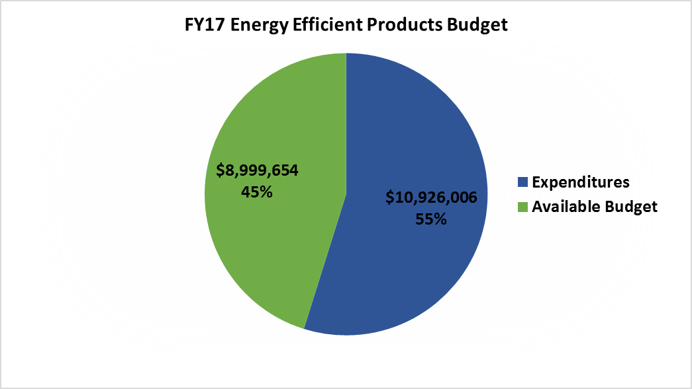
FY17 Residential Program Update

Slide 22
FY17 RESIDENTIAL Program update
Energy Efficient Products
Consists of Appliance Recycling; Appliance Incentives and Lighting Markdown Programs
Appliance Recycling lagging due to lack of marketing
Consumer appliance rebates are exceeding targets
Discounted residential lighting products are available across the state at Ace Hardware, Batteries Plus, BJ’s, Costco, Dollar Tree, Home Depot, Lowe’s, Sam’s Club, Shop Rite and Walmart
Overall the program has spent 55% of the budget while achieving 66% of the MWh goal

Slide 23
FY17 Residential Program Update

Slide 24
FY17 Residential Program Update
Home Performance with ENERGY STAR
Through Dec 31, 2016: 2301 completions (767 were Multi-family units), 2048 enrollments
Program continues to struggle with lower level enrollments
From the start of the fiscal year we have had 38 new potential HPwES contractors attend an orientation session, 4 of which became HPwES participating contractors
Existing account managers and technical field reps are actively working with new contractors and guiding them through the process to complete their first set of projects
Notes:
3701 enrollments last year same timeframe, with a huge spike in July due to funding issue in FY16 (claimed under new dollars)
With addition of new contractors, and some drop off during the renewal period of 2017, we officially count 95 HP participating contractors.

Slide 25
FY17 Residential Program Update

Slide 26
FY17 Residential Program Update
HVAC
Through 12/31/16 processed 10,180 apps; 50/50 paper/online, which has improved from 70/30 a few months ago
Actively focusing on training contractors to transition to online portal submission from the paper process
For FY18, the goal is to become paperless
The new program requirements are in effect since 1/1/17:
Permit # or a copy of the permit app required (WARM/COOL)
A copy of the AHRI cert must be submitted (WARM)
Manual J load calculations / equipment selected in accordance with ACCA Manual S (WARM)
Ongoing Manual J&S trainings offered

Slide 27
FY17 Residential Program Update

Slide 28
FY17 Residential Program Update
Residential New Construction
Continue to work with raters on the projects submittal process improvements as well as online portal data entry
Completing required online portal fields in timely manner
PDW and Final Inspection dates are sometimes still missing
Expiration notifications are being sent out to raters to notify them 60 days prior to the project expiration date to complete the final documents submission process

Slide 29
FY17 Residential Program Update
FY17 Residential Trainings-to-date
FY17 | Dates |  | Program | Description | Total times
Completed | JUL: 7/19 |  | RNC | Finding and Fixing Leaks (webinar) | 1
 | JUL: 7/21 AUG: 8/18 OCT: 10/13 NOV: 11/10 DEC: 12/8 |  | HP | HPwES Potential New Contractor Orientation | 5
 | JUL: 7/20 AUG: 8/31 DEC: 12/15 |  | HP | HPwES Program Overview Training | 3
 | AUG: 8/10 SEP :9/12 |  | HP | Real Home Analyzer Basic Data Entry | 2
 | SEP: 9/8 |  | HP | Proactive Transactions: Home Performance Professional | 1
 | SEP: 9/16 |  | HP | Business of Home Performance | 1
 | SEP: 9/7 DEC: 12/7 |  | HVAC | HVAC Best Practices | 2
 | Nov: 11/2, 11/9, 11/22 DEC: 12/2, 12/13, 12/21 |  | HVAC | Manual J and S | 6
 | Total |  |  |  | 21
In-Progress/Scheduled | JAN: 10, 18, 24 FEB: 7, 14, 17, 21, 28 MAR: 7, 9, 10, 14, 16, 21 |  | HVAC | Manual J and S | 14
 | JAN: 1/5, 1/19 FEB: 2/2 MAR: 3/2 , more TBD |  | HP | HPwES Potential New Contractor Orientation | 4
 | TBD as needed |  | HP | HPwES Program Overview Training | 0
 | TBD as needed |  | HP | Real Home Analyzer Basic Data Entry | 0
 | JAN: 1/19 APR: 4/13, more TBD |  | HP | Proactive Transactions: Home Performance Professional | 2
 | JAN: 1/26 APR: 4/20, more TBD |  | HP | Business of Home Performance | 2
 | MAR: 3/29, more TBD |  | HVAC | HVAC Best Practices | 1
 | Total |  |  |  | 23
 |  |  |  | FY17 Residential Trainings-to-date | 44
Notes:
Manual J and S trainings = 20 in total will be provided by June 30, 2017
Utilities continue to sponsor these trainings as well
Proactive Transactions is a full day sales training for HP contractors
Business of Home Performance is a full day training to prep a business model and marketing for HP contractors
HVAC Best Practices is a full day for HVAC contractors on industry best practices, on Quality Assurance, and customer service

Slide 30
FY17 Residential Program Update
FY 2017 SEP Funding HPwES & HVAC - as of 1/20/17
 | HPwES |  | HVAC
 | Projects | SEP Funds | Projects | SEP Funds
Commitments | 9 | $59,005.56
Completions | 21 | $166,112.42 | 375 | $136,300.00
Total | 30 | $225,117.98
Total FY17 Allocation |  | $295,775.70 |  | $210,628.15
Available FY17 Funds |  | $70,657.72 |  | $74,328.15
With the current run rate, the funds for both programs may be exhausted in March/April ; communications to contractors will follow

Slide 31
FY17 Outreach Update
Microsoft Dynamic Customer Relationship Management (CRM) Update:
Continued calibrating various data inputs and outputs specific to NJCEP and the Outreach Team
Posting public events on NJCEP website calendar for NJCEP, Utilities and Sustainable Jersey
Participated in 131 events from July through January which identified 419 project leads
Creative Outreach Team participated in 66 events from July through January

Slide 32
FY17 outreach Update
The third Enhanced Outreach Account Manager for residential programs started November 7 and will handle the central part of the state
Working with the Middlesex County Board of Realtors regarding future trainings
Developed a step-by-step guide for HVAC contractors of how to submit WARM/COOL applications through the online portal

Slide 33
FY17 outreach Update
Conducting presentations statewide to NJ Association of Business Official (NJASBO) and NJ School Building & Grounds (NJSBG)
Conducted monthly joint utility / Outreach Team meetings including NJNG, SJG, ETG, PSE&G, JCP&L and ACE to coordinate NJCEP and utility program promotion
Conducted monthly joint Sustainable Jersey / Outreach Team meetings to coordinate NJCE programs with SJ certification actions and sustainability challenges

Slide 34
FOR MORE INFORMATION
Visit: NJCleanEnergy.com
Call: 866-NJSMART
Stay Informed: NJCleanEnergy.com/NEWSLETTER

