Slide 1


Energy Efficiency Stakeholder Meeting
March 16, 2023
Notes:
TRC to start with housekeeping and introduce Stacy

Slide 2
Agenda
Welcome & Introductions
Re-cap of Last Meeting
Current Program Updates
  BPU Update
  Utility Company Presentation
RECO Clean Heat Program
FY23 True-up Budget
New Construction Program Update
Planned Triennium 2 Timeline
General Q&A
Items of Interest
Next Meetings
Notes:
Stacy

Slide 3
Recap of Last Month
Notes:
Stacy

Slide 4
February Meeting Recap
What we covered:
Transition information on NJCEP website
NJCEP and Utility Program updates
NJCEP New Construction Program update
Working Group updates
Triennium 2 timeline update
Q&A
Notes:
Stacy

Slide 5
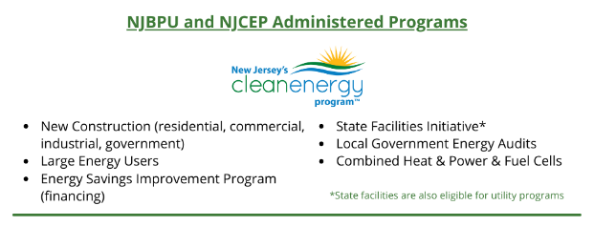


Post-Transition
Energy Efficiency Programs
Notes:
Stacy

Slide 6
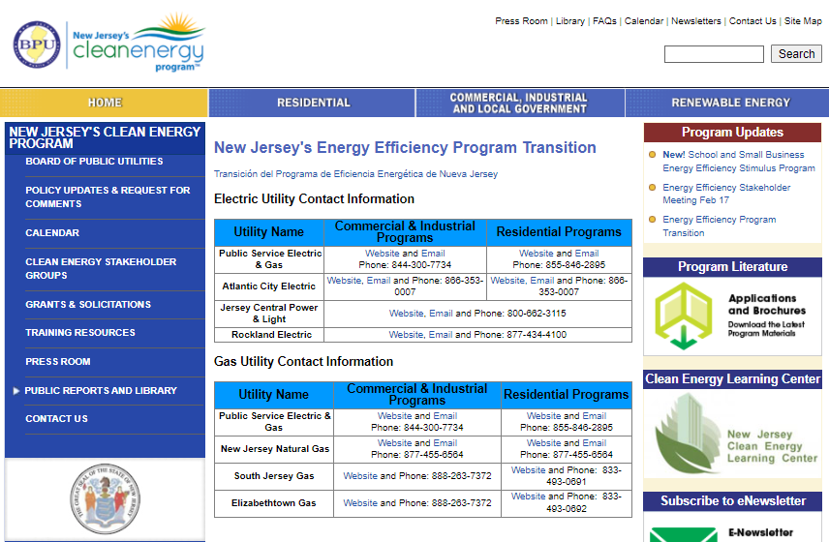
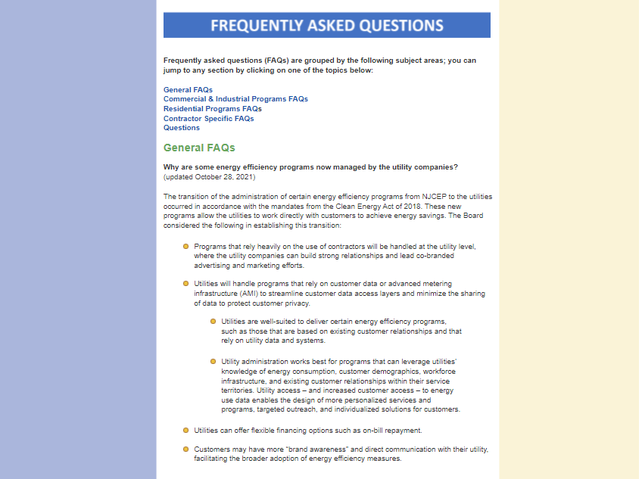
Visit our transition website:
www.NJCleanEnergy.com/TRANSITION
Notes:
Stacy

Slide 7
Current Program Updates
Notes:
Sherri

Slide 8

BPU Program Updates:
Progress to Goals (PTG) Report
as of February 2023 – FY23
Note: The results presented here are preliminary and are subject to change.
Notes:
Marybeth

Slide 9
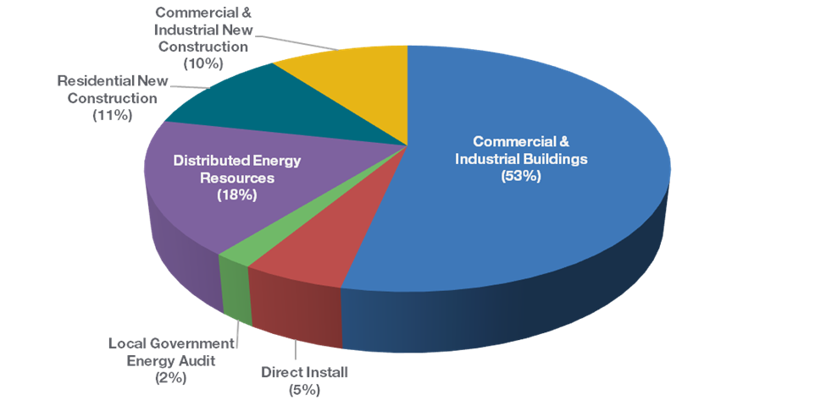
Budget Break-down by Program
FY23 TRC Managed Programs
Incentive Budget: $117,415,104

Slide 10


Energy Efficiency Programs FY23
NJCEP/TRC Managed -
Closed/Closing Out, Transitioned to Utilities
NJCEP/TRC Managed -
Open
  Residential Products & HVAC
  Residential Existing Homes
  C&I Buildings (existing buildings)
    SmartStart Retrofit
    Pay for Performance Existing Buildings
  Direct Install
  New Construction Was: Residential New Construction, SmartStart New Construction, Pay for Performance New Construction, Customer Tailored Energy Efficiency Pilot New Construction
  Large Energy Users
  Local Government Energy Audit
  Distributed Energy Resources
  School & Small Business Stimulus Program (federally funded)
BPU/Utility Managed
Comfort Partners

Slide 11
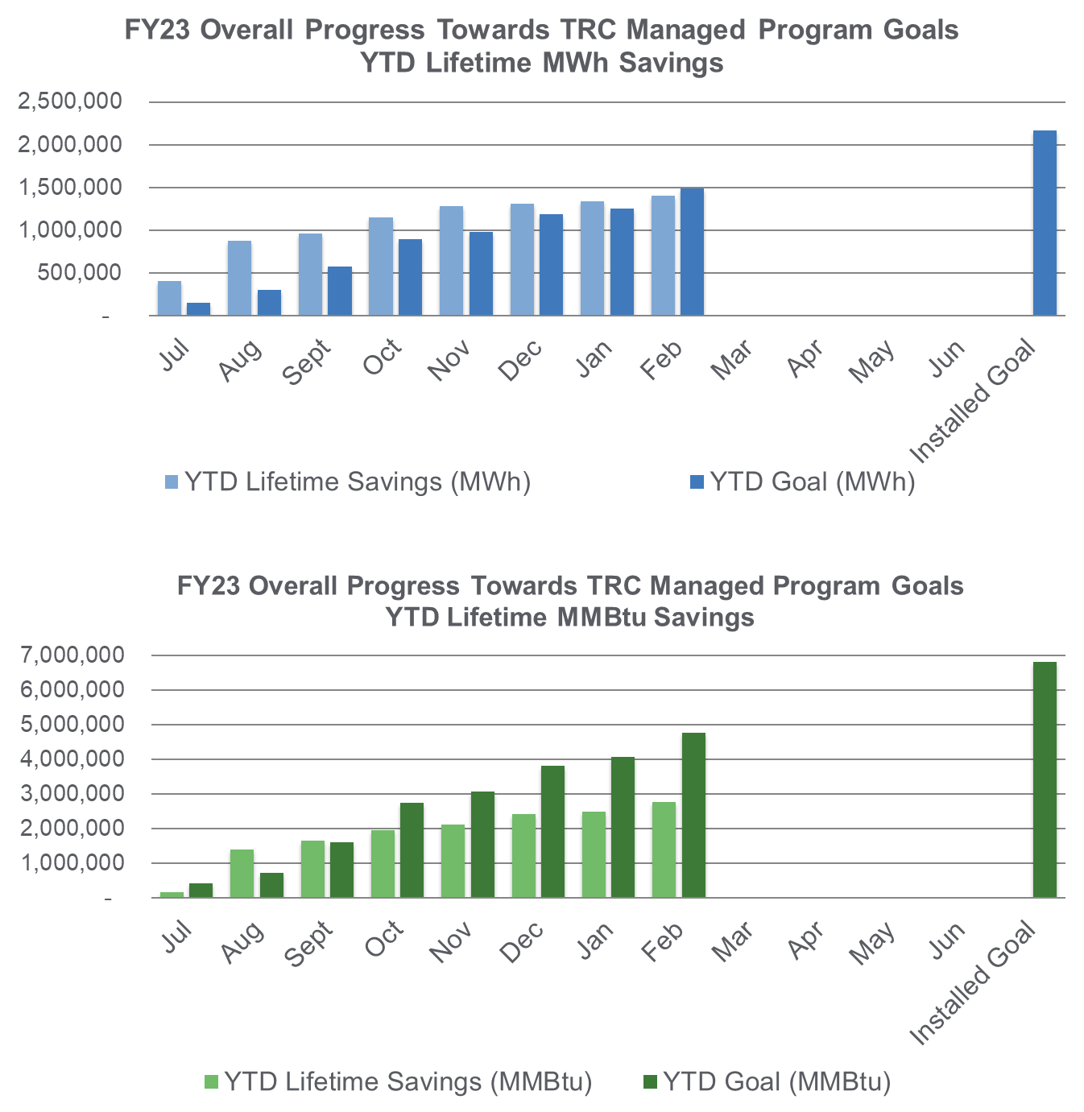
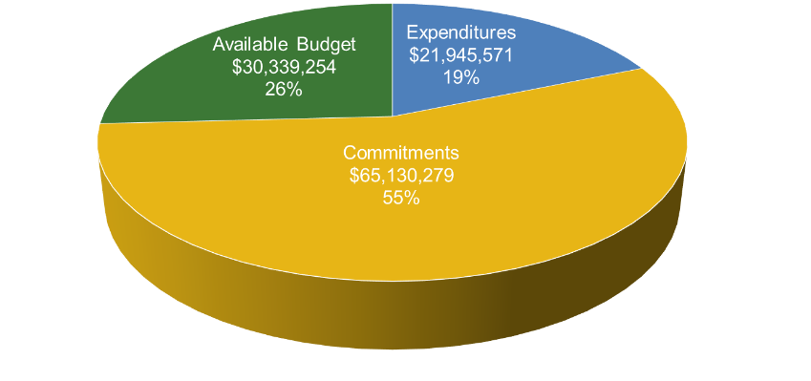
Progress Towards Goals – TRC Managed Programs
FY23 TRC Managed Programs
Incentive Budget: $117,415,104

Slide 12
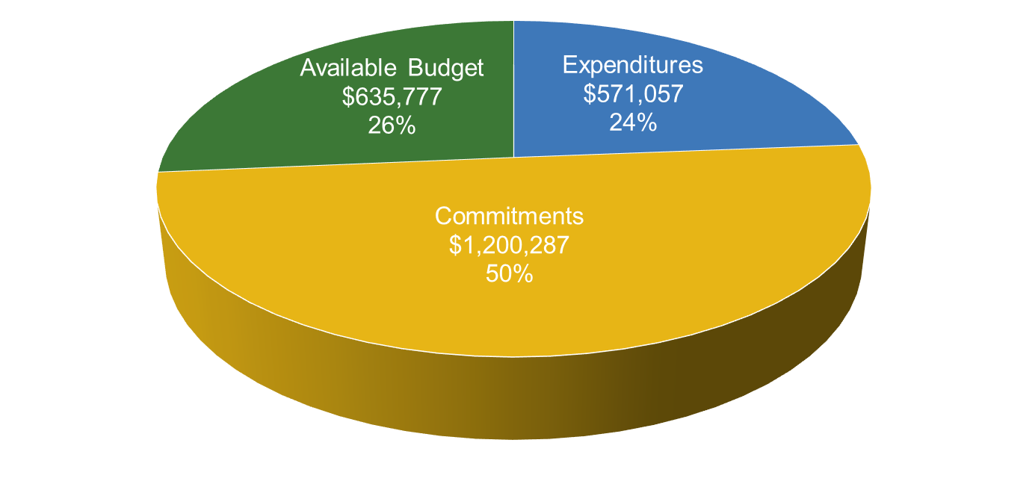
Local Government Energy Audit (LGEA)
FY23 Incentive Budget: $2,407,121
Program Highlights
Received: 12 applications this month 373 YTD
Approved: 46 applications this month 275 YTD
Audited approximately 1,058,600 square feet
Held 1 Exit Meeting for 3 sites (including additional scopes)
Delivered Final Audit reports on 3 sites (1 entity)

Slide 13
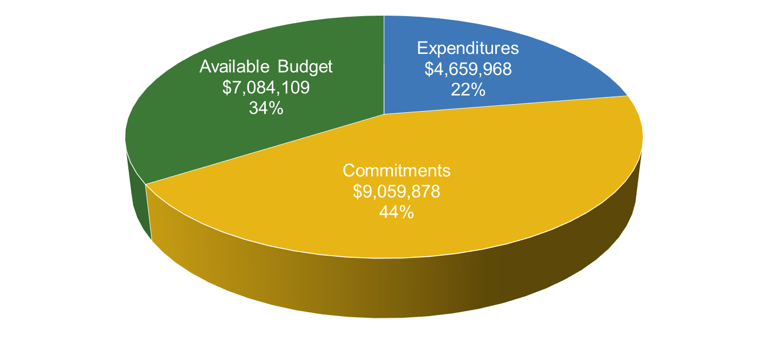
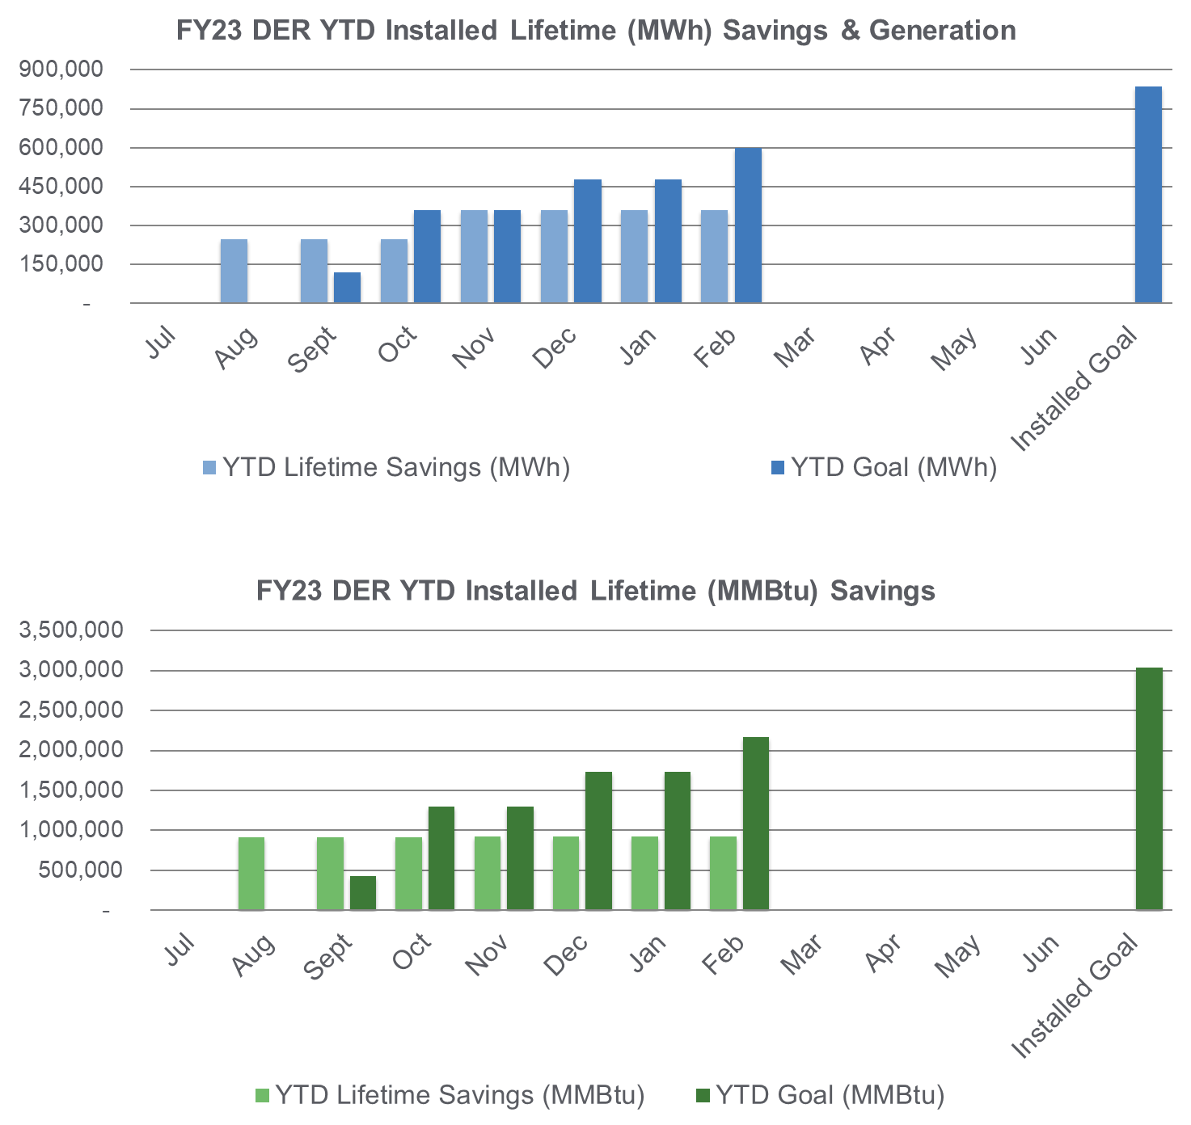
Distributed Energy Resources
CHP and Fuel Cells
FY23 Incentive Budget: $20,803,955
Program Highlights
Received: 0 applications this month 1 YTD
Approved: 0 applications this month 2 YTD
Completed: 0 installations this month 7 YTD

Slide 14
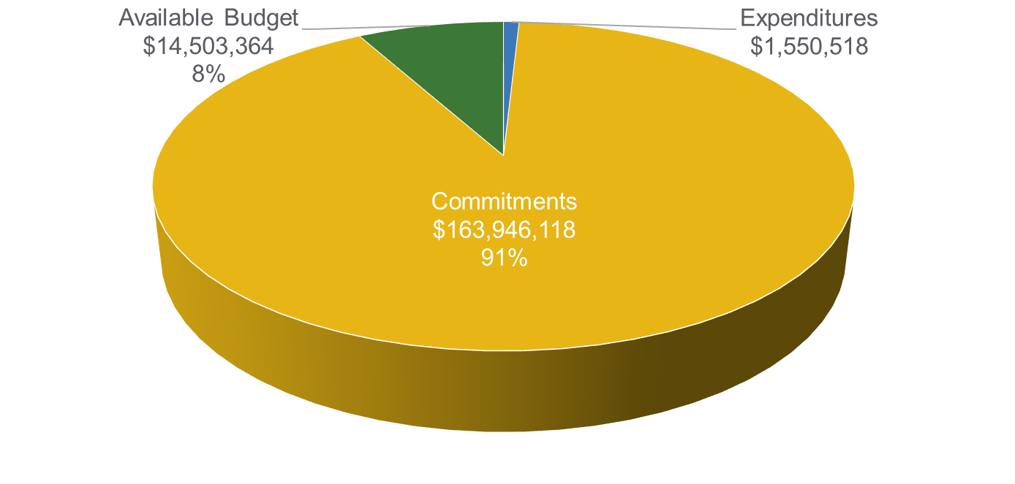
School & Small Business Stimulus Program
FY23 Incentive Budget: $180,000,000
Program Highlights
Received: 12 applications this month 147 YTD
Approved: 20 applications this month 142 YTD
Completed: 6 installations this month 22 YTD
Note: This program is a multi-year continuing grant and not based on a fiscal year.

Slide 15
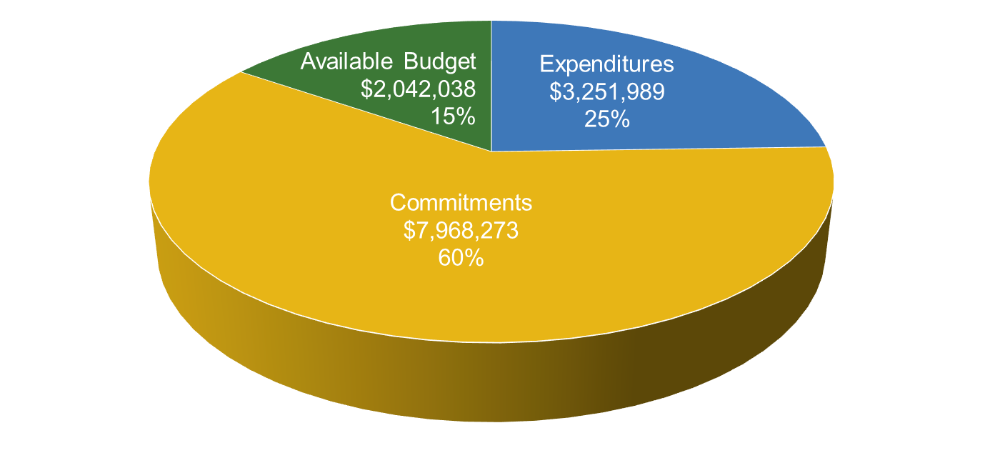
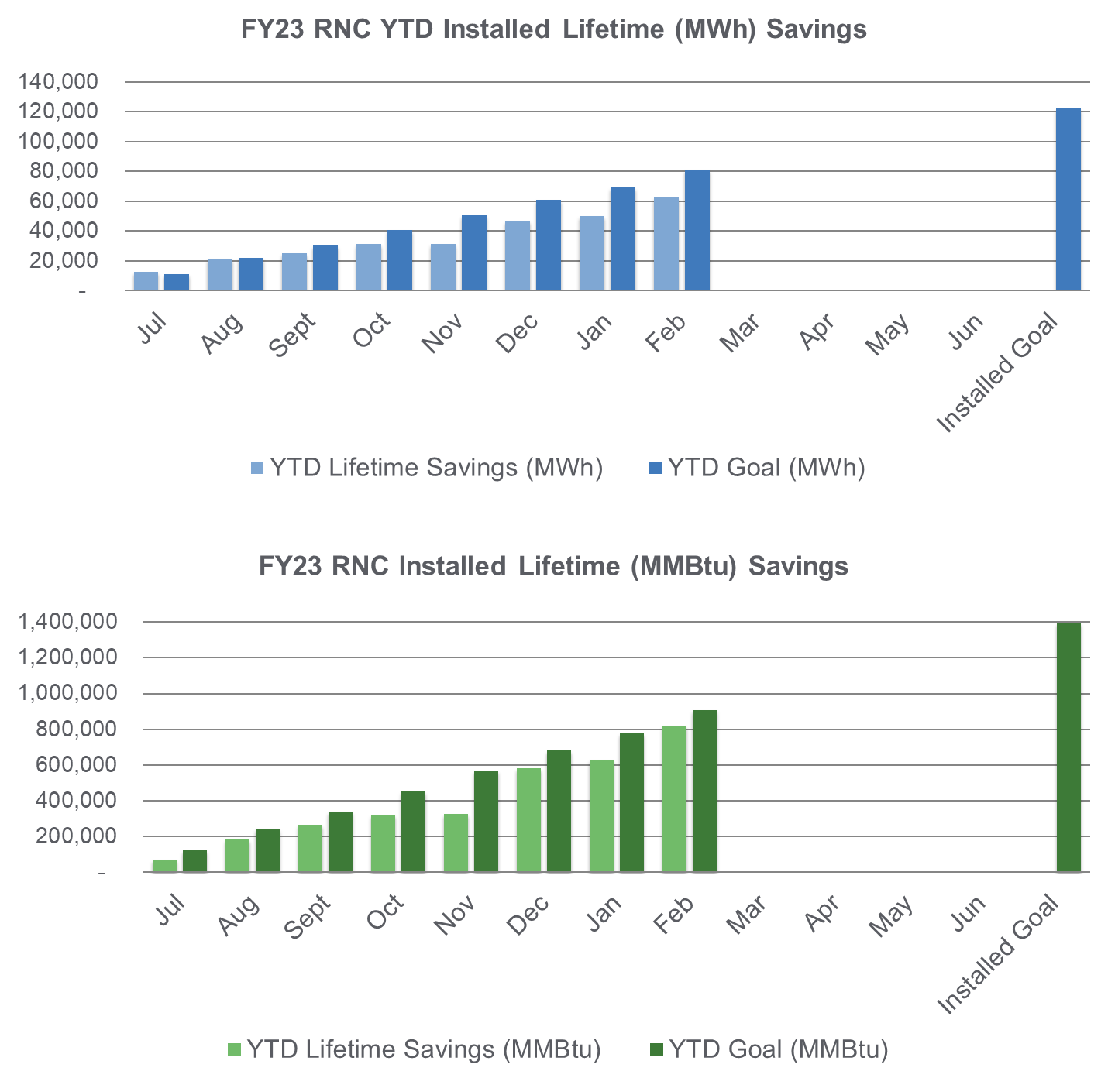
New Construction Programs
Residential New Construction
FY23 Incentive Budget: $13,262,300
Program Highlights
Site Registrations Received/Enrolled: 169
Site Registrations Approved: 164
Incentive Applications Received: 352
Incentive Applications Approved: 294
Projects Cancelled: 101

Slide 16
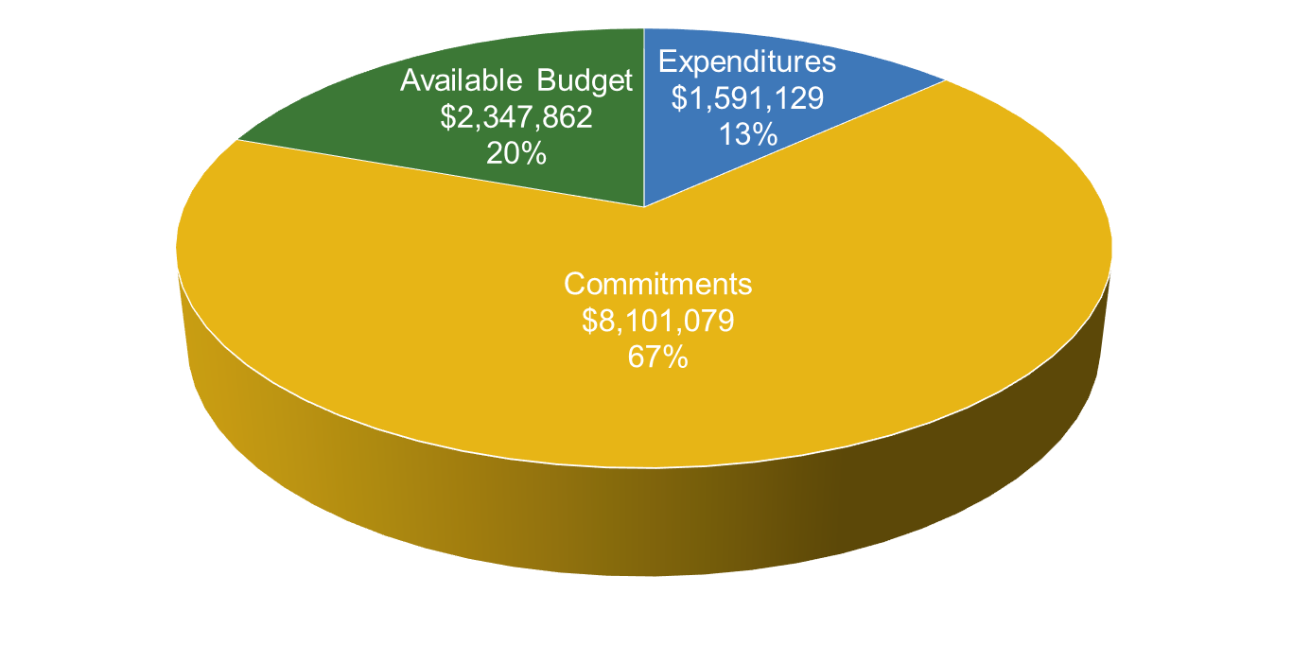
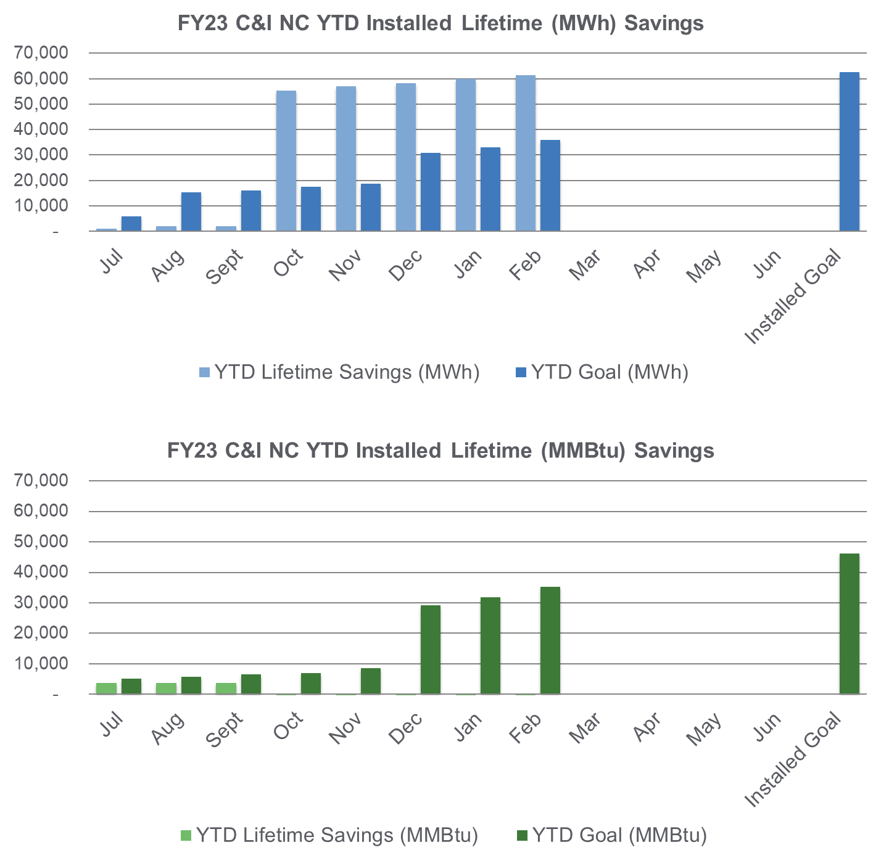
New Construction Programs (cont.)
C&I New Construction: P4P NC and C&I NC
FY23 Incentive Budget: $12,040,069
Program Highlights
Received: 2 enrollments this month 44 YTD
Approved: 3 projects this month 46 YTD
Paid: 3 applications this month 33 YTD
16

Slide 17
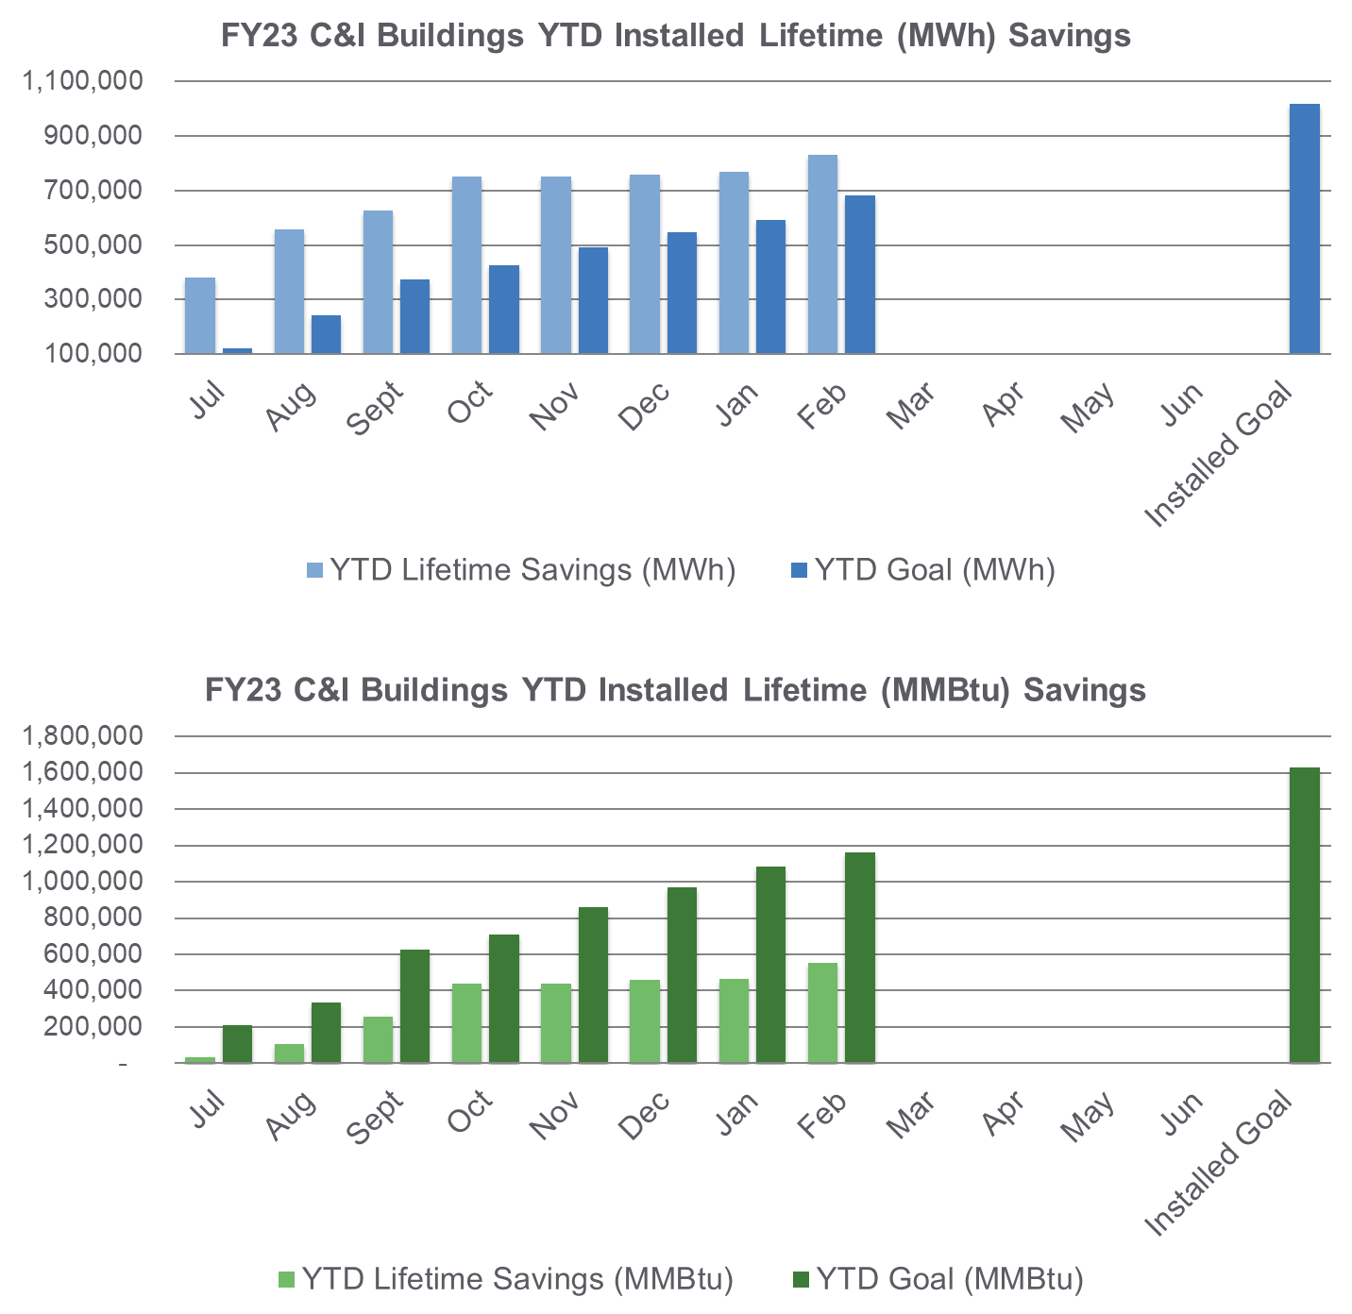
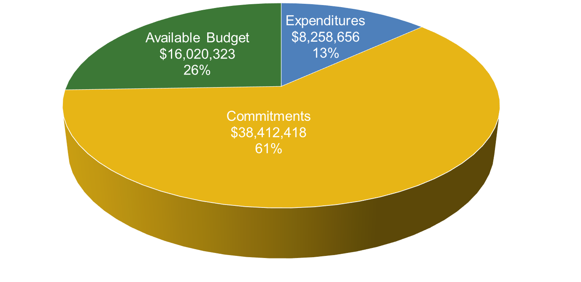
Commercial & Industrial Programs
C&I Buildings: Retrofit, CTEEP, P4P EB, LEUP
FY23 Incentive Budget: $62,691,396

Slide 18
C&I Buildings – Program Highlights
Large Energy User Program
Received: 1 application this month 7 YTD
Approved: 0 Final Energy Efficiency Plans this month 4 YTD
Paid: 0 applications this month 7 YTD
Retrofit (Close-Out Program: transitioning to Utilities)
Received: 1 application this month 1 YTD
Approved: 1 application this month 8 YTD
Paid: 6 applications this month 120 YTD
Pay for Performance Existing Buildings (Close-Out Program: transitioning to Utilities)
Received: 0 applications this month 0 YTD
Approved: 4 Energy Reduction Plans 15 YTD
Completed: 0 projects this month 4 YTD
Customer Tailored Energy Efficiency Pilot (Close-Out Program: transitioning to Utilities)
Received: 0 new enrollments this month 0 YTD
Approved: 0 applications this month 5 YTD
Paid: 0 applications this month 57 YTD
Held: 0 scoping session meetings with customers this month 0 YTD

Slide 19
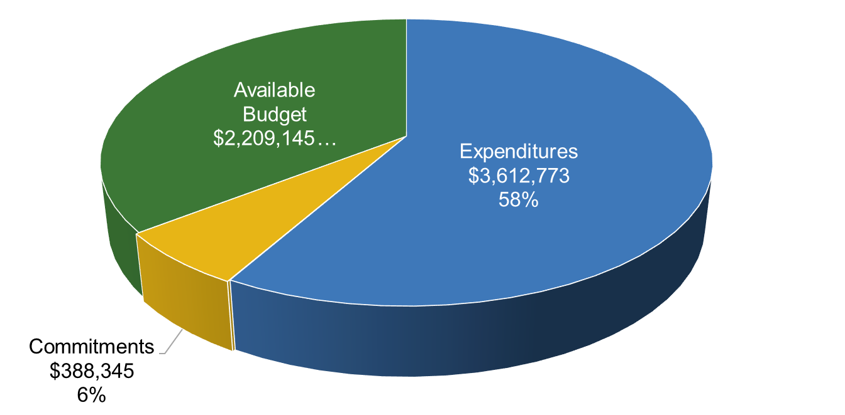
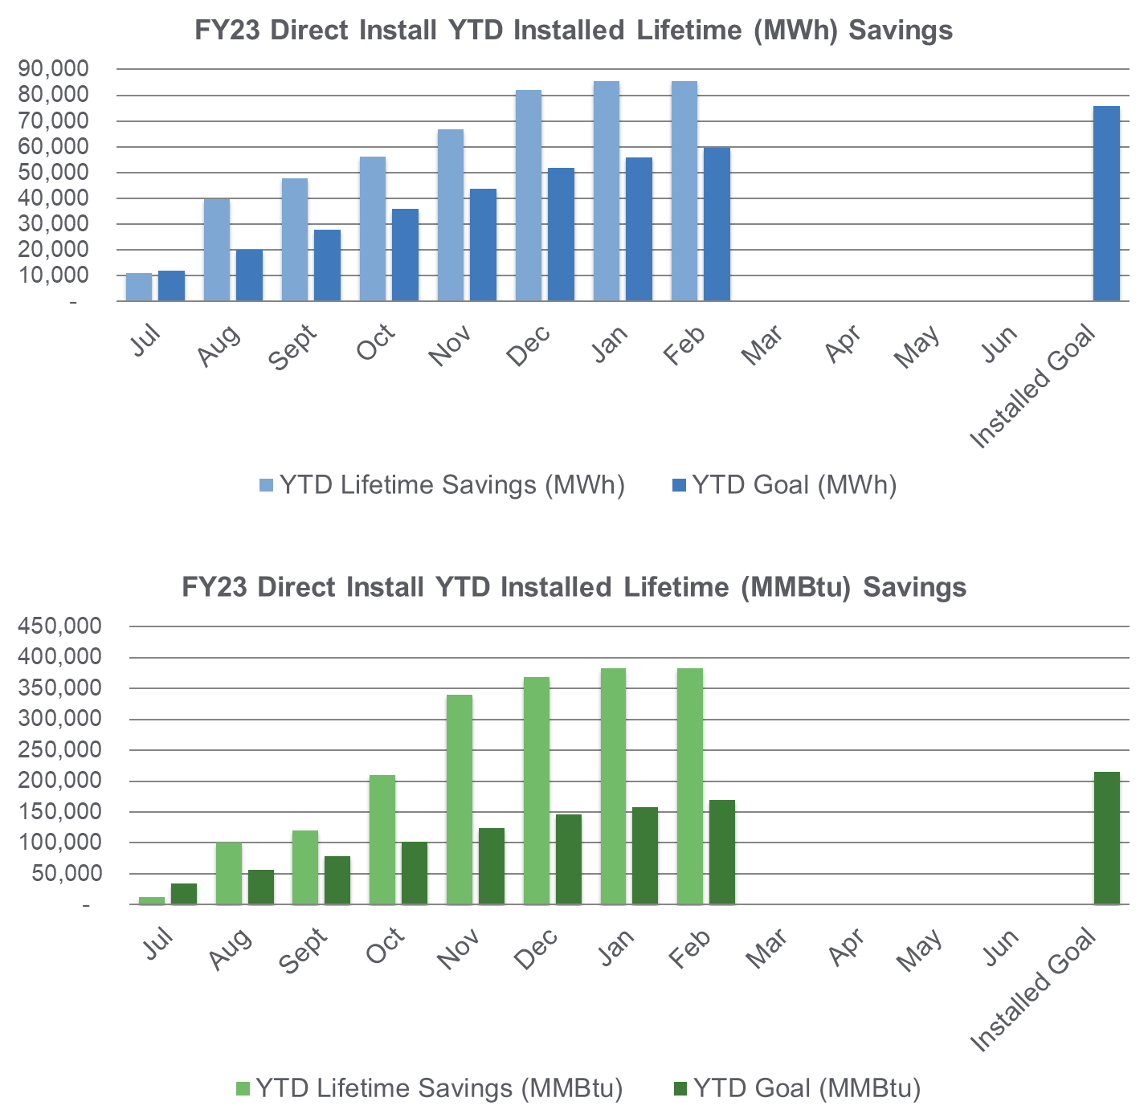
Direct Install (Close-out Program: transitioning to Utilities)
FY23 Incentive Budget: $6,210,263
Program Highlights
Received: 0 enrollments this month 0 YTD
Approved: 0 applications this month 0 YTD
Paid: 0 applications this month 80 YTD

Slide 20
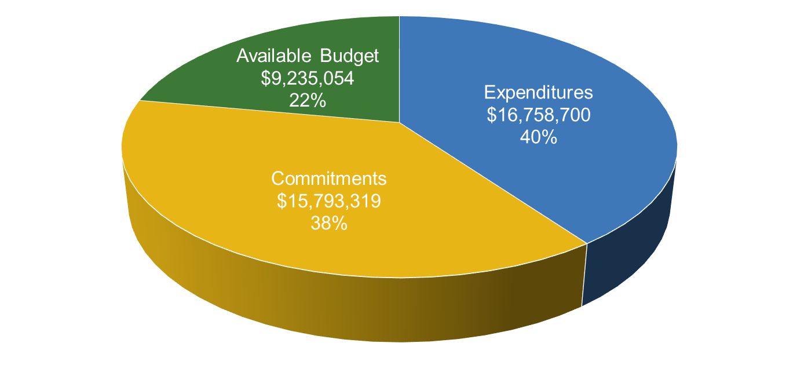
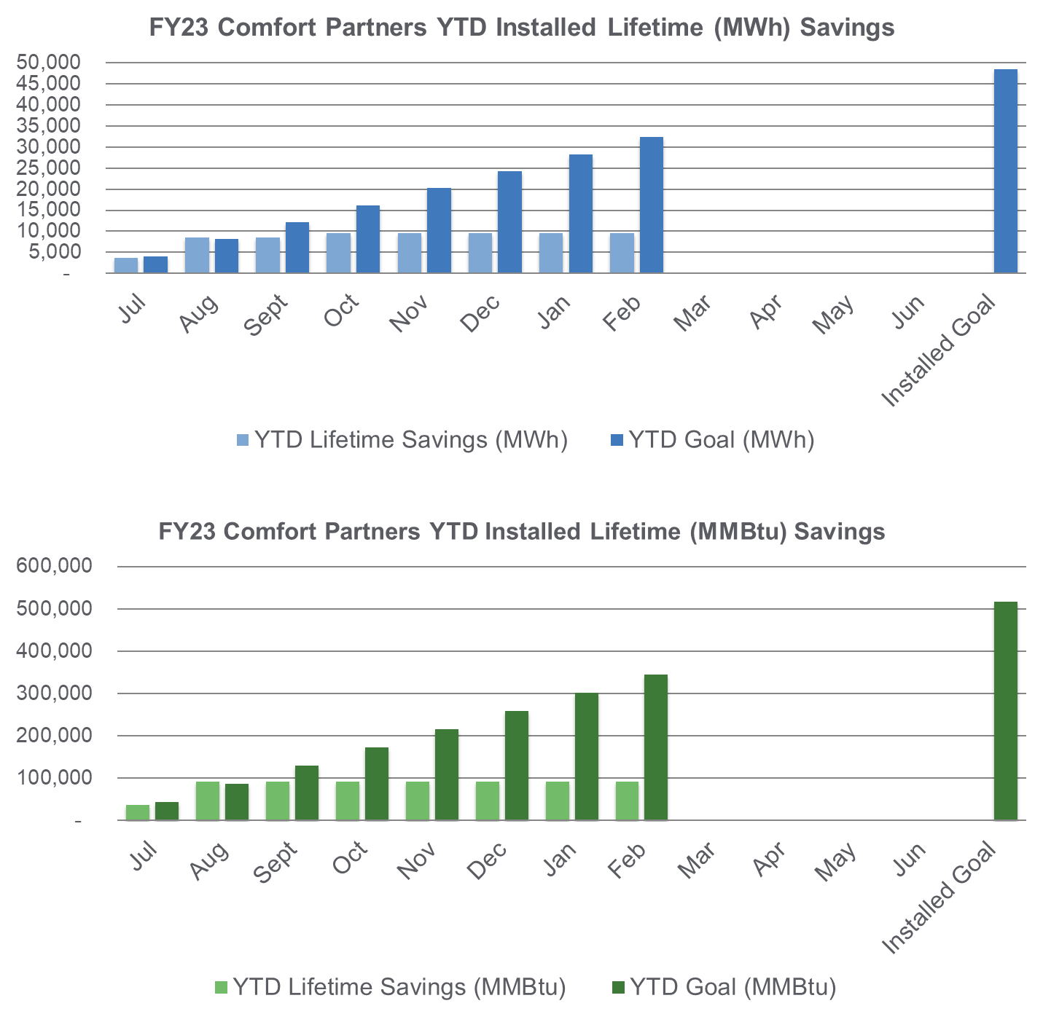
Comfort Partners
BPU/Utility Managed
FY23 Incentive Budget: $41,787,072
Program Highlights
Completed: | 340 projects this month | 2,480 YTD
20
20

Slide 21
Utility Updates
NJ Energy Efficiency Stakeholder Meeting
March 16, 2023
Notes:
Anne-Marie

Slide 22
Reminders
Reach out to utilities where you may be interested in doing business.
  Explore the information they have posted and reach out if you have questions.
  Sign up for any contractor updates if that is available.
  Build your understanding of utility specific elements (e.g. financing options, online forms)
  Some programs have specific contractor requirements and may require a Participating Contractor Agreement
Contact info for all utilities is available on the NJCEP Transition page
Utilities appreciate your patience during this transition
Committed to updating FAQs and materials to provide clarity to customers and contractors

Slide 23
Program Updates
Recurring joint utility calls to provide program updates and secure feedback
  Home Performance with ENERGY STAR contractors –
    Normally meetings are held every other month
    Held a special meeting earlier today – March 16th
  HVAC contractor meeting
    Look for an announcement for an April meeting
  PSE&G Trade Ally Networking Event
    April 13th – 8am, Edison – Save the Date
    Home Performance with ENERGY STAR contractors & HVAC contractors
  Reach out to your utility if you are interested in attending future meetings
  Contractors do not need to wait for meetings if they have questions
  Utilities responded to the DOE RFI on the Inflation Reduction Act programs

Slide 24
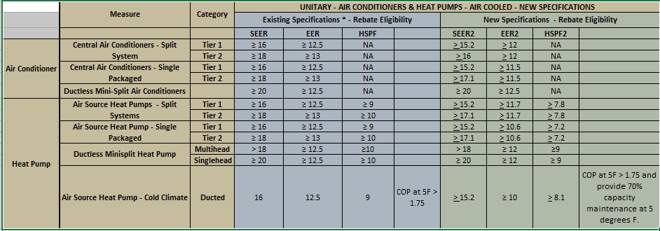
Program Updates
After considering additional trade ally feedback, utilities are making minor changes to the implementation of the DOE Cooling Standard. This new chart will be effective on April 1, 2023.

Slide 25
DOE news on HPwE Program
On February 22, 2023, the US DOE notified all HPwES sponsors that they plan to sunset the HPwES program
Rationale is tied to belief that new programs under both the Bipartisan Infrastructure Action and the Inflation Reduction Act will be transformative in nature so HPwES will no longer be necessary
NJ Utilities had no advance knowledge or input on this decision
Utilities have the opportunity to provide feedback on their proposed timeline for transition.
  Met with the HPwES contractors earlier today to gather input from participating contractors
There is no immediate change to the
existing HPwES program

Slide 26
Questions?
RECO Presentation to follow
April EE Stakeholder Meeting will include a presentation from PSE&G on their programs

Slide 27
Rockland Electric Company
Clean Heat Program – Program Overview
March 16, 2023

Slide 28
Agenda
  What will we cover today?
  Clean Heat Program
  Program Overview
  Becoming a Participating Contractor
  Program Incentives
  Required Document Checklist
  Program Tools
  Next Steps
Notes:
Note: This slide deck contains information current for Q4 2022. ​
The presentation will be updated as changes happen. ​
Please refer to most current information for your accuracy.​

Slide 29
Program Overview
On February 1, 2022, Rockland Electric Company Launched NJ’s only program dedicated to cold climate ccASHP and GSHP rebates.
Customer Eligibility:
  Residential and C&I Rockland Electric Company Customers
  Retrofit Projects Only
  Equipment Eligibility:
  NEEP Certified Equipment only
Program Tools available:
  Program Manual
  Clean Heat Bulk Upload Template
  Sightline Online Intake Tool
  Clean Heat Prescriptive Calculator
  ASHRAE design temperature counties for New Jersey
Program Overview

Slide 30
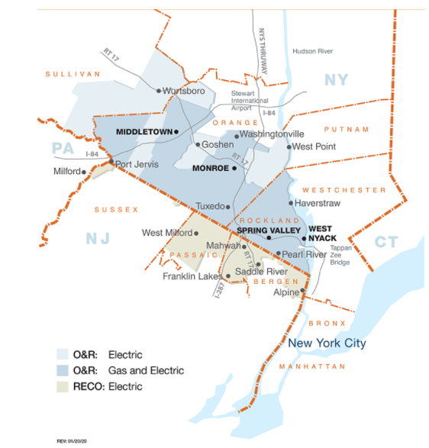
Service Territory
County | Township | Communities
Bergen | Mahwah, Wyckoff (Part) | Alendale, Alpine, Closter; Cresskill, Demarest, Franklin Lakes, Harrington Park, Haworth (Part), Montvale, Northvale, Norwood, Oakland, Old Tappan (Part), Ramsey, River Vale (Part), Rockleigh, Saddle River (Part), Upper Saddle River
Passaic | West Milford (Part) | Ringwood (Part)
Sussex | Montague (Part), Vernon (Part), Wantage (Part)

Slide 31
Account Eligibility
When submitting a Rockland Electric Company Clean Heat application, you will be required to provide an active Rockland Electric Company Electric account number.
Related to the owner of the Rockland Electric Company account, the invoice MUST show the name and exact address of where the service was provided.
If a landlord requests the service, then the names of both landlord and account holder must be on the customer invoice.
The account holder of the Rockland Electric Company Account must also be the one who signs the Customer Acknowledgement form.

Slide 32
Becoming a Participating Contractor

Slide 33
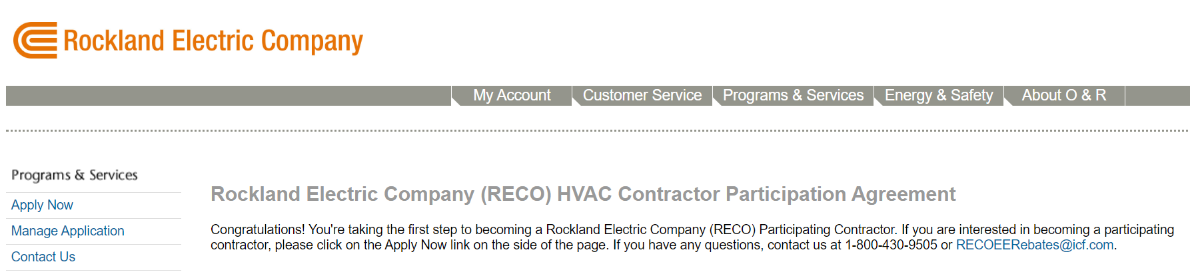
RECO-Contractors.ProgramProcessing.com/
  Apply here to become a participating contractor
Begin your contractor enrollment here

Slide 34
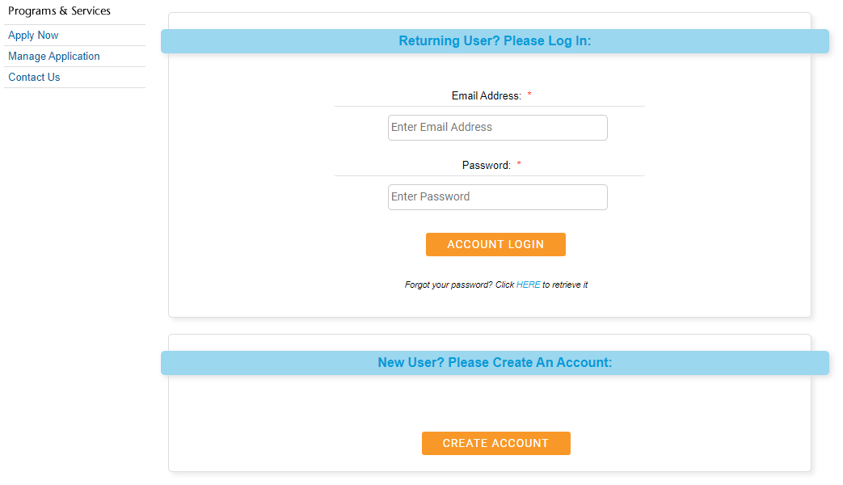
Contractor CPA Portal
Already registered in Rockland Electric Clean Heat? Contractor credentials do not work on this OIT? Please create a new login.
New users create a new account. For Utility Account number, you may leave it blank.
Any problems? Please send your account manager an email.

Slide 35
Contractor Supporting Documentation
RECO-Contractors.programprocessing.com
You will need copies of these items on hand:
1) Your business’s New Jersey Division of Revenue Business Registration Certificate
2) W-9 or at least tax ID number.
3) Your business’s New Jersey Business License
4) Your business’s Certificate of Insurance made to (“named insured”):
Orange and Rockland Utilities
390 W. Rt 59
Spring Valley, NY 10977

Slide 36
Contractor Supporting Documentation – con’t.
RECO-Contractors.programprocessing.com
Rockland Electric Compnay Clean Heat Contractor Application (completed online at https://RECO-contractors.programprocessing.com/)
Clean Heat Contractor Participation Agreement (Found on the Apply Now page)
U.S. Environmental Protection Agency Section 608 Technician Certificate
ASHP Manufacturer-sponsored Installation Training Certificate (or comparable proof of training)
Ground Source Heat Pump Contractors: Installer Credentials, Full Load
International Ground-Source Heat Pump Association (IGSHPA) Accredited Installer Certificate or Active Certified GeoExchange Designer (CGD) Certificated from the Association of Energy Engineers.

Slide 37
Becoming a Participating Contractor –
Enrollment Requirements
Ground Source Heat Pump Contractors: Installer Credentials, Custom GSHP Systems
The applicant must include one of the following:
  Active Certificate GeoExchange Designer (CGD) Certificate from the Association of Energy Engineers
  An Active NJ Professional Engineering license
  An Active NJ Registered Architect license
Driller Credentials:
Active registration and certification for open-loop geothermal well drilling by the Department of Environmental Conservation.
National Ground Water Association Certified Vertical Closed-Loop Driller (CVCLD) Certificate

Slide 38
Incentive Structure

Slide 39
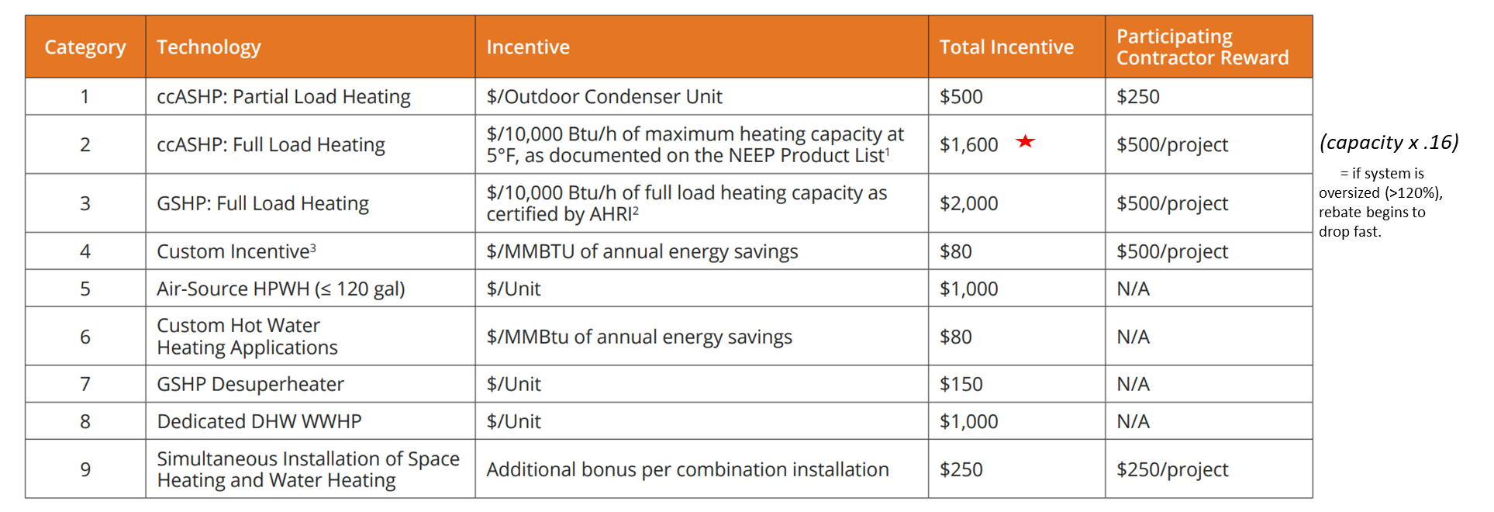
School of Clean Heat
  Rockland Electric Current Incentives

Slide 40
Required Project Documentation Checklist

Slide 41
Required Document Checklist
Participation Acknowledgement Form
System Total Heating Capacity Documents (NEEP Sheets for ASHP; AHRI Sheets for GSHP)
Invoice or Contract Between Contractor and Rockland Electric Company Account Holder
Load Calculations for building heating load (BHL) and building cooling load (BCL) - Manual J or Another Code Approved Methodology (Full Reports even for partial load)
Rockland Electric Company Clean Heat Prescriptive Incentive Calculator
Premise Account Information
System Installation Photos - Longshot photos of Condenser
Entire Nameplate Photos

Slide 42
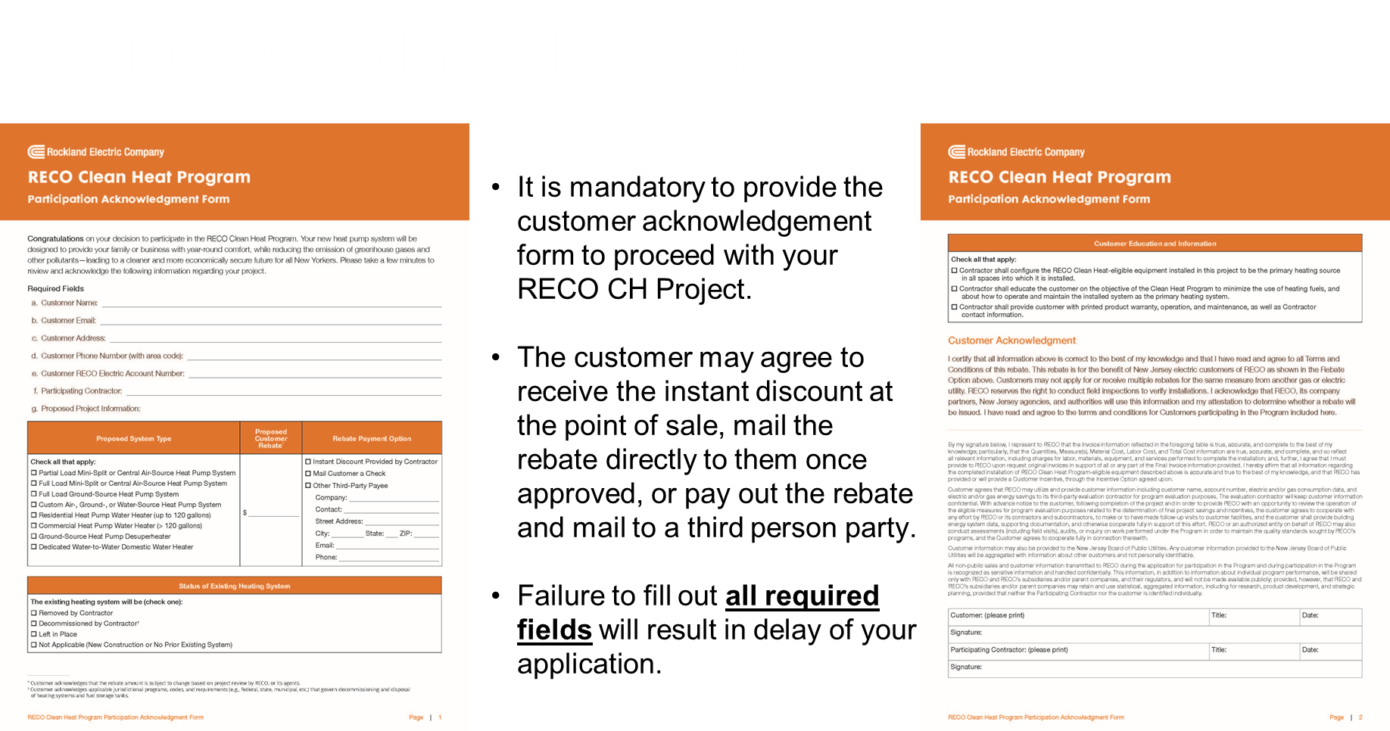

Slide 43
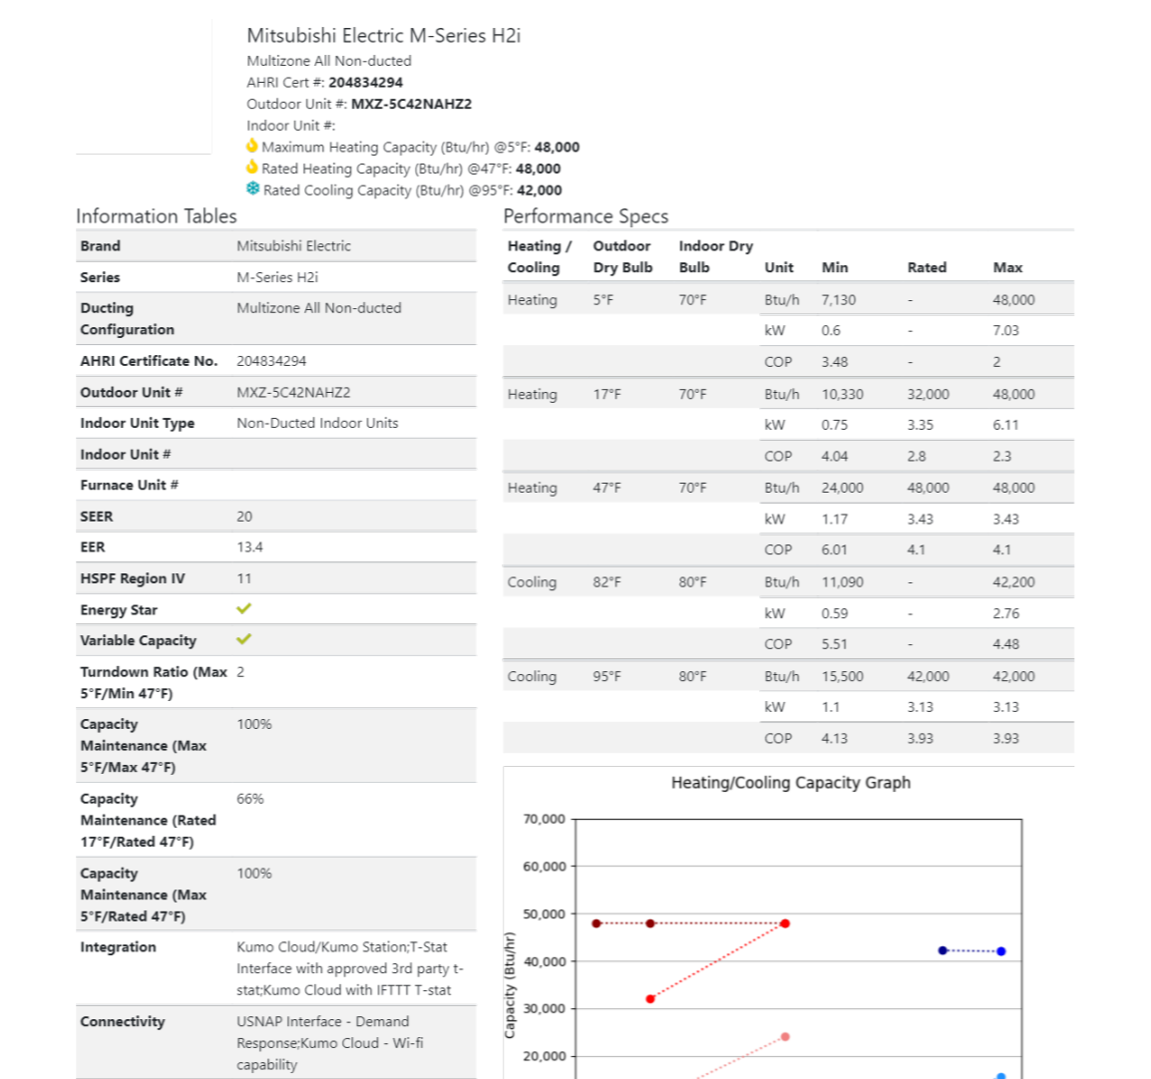

NEEP Certification
Required Docs – NEEP Certificate
  Listing at ASHP (neep.org). https://ashp.neep.org/#!/
  NEEP details should match your install.
  The 5-degree Max Heating Capacity determines the full load incentive amount.
  (e.g., 48,000*.16 = $7,680 total rebate)
  NEEP data is an acceptable way to determine how a heat pump performs at a certain design temperature using the prescriptive calculator.
  Shows Minimum Cooling Capacity at 95
  Save your projects’ NEEP certificate to upload to the OIT.

Slide 44
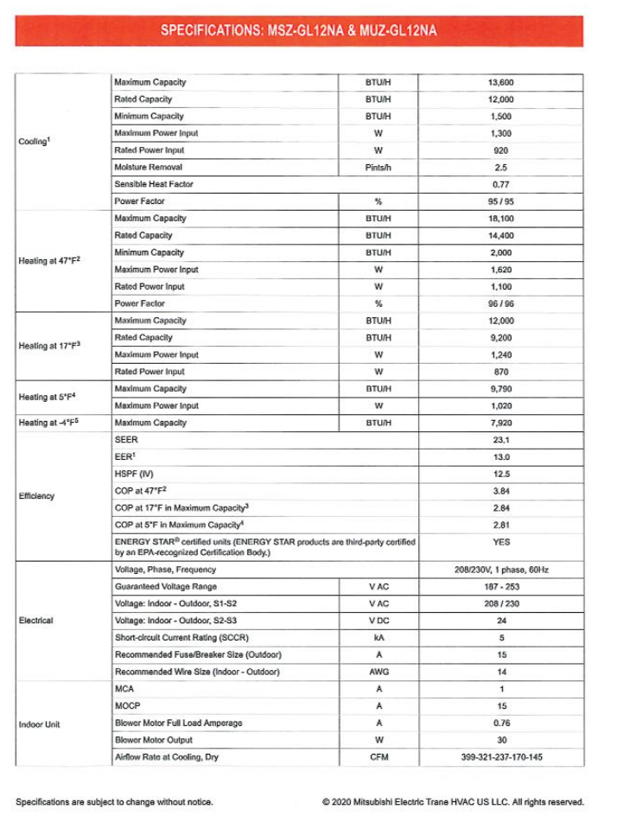
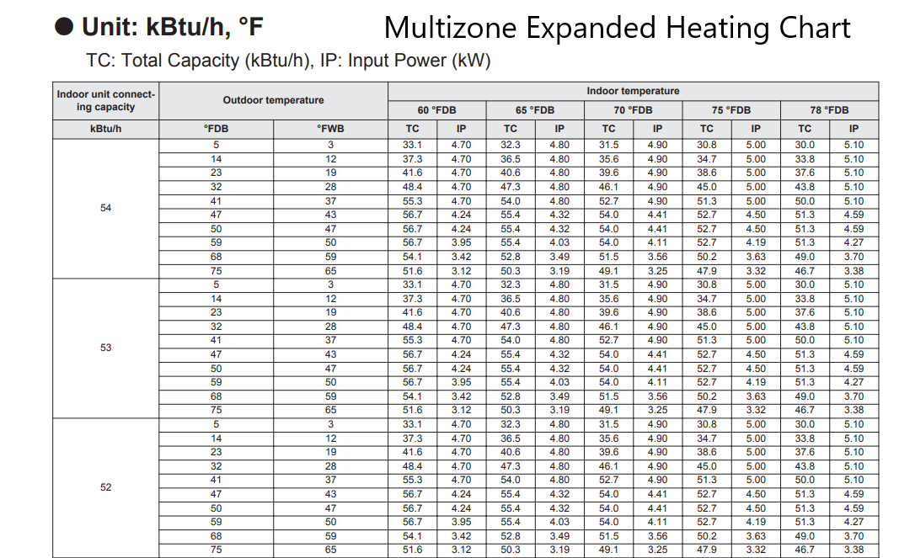
Manufacturer Heating Charts
  Expanded Manufacturer Heating Charts (if needed)

Slide 45
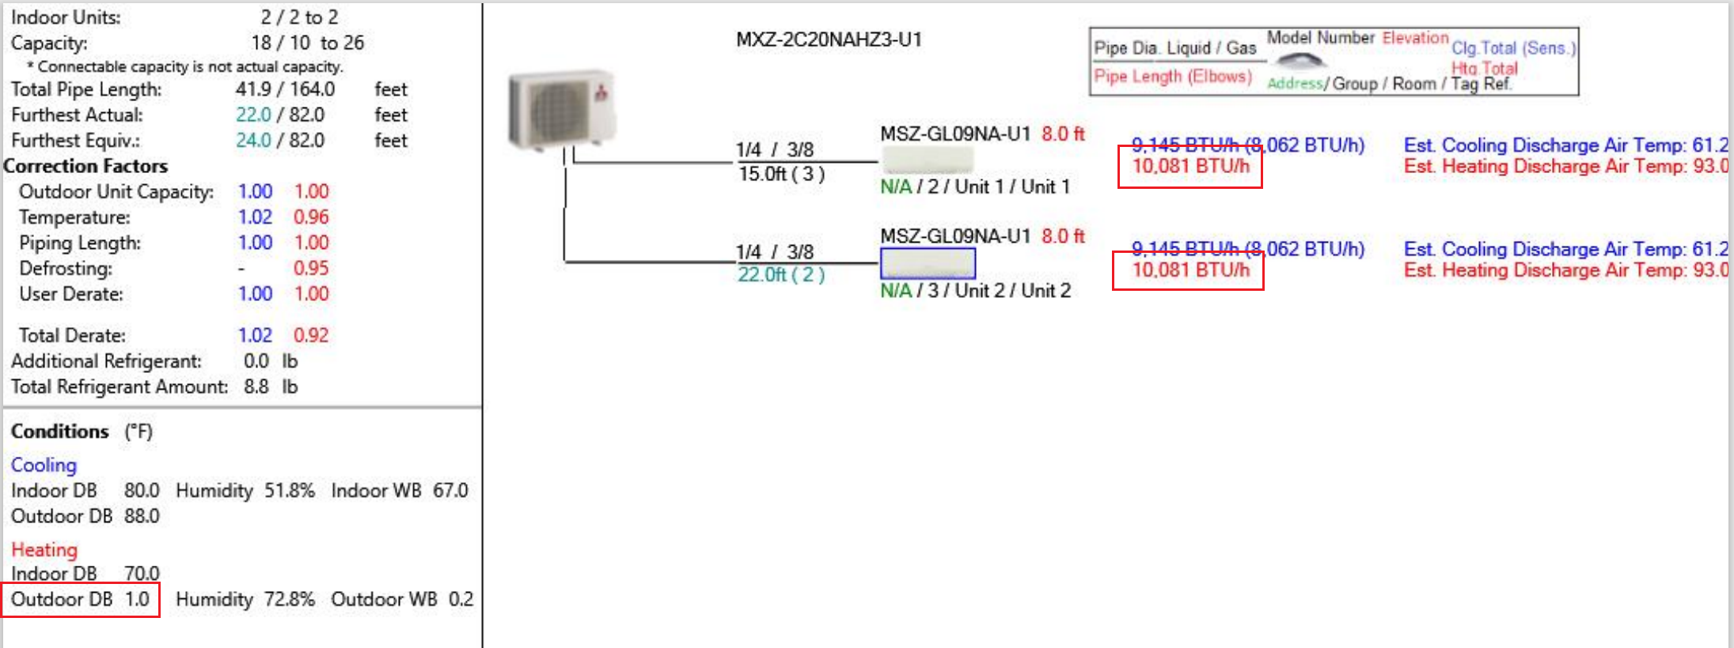
System Capacity
  System Capacity Diagram if Available
  A system capacity diagram lists condenser output at design temperature.
  Make sure to use the SAME temps as your Manual J Design Temps.
  A NEEP Certificate is still required for Cooling Minimum capacity.
75.0
91.0
8.0

Slide 46
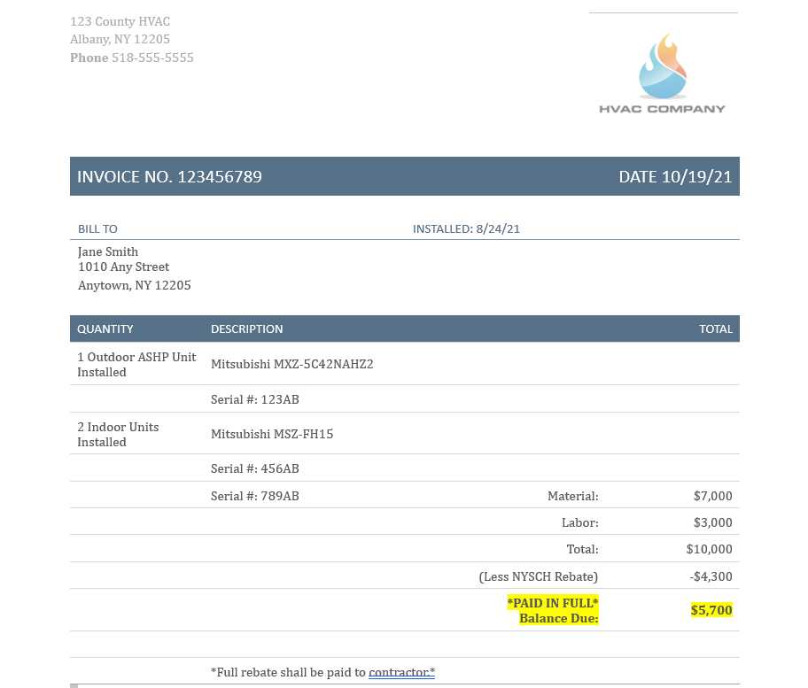
Customer Invoice
  Customer Invoice
Sample Invoice
Does address match the premise and customer acknowledgement form? If it’s different, is this explainable and clear?
Is there an install date mentioned? (If not, we may assume the invoice date is the install date).
00
Are the outdoor models/serials mentioned?
Is there a clear grand total for the heat pump install?
Was the rebate shown as taken off the invoice or not?
Is the install paid in full?
Any notes we need to compare to Customer Acknowledgement Form to make sure it is correct?
(e.g., payee info/address)
New Jersey Division of Revenue Business Registration Certificate

Slide 47
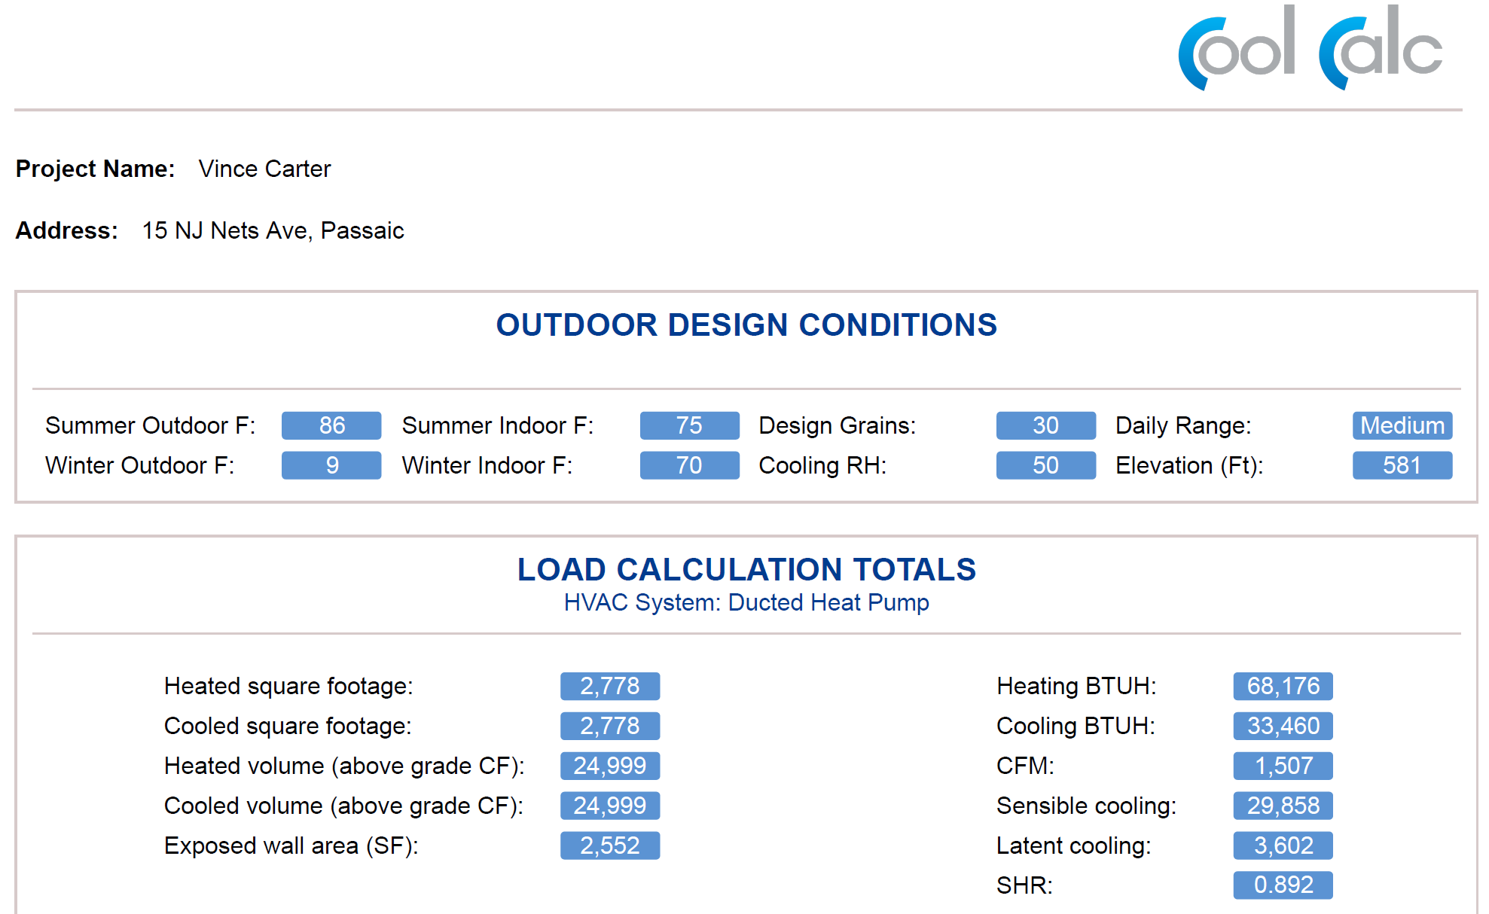
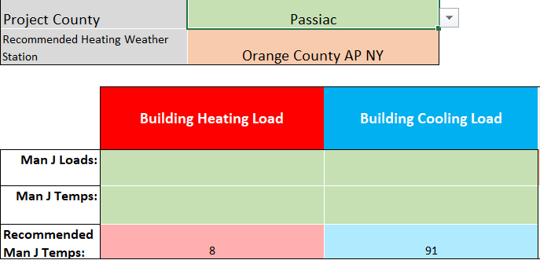
Manual J Documentation
  Required Docs - Manual J
  Design Temps +/- 5 degrees of the suggested temp based on the county your project is in. (Use the Rockland Electric Company Calculator to verify this temperature.)
  Load calculations should cover the entire structure – even for partial load projects.
  Please submit the full Manual J report and not just the summary page.

Slide 48
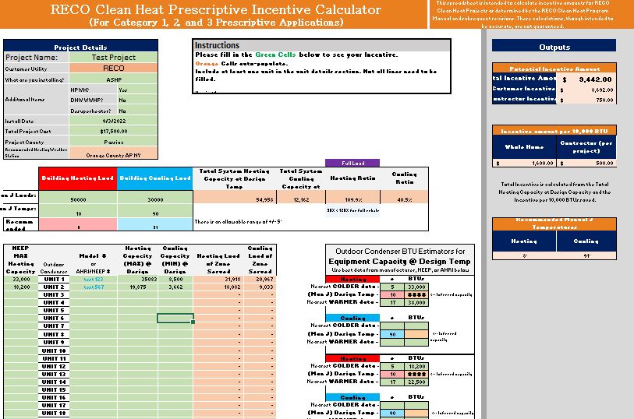
Filling Out the Calculator
  When you have your data, fill out the calculator.

Slide 49
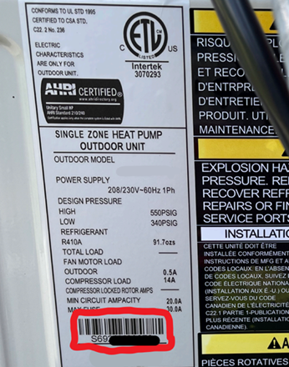
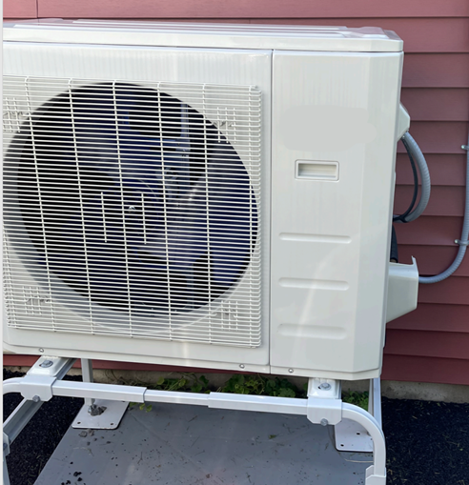
Photo Documentation
  Installation Photos – Minimum 2 photos per condenser (including HPWHs)
  1) Nameplate photo that clearly shows model & serial numbers for all heat pumps (or heat pump water heater). Include QR or bar code.
  2) “Longshot” photo of the installed heat pump (or HPWH) from several steps back, showing the unit is installed well, location, lines insulated, snow protective cover if needed, etc.
  If you think you should include a few other pictures to explain a unique situation, do so.
  No interior unit pics are necessary.
  Make sure your crew gets the necessary, clear pics. Without these photos, a project is unable to be submitted to the OIT!

Slide 50
Clean Heat Program Tools

Slide 51
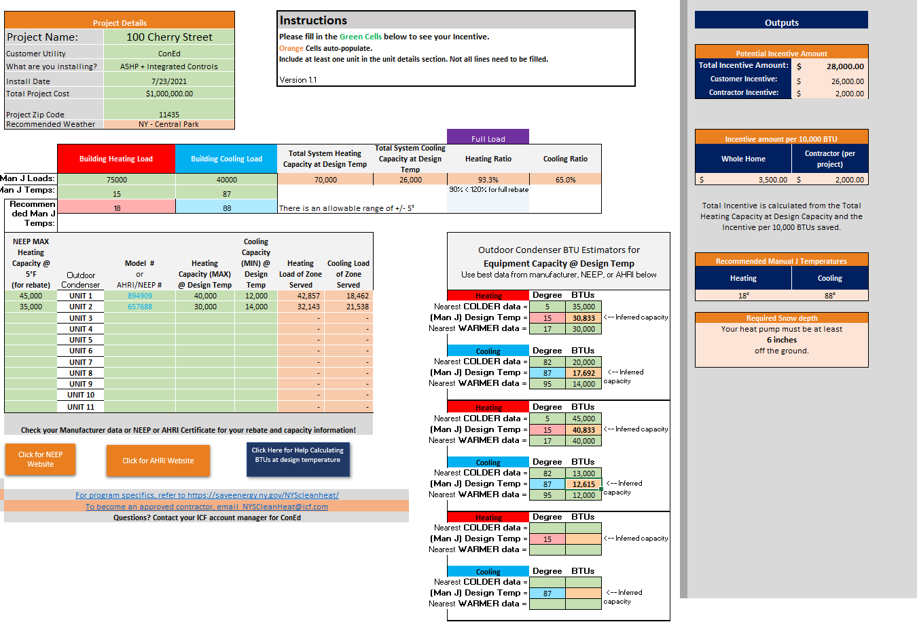
Prescriptive Incentive Calculator
In preparation for Online Intake Tool submission, we are creating an all-in-one spreadsheet to determine if:
  A project qualifies
  Incentive amounts
  Accurate BTU estimations for temperatures outside of NEEP set points
  Heating Loads of Zones Served
  Cooling Loads of Zones served
  Total System Heating capacity
  Total System Cooling Capacity
Refer to your Manual J & NEEP documents to fill out the green cells.
NOTE: Program Guidelines state you may go over the 120% threshold BHL Ratio. If you do, please be advised the following equation would be used to calculate the rebate amount:
  ((5 Degree Max Capacity/10,000)*(Category Incentive))*(1.2/(Total System Capacity of BHL at Design Temp / Building Heating Load))
Please use the following link to download: Rockland Electric Company Clean Heat Prescriptive Incentive Calculator

Slide 52
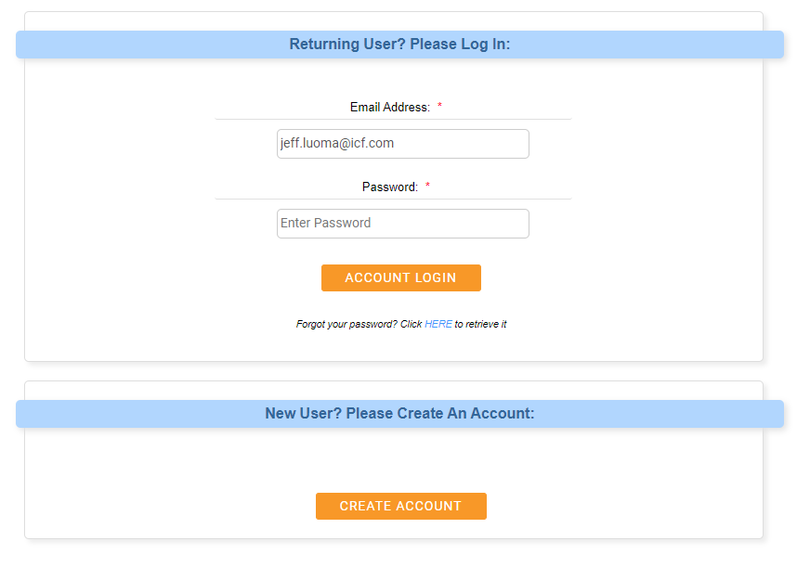
Online Intake Tool (OIT)
  Online Intake Tool – Submit your project
Rockland Electric (programprocessing.com)
RECO-nych.programprocessing.com
Create a login if you hadn’t yet.
If you have issues logging in, contact your account managers.

Slide 53
Next Steps

Slide 54
Next Steps
  The following items will be sent via email after this call:
    Webinar deck from today’s presentation
    Clean Heat Program Manual
    Link to Contractor Application and Contractor Agreement
  Start promoting the program to your customer base!

Slide 55
Rockland Electric Company Q & A
  Q & A

Slide 56

Rockland Electric Company Program Team - ICF
Program Managers- Rockland Electric Company Clean Heat Program
  Kenneth Latal - Kenneth.Latal@icf.com
Account Managers
  Jeff Luoma – Jeff.Luoma@icf.com
  Joseph Morgan – Joseph.Morgan@icf.com

Slide 57
  Thank You !

Slide 58
FY23 True-up Budget
Notes:
Sherri

Slide 59
FY23 True-up Budget
Request for Comments issued February 17, 2023
Informational Session was held March 3, 2023
Comments were due March 10, 2023
Next Steps
BPU consideration
Notes:
Sherri

Slide 60
New Construction Program /
Garden State Challenge Pilot Update
Notes:
Sherri

Slide 61
New Construction Program/Garden State Challenge Pilot Update
Next Steps
Finalize program design with Board Staff
Release for public comment as Compliance Filing update
Notes:
Sherri

Slide 62
Triennium 2 Timeline
Notes:
Rupa

Slide 63
Planned Triennium 2 Timeline
# | Task | Date
 | Main Straw Proposal (Programs, Workforce, Flexibility, EE Resource, Reporting, etc.)
1 | Notice of Stakeholder Meetings | 3/31/2023
2 | Release Straw Proposal for Public Comment | 3/31/2023
3 | Virtual Stakeholder Meeting (1-2:30) | 4/6/2023
4 | Preliminary Comment Deadline (2 weeks) | 4/14/2023
 | EM&V Straw Proposal (NJCT, TRM, EM&V Framework)
5 | Release Straw Proposal for Public Comment | 4/6/2023
6 | Virtual Stakeholder Meeting (1-2:30) | 4/11/2023
7 | Preliminary Comment Deadline (2 weeks) | 4/21/2023
 | Goals & Targets Straw Proposal (Goals, QPI/PIM, Energy Savings Carryover)
8 | Release Straw Proposal for Public Comment | 4/14/2023
9 | Virtual Stakeholder Meeting (1-2:30) | 4/25/2023
10 | Final Comments (All Straw Proposals) Deadline (2 weeks) | 4/28/2023
Notes:
Rupa

Slide 64
General Q&A
To submit questions in advance for next month: EnergyEfficiency@bpu.nj.gov
Notes:
Stacy

Slide 65
Items of Interest
Notes:
Stacy
Opportunity to share EE updates (no business promotions) (ask stakeholders to raise hands)

Slide 66
Next Meetings
Notes:
Stacy

Slide 67
Energy Efficiency Stakeholder Meetings
NJCleanEnergy.com/StakeholderGroups/Energy-Efficiency
3rd Thursday of the Month, 1-2:30pm
April 20, 2023
May 18, 2023
June 15, 2023
July 20, 2023
August 17, 2023
September 21, 2023
October 19, 2023
(no November meeting)
December 21, 2023
Notes:
Stacy

Slide 68

More Information
Visit
NJCleanEnergy.com
NJCleanEnergy.com/StakeholderGroups/Energy-Efficiency
CONTACT
EnergyEfficiency@bpu.nj.gov
866.NJ.SMART (657.6278)
EE Listserv
NJCleanEnergy.com/LISTSERVS
@NJCleanEnergy
Notes:
Stacy

