Slide 1

New Jersey
Clean Energy Learning Center
http://njcelc.com
Deane Evans, Executive Director
The Center for Building Knowledge at NJIT

Slide 2
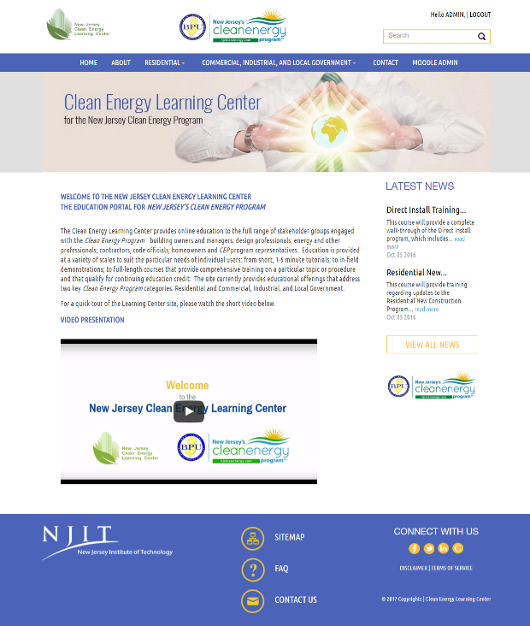
Homepage

Slide 3
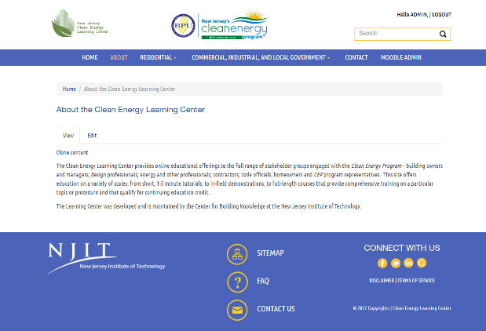
About
The Clean Energy Learning Center provides online educational offerings…

Slide 4
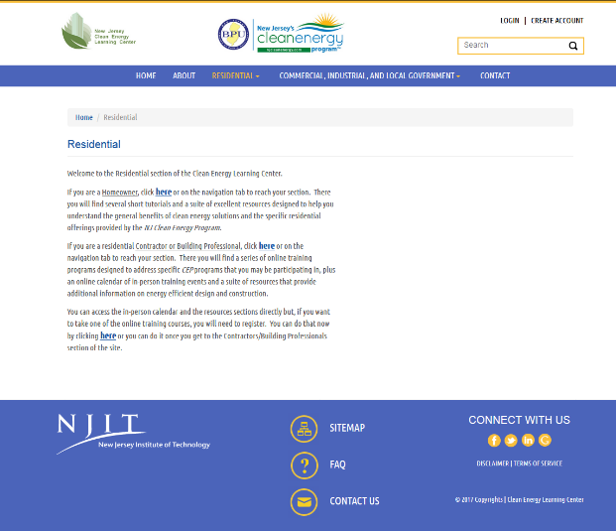
Residential
Landing Page
Education and Online Resources for Homeowners

Slide 5
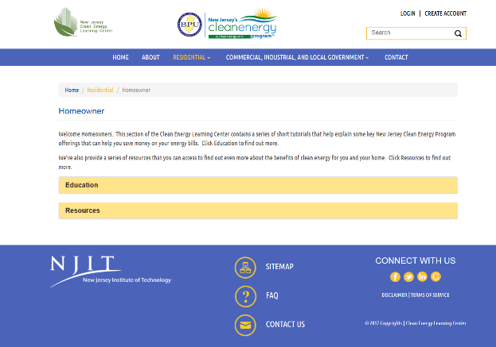
Residential
Homeowner

Slide 6
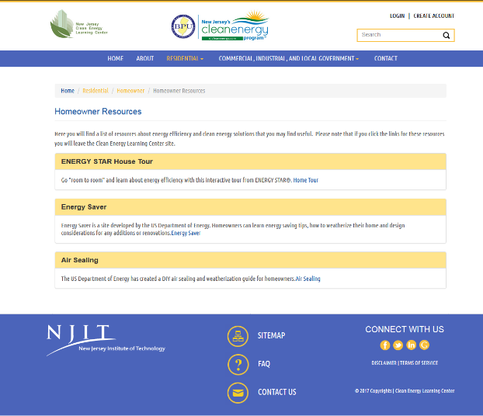
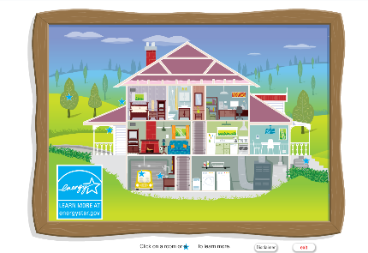
Residential
Homeowner - Resources

Slide 7
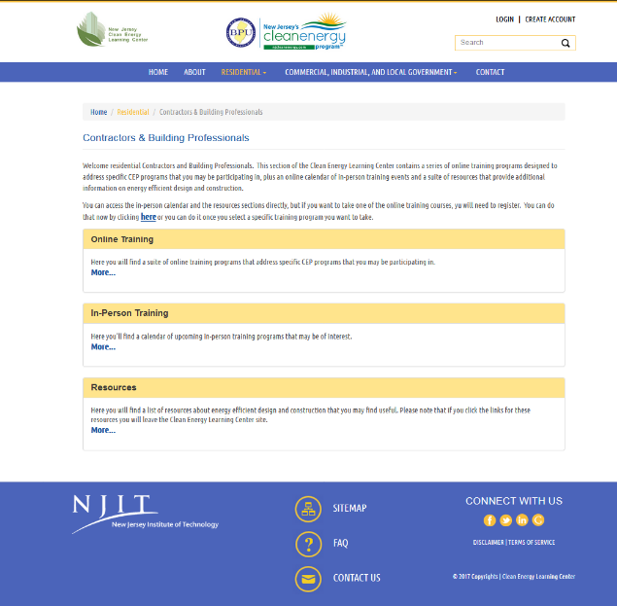
Residential
Contractors & Bldg. Professionals

Slide 8
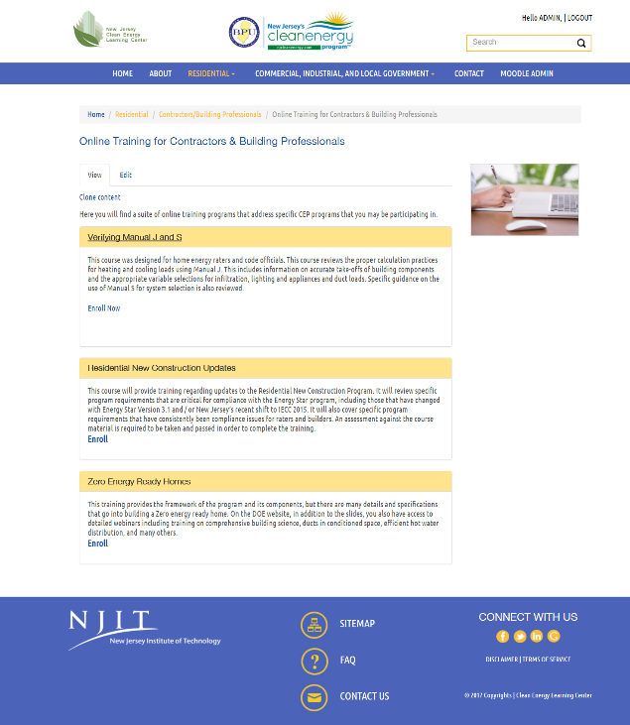
Residential
Contractors & Bldg. Professionals - Online Training

Slide 9
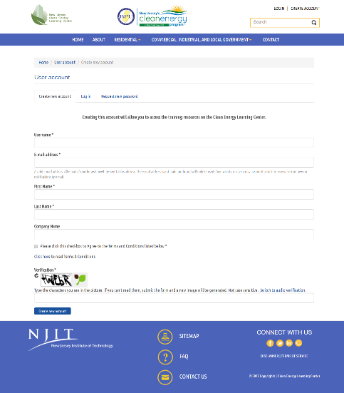
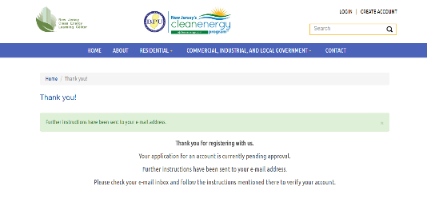
Registration
Step 1
Step 2

Slide 10
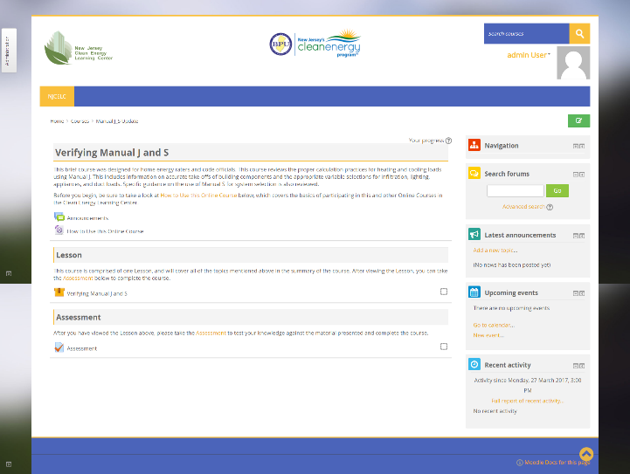
Online Course
Course Landing Page
Use the Landing Page to access all of the activities within a Course, including video tutorials, lessons, and assessments

Slide 11
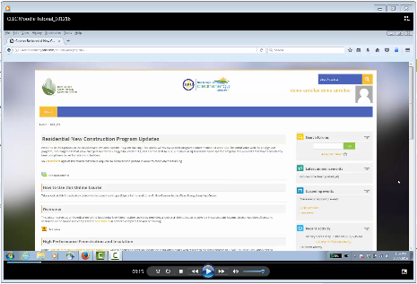
Online Course
Course Landing Page and ‘How To’ Video

Slide 12
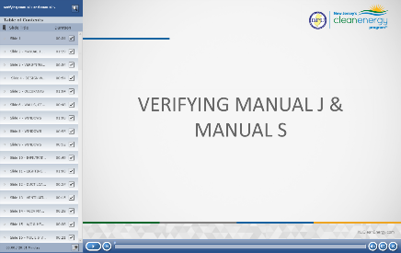
Online Course
Course Landing Page and Video Player

Slide 13
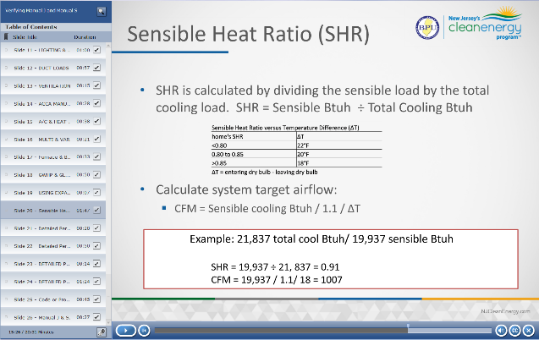
Online Course
Course Video Player and Content

Slide 14
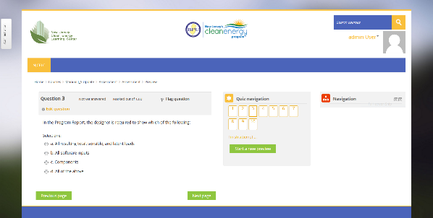
Online Course
Course Landing Page and Assessment

Slide 15
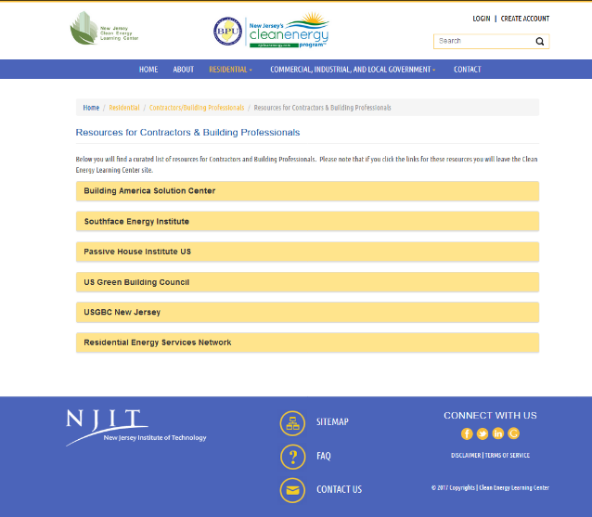
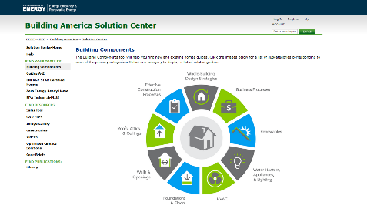
Residential
Contractors & Bldg. Professionals - Resources

Slide 16
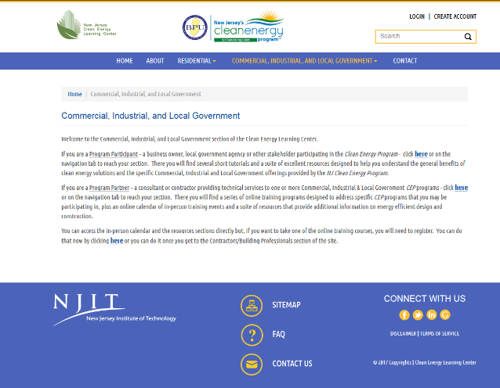
C&I, Local Govt.
Landing Page
Education and Online Resources for Program Participants

Slide 17
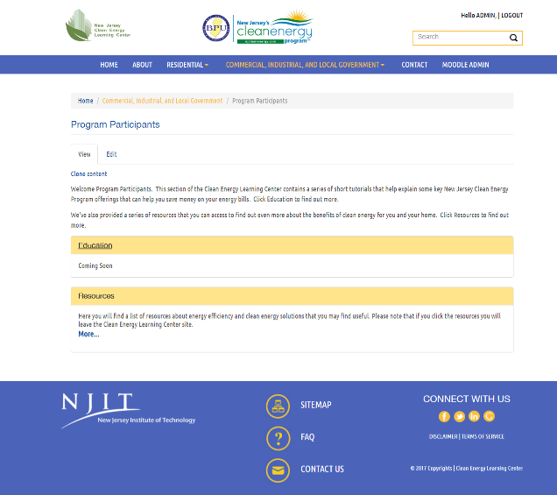
C&I, Local Govt.
Program Participants
Education and Online Resources for Program Participants

Slide 18
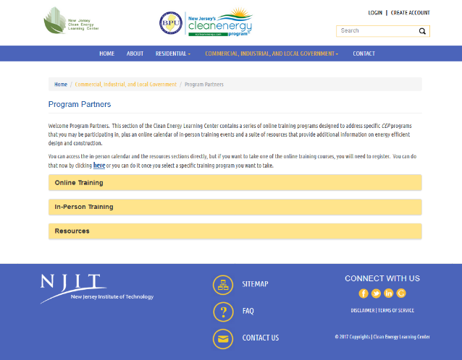
C&I, Local Govt.
Program Partners

Slide 19
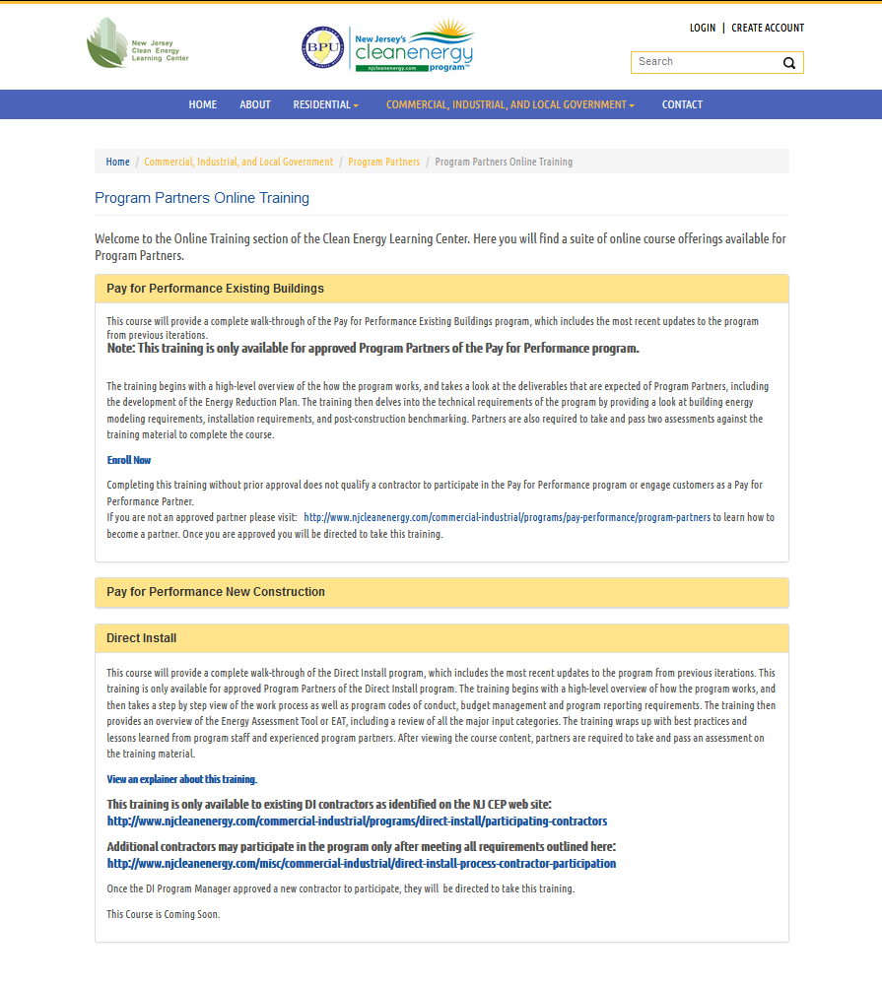
C&I / Local Govt.
Program Partners - Online Training

Slide 20
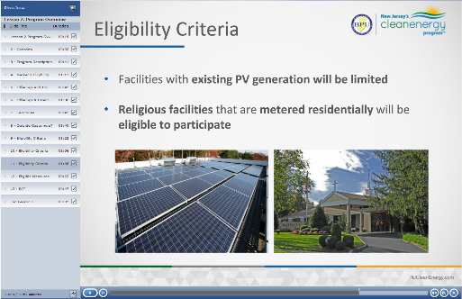
C&I / Local Govt.
Program Partners - Online Training

Slide 21
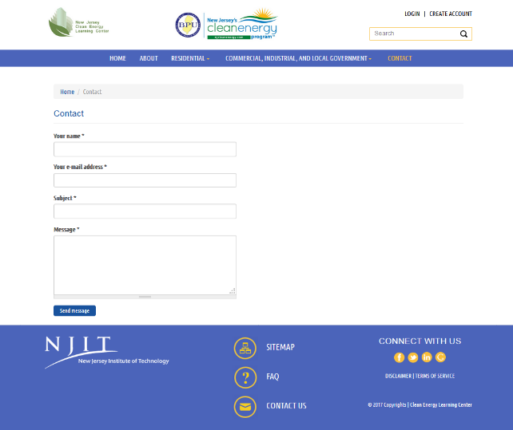
Contact Form

Slide 22
For More Information:
Visit: http://njcelc.com/
Email: info@njcelc.com
Thank You!

