Slide 1
FY17 Results through
May 31
EE Committee Meeting
June 13, 2017

Slide 2
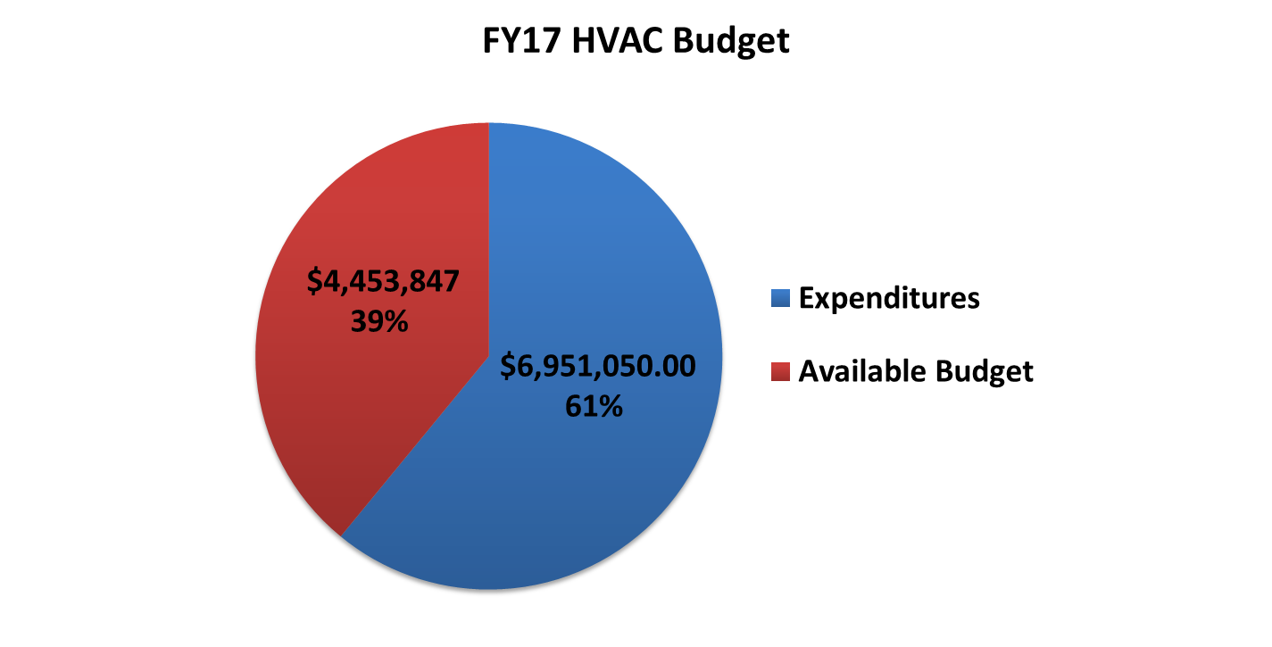
HVAC Program

Slide 3
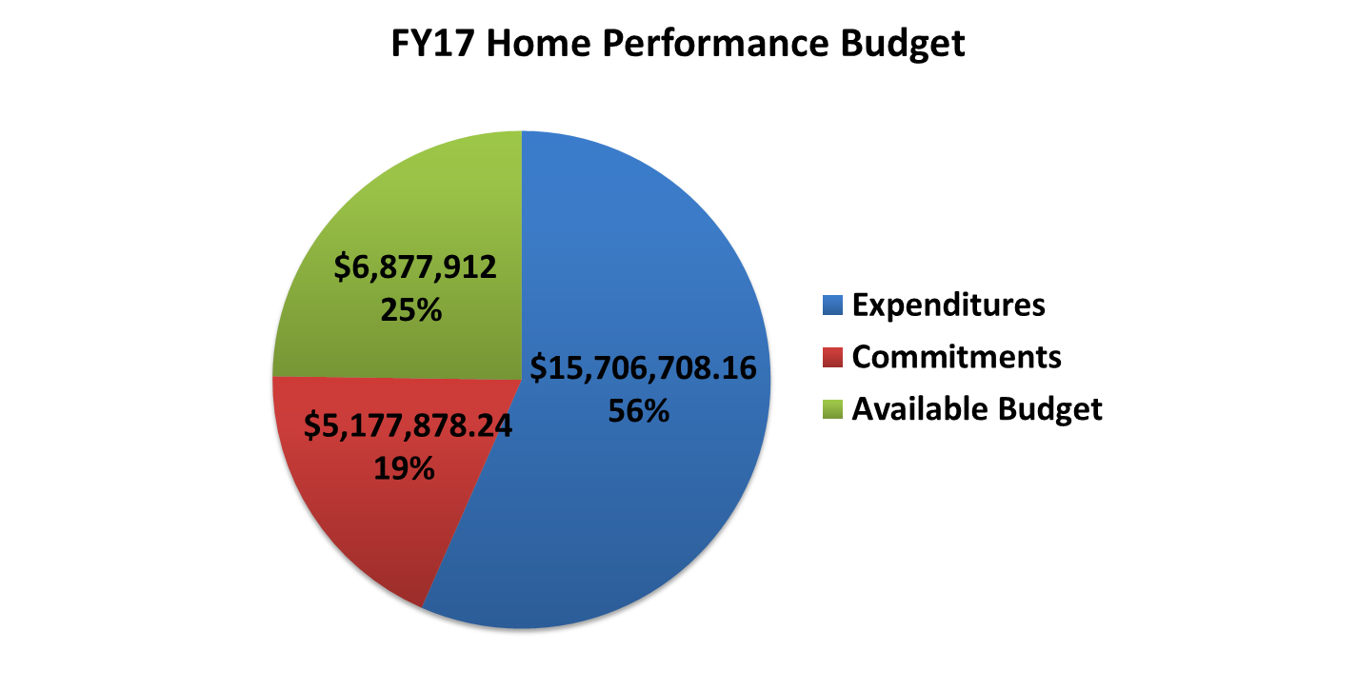
Home Performance Program

Slide 4
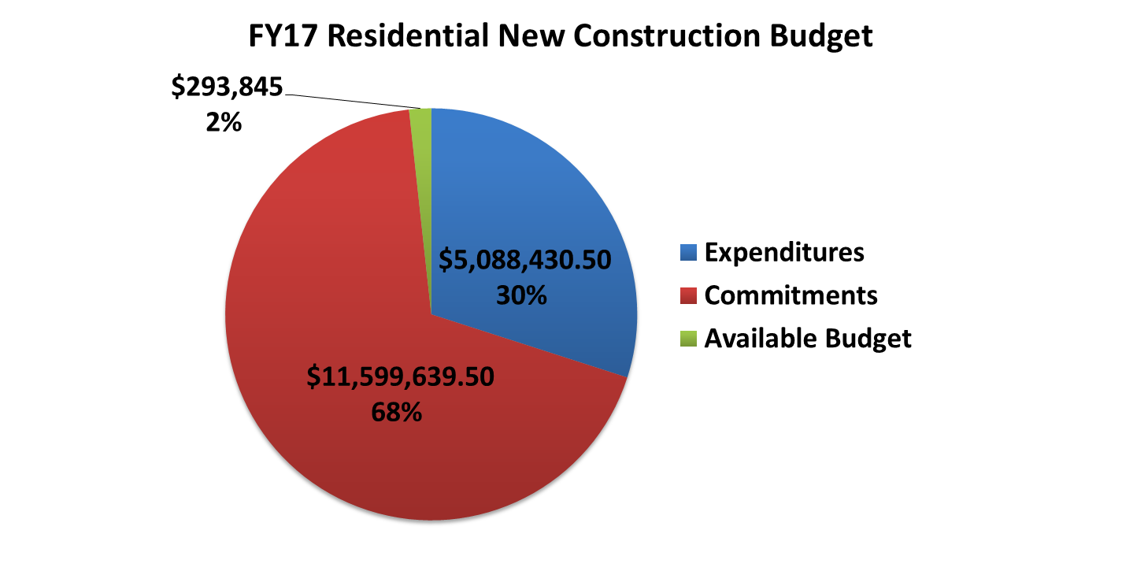
Residential New Construction

Slide 5
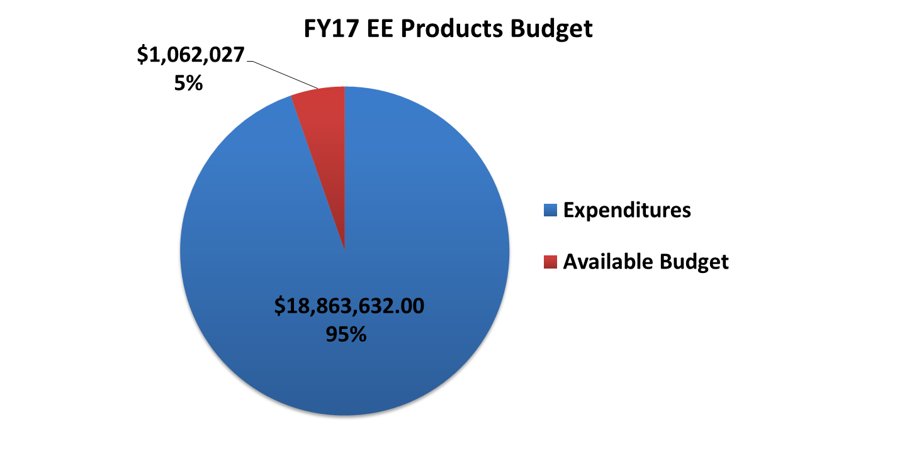
EE Products - Retail Lighting

Slide 6
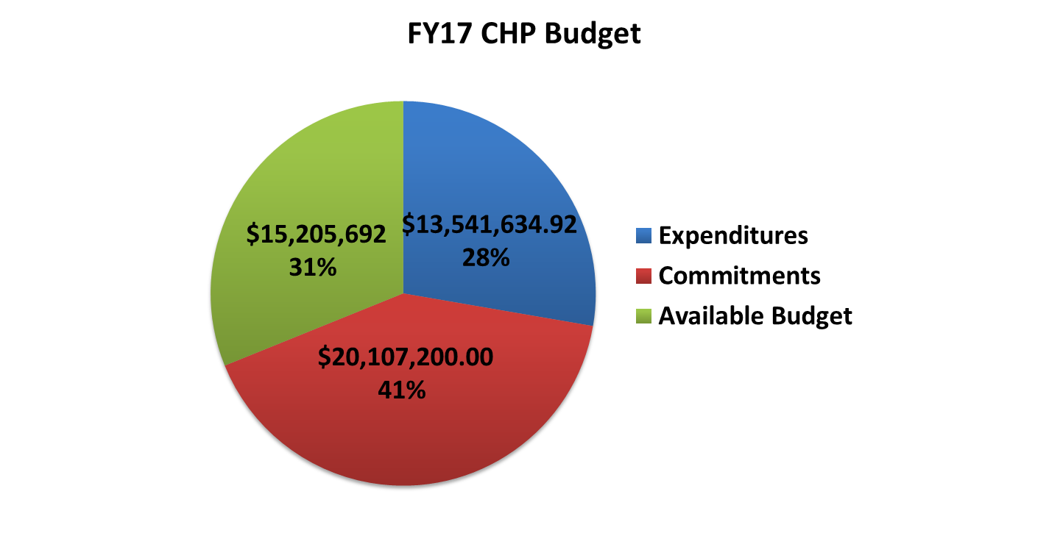
Combined Heat & Power - Fuel Cell

Slide 7
Renewable Electric Storage

Slide 8
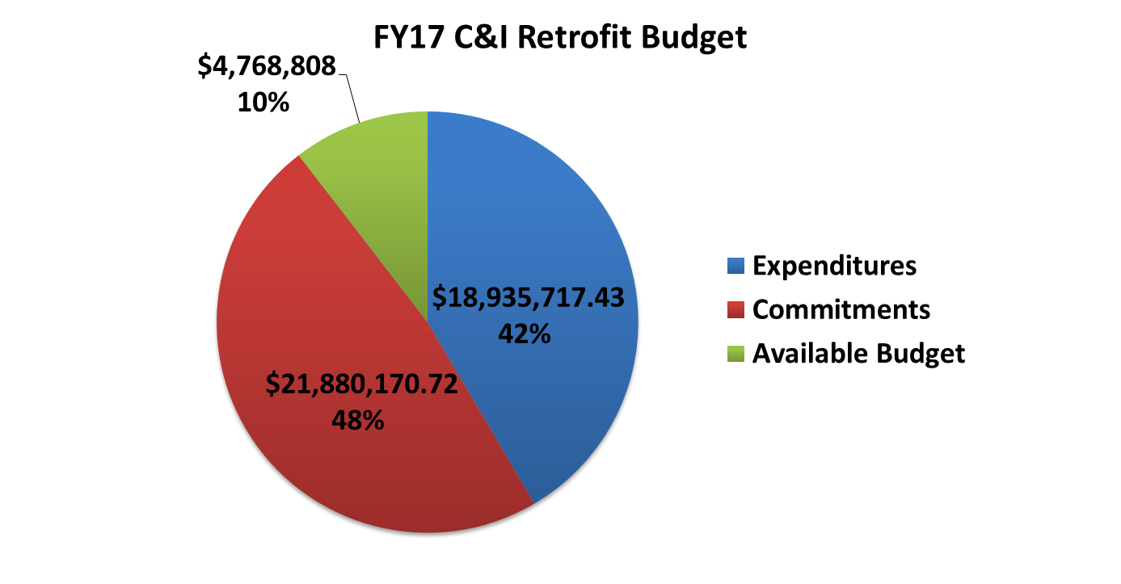
NJ SmartStart Buildings

Slide 9
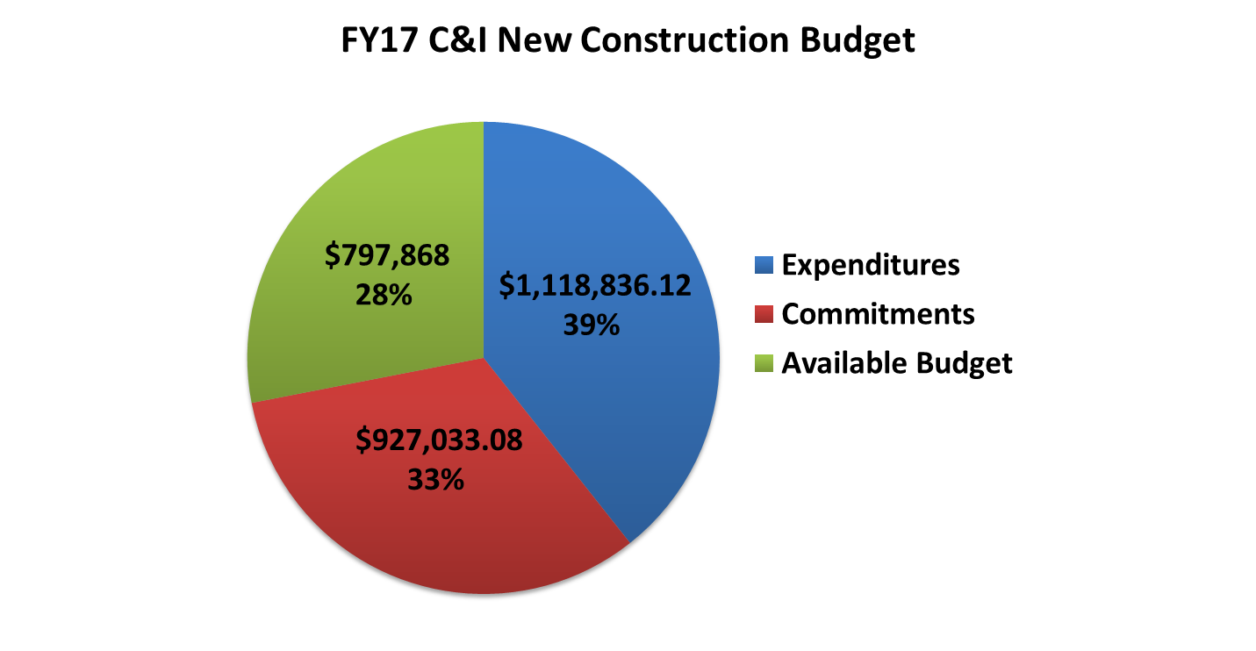
NJ SmartStart Buildings

Slide 10
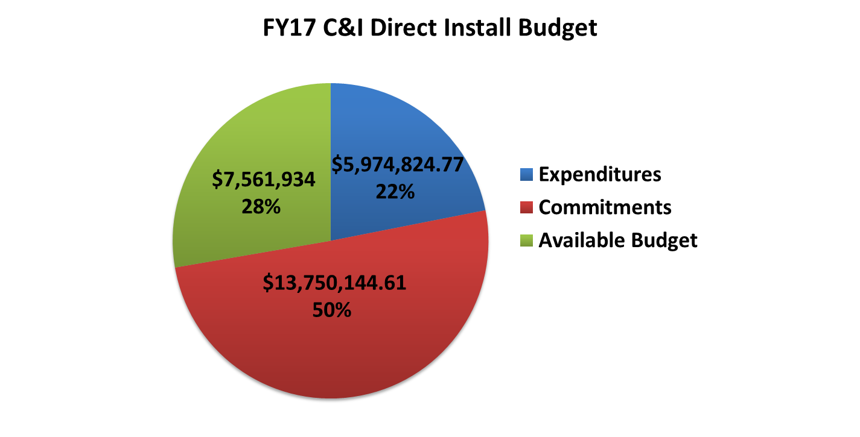
Direct Install

Slide 11
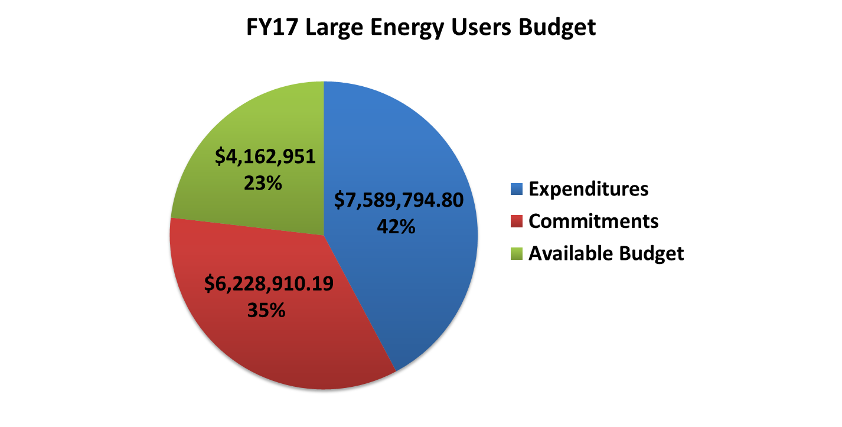
Large Energy Users

Slide 12
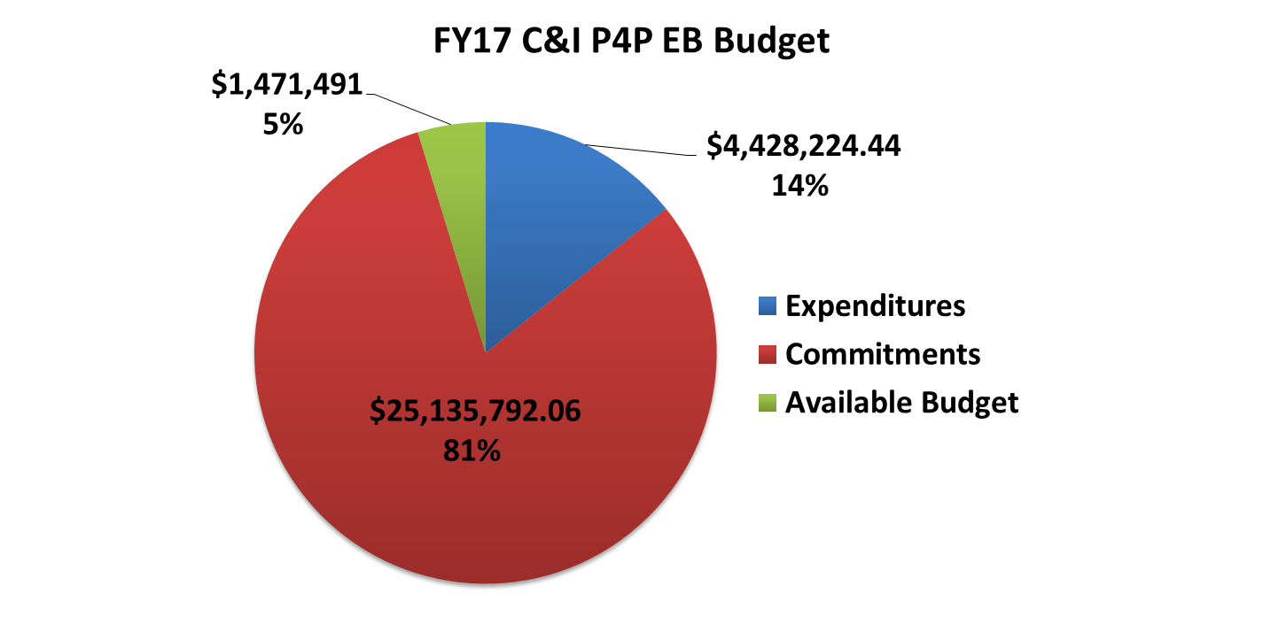
Pay for Performance Existing Buildings

Slide 13
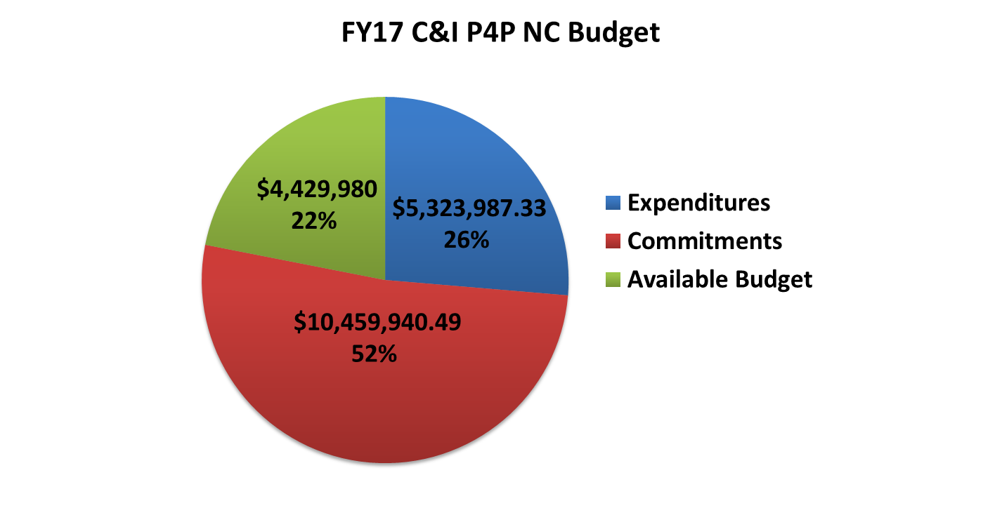
Pay for Performance New Construction

Slide 14
Local Government Energy Audit

