Slide 1
Sustainable Jersey
BPU Energy Efficiency Committee
April 11, 2017
Presenters:
Nancy Quirk, Program Coordinator
Tony O’Donnell, Economist

Slide 2
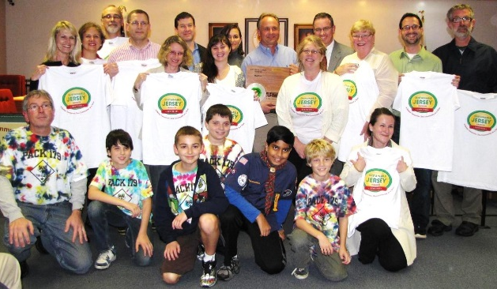
What is Sustainable Jersey?
Certification program for municipalities and schools
Collaborate with public, private, state, and local actors
Convene issue-based Task Forces of subject matter experts
We provide:
    Actions to help municipalities and schools become more sustainable
    Tools, resources, and guidance to make progress
    Grants and funding for municipalities and schools
    Regional Hubs across the state bringing municipal teams together

Slide 3
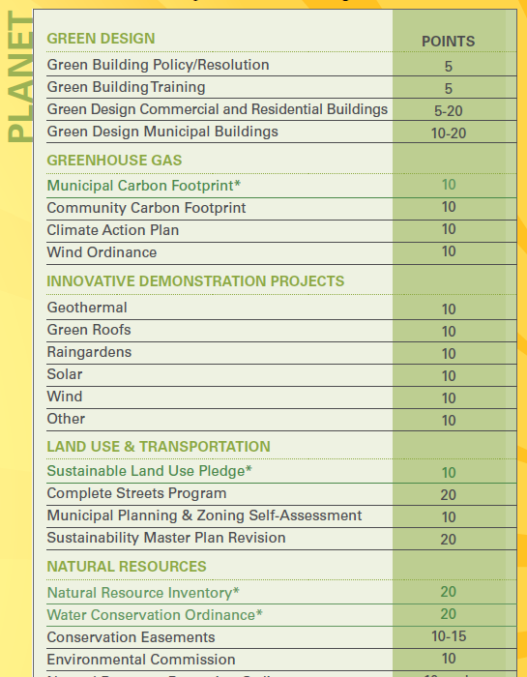
Actions: Prosperity, Planet, People
Municipalities / Schools choose from menu of actions to accumulate points
Actions created by issue-based Task Forces:
  subject matter experts
  local leaders
  state / federal agencies
  stakeholders

Slide 4
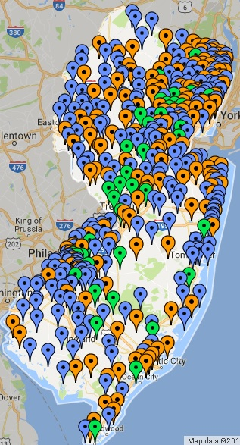
Participating Municipalities
Program start: February 2009
441 (78%) NJ municipalities participating
88% of NJ’s population lives in these communities
205 municipalities certified
    159 towns at bronze level
    46 towns at silver level

Slide 5

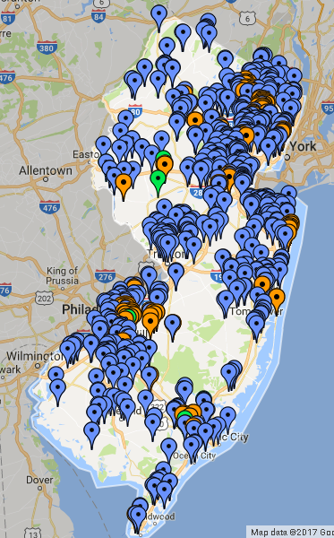
Participating Schools
Program start: October 2014
251 school districts participating
618 schools participating
118 schools certified:
    109 certified at bronze level
    9 certified at silver level

Slide 6
Statewide Impact by Year – Municipal Program

Slide 7
Municipal Program Energy Actions 2014
Municipal Program Energy Actions – 2017 Certification Cycle
Climate Planning and
Energy Efficiency
Renewable Energy
Alternative Vehicles
Municipal Carbon Footprint
Energy Tracking & Management
Audit One Building
Inventory & Upgrade All Buildings
High Performance Buildings
Energy Impact
Of Municipal
Operations
On-Site Solar Energy
On-Site Geothermal
On-Site Wind Energy
Fleet Actions
Procurement Actions
Municipal Impact
On Community
Energy Use
Community Carbon Footprint
Climate Action Plan
HPwES Program
HPwES Outreach
Direct Install Program
Direct Install Outreach
Wind Ordinance

Slide 8
Municipal Program Energy Actions 2017
Municipal Program Energy Actions – 2017 Certification Cycle
Climate Planning and
Energy Efficiency
Renewable Energy
Alternative Vehicles
Energy Impact
Of Municipal
Operations
Municipal Carbon Footprint
Energy Tracking & Management
Energy Efficiency for Municipal Facilities
On-Site Solar Energy
On-Site Geothermal
On-Site Wind Energy
Purchase Renewable Energy
Fleet Actions
Procurement Actions
Municipal Impact
On Community
Energy Use
Community Carbon Footprint
Climate Action Plan
Residential Energy Efficiency Outreach
Commercial Energy Efficiency Outreach
Wind Ordinance
Renewable GEA
Make Your Town Solar Friendly
Community-Led Solar Initiatives
Make Your Town EV Friendly
Public EV Chargers

Slide 9
Energy Efficiency Actions for 2017
Energy Efficiency for Municipal Facilities
Residential Energy Efficiency Outreach
Commercial Energy Efficiency Outreach
  Performance-based measurement
    Multiple tiers of engagement in NJCEP represented (audits and/or building upgrades) with points increasing as municipality completes more programs
    Sliding scale awards most points for >30% energy use reduction
Target rate of impact
    lifetime penetration rate at or above 10% of all NJ municipalities for HPwES and Comfort Partners is part of new GOLD star standard
    5% participation rate in business community for Direct Install earns additional points

Slide 10
Municipal Action Statistics (2010-2016)

Slide 11
Municipal Action Statistics (cont.)

Slide 12
School Action Statistics (2015-2016)

Slide 13
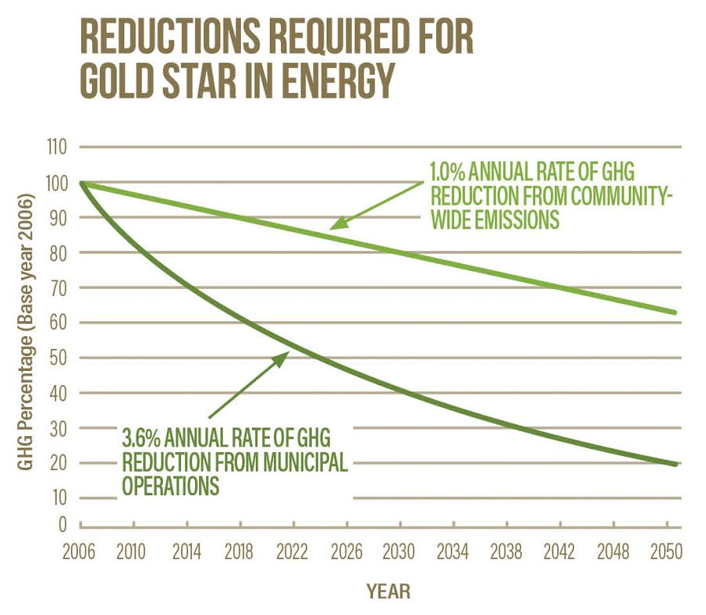
Gold Star in Energy
Municipal operations
  GOAL: Lower GHG emissions from municipal operations and facilities
    Municipal buildings
    Fleet – alternative fuel vehicles
    Operations (landscaping, energy and water conservation, etc. )
Community-wide
  GOAL: Lower community-wide GHG
    Make Your Town Electric Vehicle Friendly
    Public Electric Vehicle Charging Infrastructure
    Make Your Town Solar Friendly
    Community Led Solar Initiatives
    Residential Energy Efficiency
    Commercial Energy Efficiency

Slide 14
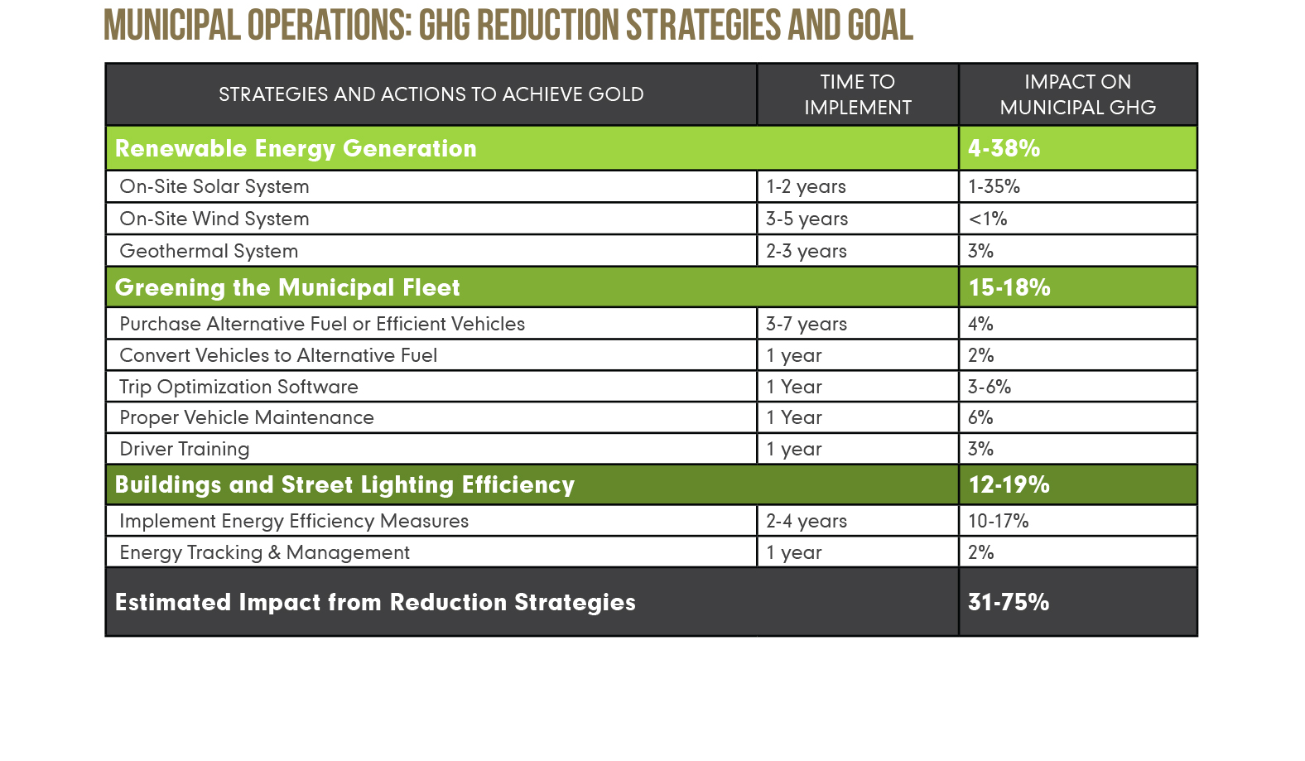
Strategies for Getting to Gold

Slide 15
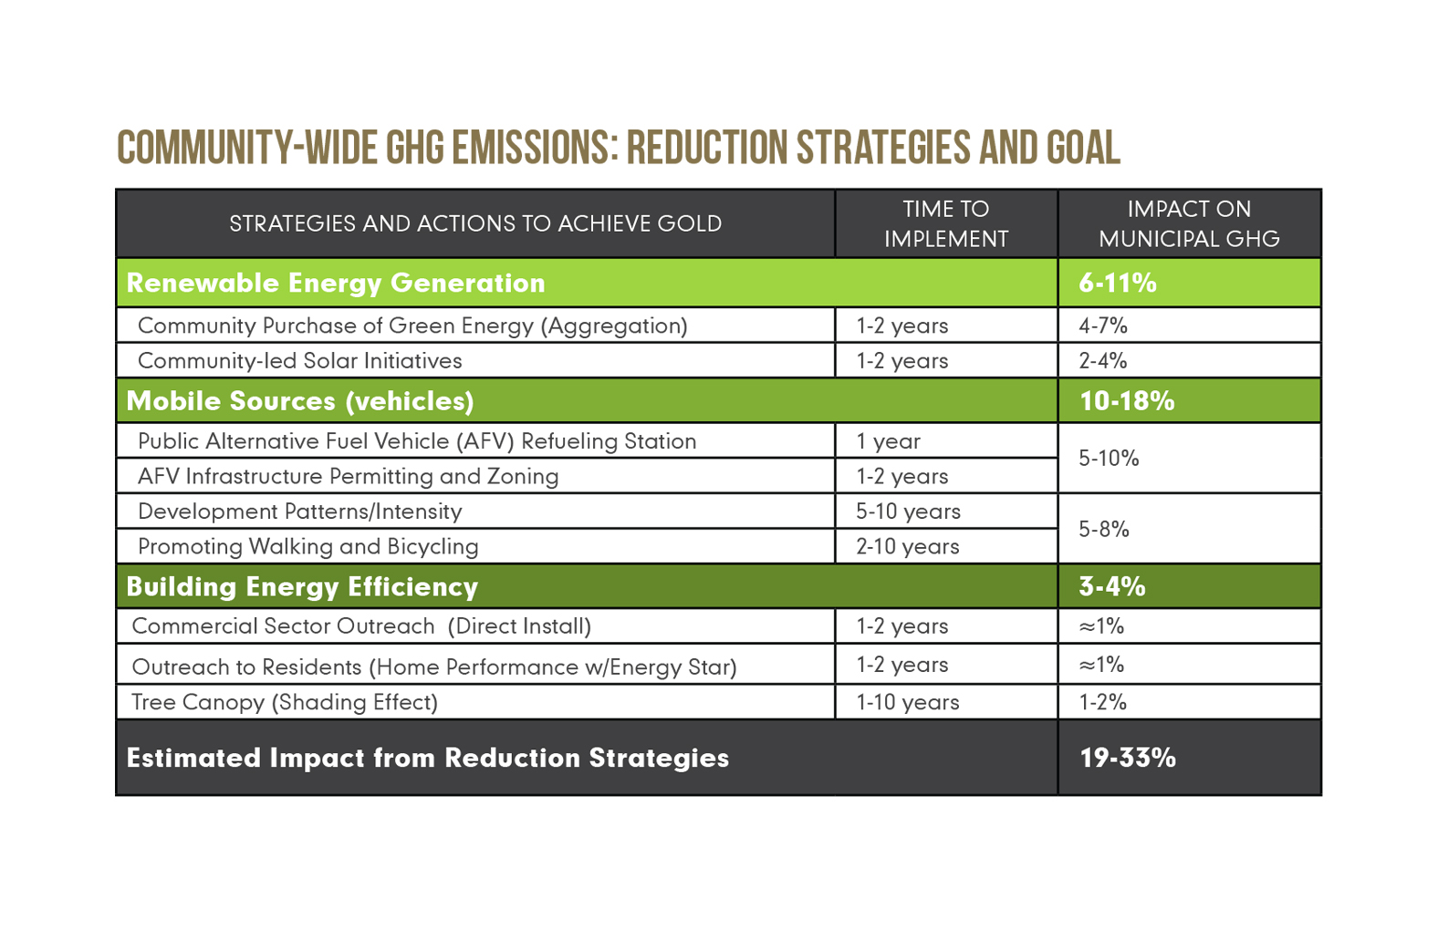
Strategies for Getting to Gold

Slide 16
2017-2018 Proposed Program Elements
Technical Assistance to targeted municipalities
HPwES Action upgrade
New Jersey Clean Energy Database
  Data compiled on US DOE grant
  Compare how schools and municipalities interact with NJCEP
Behavior-based Energy Efficiency in Schools Action
SJ Regional Hubs
  Multi-municipality collaboration

Slide 17











Sustainable Jersey Supporters
Underwritten By:
Sponsored By:
Small Grants Program Underwriters
Platinum Sponsors
Gold Sponsors
Silver Sponsors
Bronze Sponsors

Slide 18









Sustainable Jersey for Schools Supporters
Underwritten By:
Sponsored By:
Sustainable Jersey for Schools Small Grants Program Underwriters
Founding Sponsors
Silver Sponsors
Notes:
Sustainable Jersey has three funding sources: 1/3 Private Foundations; 1/3 Business Sponsors; 1/3 State Funding
Here are the Sustainable Jersey sponsors.

Slide 19
Thank You!
For further information, contact:
Nancy Quirk, Program Coordinator Advanced Infrastructure
  Email: quirkn@tcnj.edu
  Phone: 609.771.2902
Tony O’Donnell, Economist
  Email: odonnela@tcnj.edu
  Phone: 609.771.2921
Sustainable Jersey websites
  www.sustainablejersey.com
  www.sustainablejerseyschools.com

