Slide 1


Energy Efficiency Stakeholder Meeting
April 20, 2023
Notes:
TRC to start with housekeeping and introduce Stacy

Slide 2
Agenda
Welcome & Introductions
Re-cap of Last Meeting
Current Program Updates
  BPU Update
  Utility Company Presentation
FY22 Statewide Compilation Report
FY23 True-up Budget
New Construction Program Update
Triennium 2 Straw Proposals
General Q&A
Items of Interest
Next Meetings
Notes:
Stacy

Slide 3
Recap of Last Month
Notes:
Stacy

Slide 4
March Meeting Recap
What we covered:
NJCEP and Utility Program updates
RECO Clean Heat Program
FY23 True-up Budget
NJCEP New Construction Program update
Planned Triennium 2 Timeline
Q&A
Notes:
Stacy

Slide 5
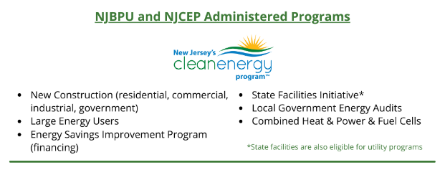


Post-Transition Energy Efficiency Programs
Notes:
Stacy

Slide 6
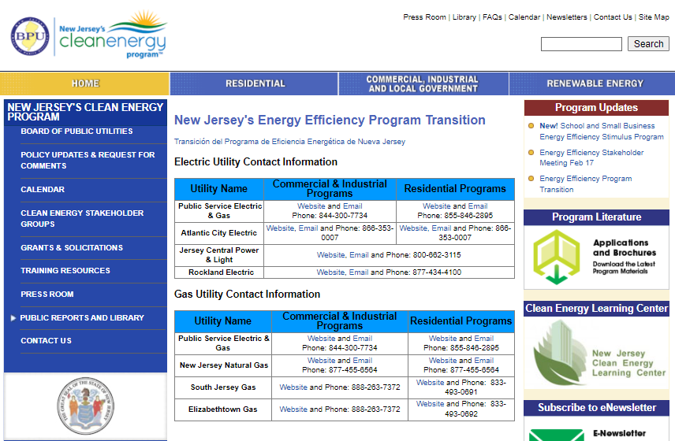
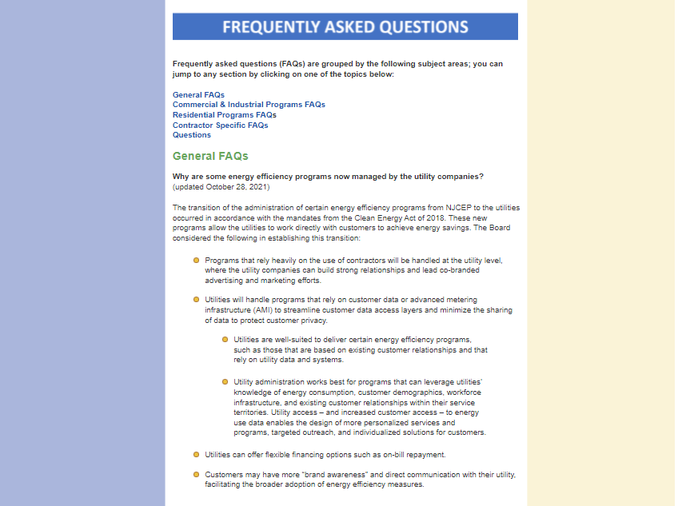
Visit our transition website:
www.NJCleanEnergy.com/TRANSITION
Notes:
Stacy

Slide 7
Current Program Updates
Notes:
Mike A.

Slide 8

BPU Program Updates:
Progress to Goals (PTG) Report
as of March 2023 – FY23
Note: The results presented here are preliminary and are subject to change.
Notes:
Mike A.

Slide 9
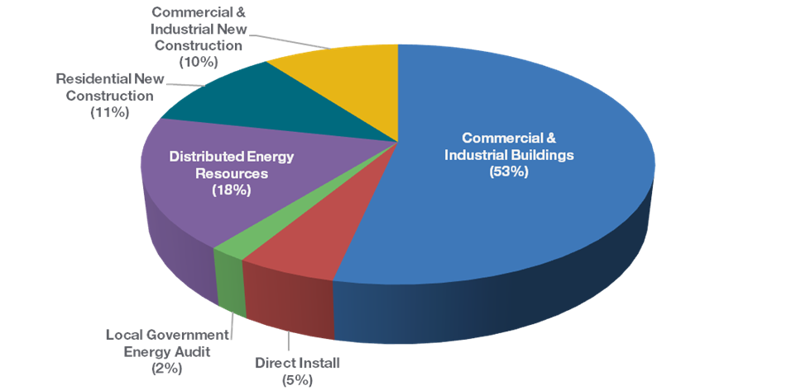
Budget Break-down by Program
FY23 TRC Managed Programs
Incentive Budget: $117,415,104

Slide 10


Energy Efficiency Programs FY23
NJCEP/TRC Managed -
Closed/Closing Out, Transitioned to Utilities
NJCEP/TRC Managed -
Open
  Residential Products & HVAC
  Residential Existing Homes
  C&I Buildings (existing buildings)
    SmartStart Retrofit
    Pay for Performance Existing Buildings
  Direct Install
  New Construction Was: Residential New Construction, SmartStart New Construction, Pay for Performance New Construction, Customer Tailored Energy Efficiency Pilot New Construction
  Large Energy Users
  Local Government Energy Audit
  Distributed Energy Resources
  School & Small Business Stimulus Program (federally funded)
BPU/Utility Managed
Comfort Partners

Slide 11
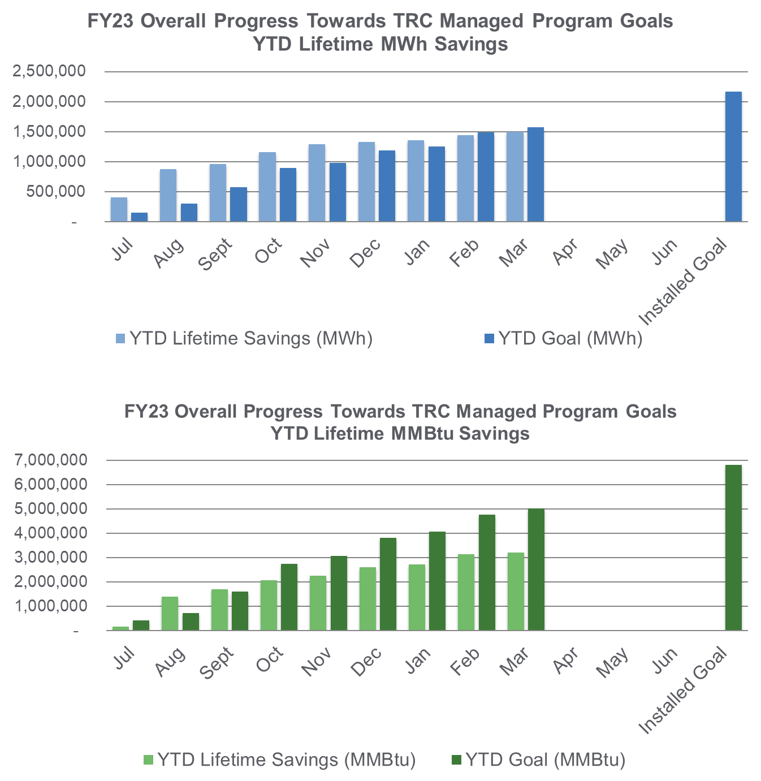
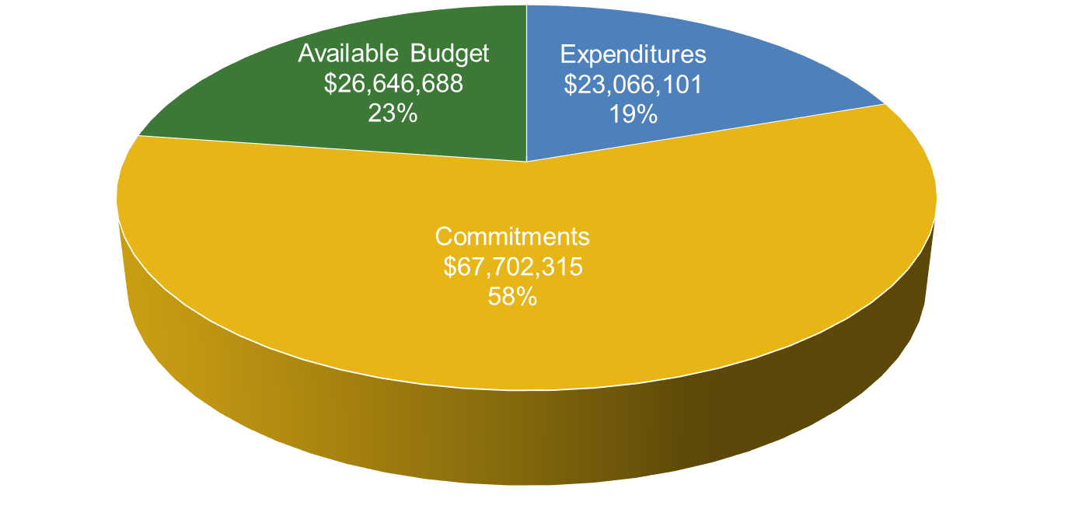
Progress Towards Goals – TRC Managed Programs
FY23 TRC Managed Programs
Incentive Budget: $117,415,104

Slide 12
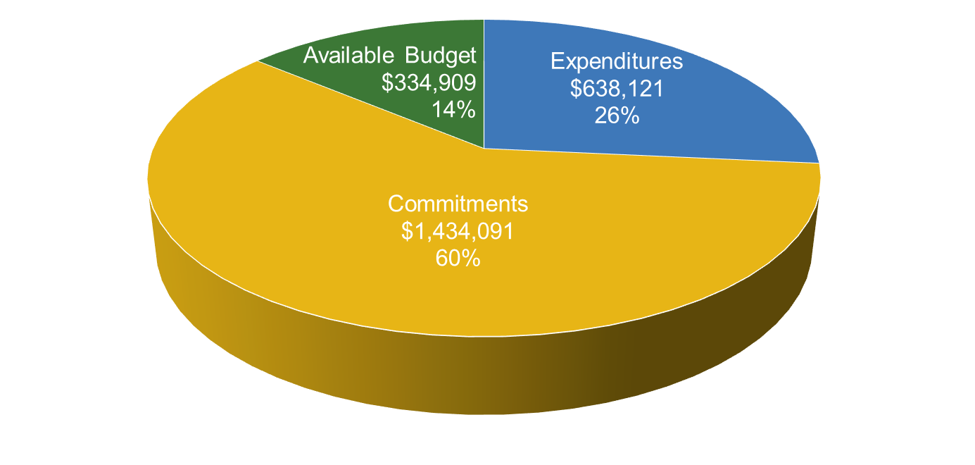
Local Government Energy Audit (LGEA)
FY23 Incentive Budget: $2,407,121
Program Highlights
Received: 27 applications this month 402 YTD
Approved: 52 applications this month 327 YTD
Audited approximately 1,341,552 square feet
Held 3 Exit Meetings for 29 sites (including additional scopes)
Delivered Final Audit reports on 31 sites (4 entities)

Slide 13
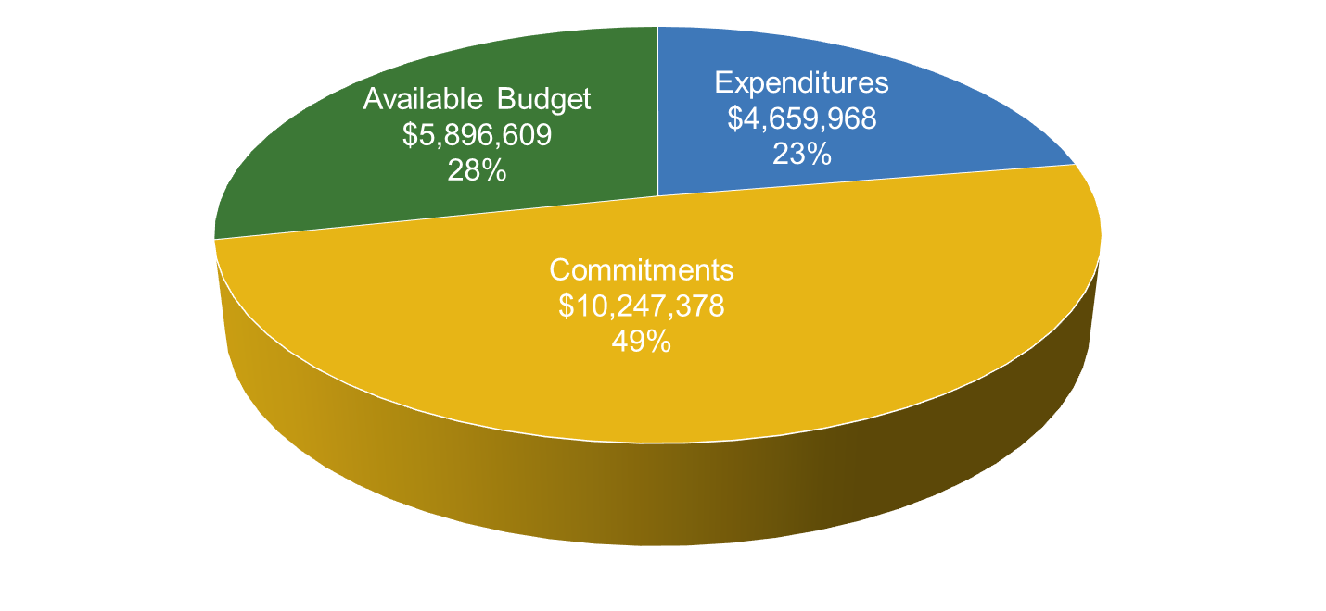
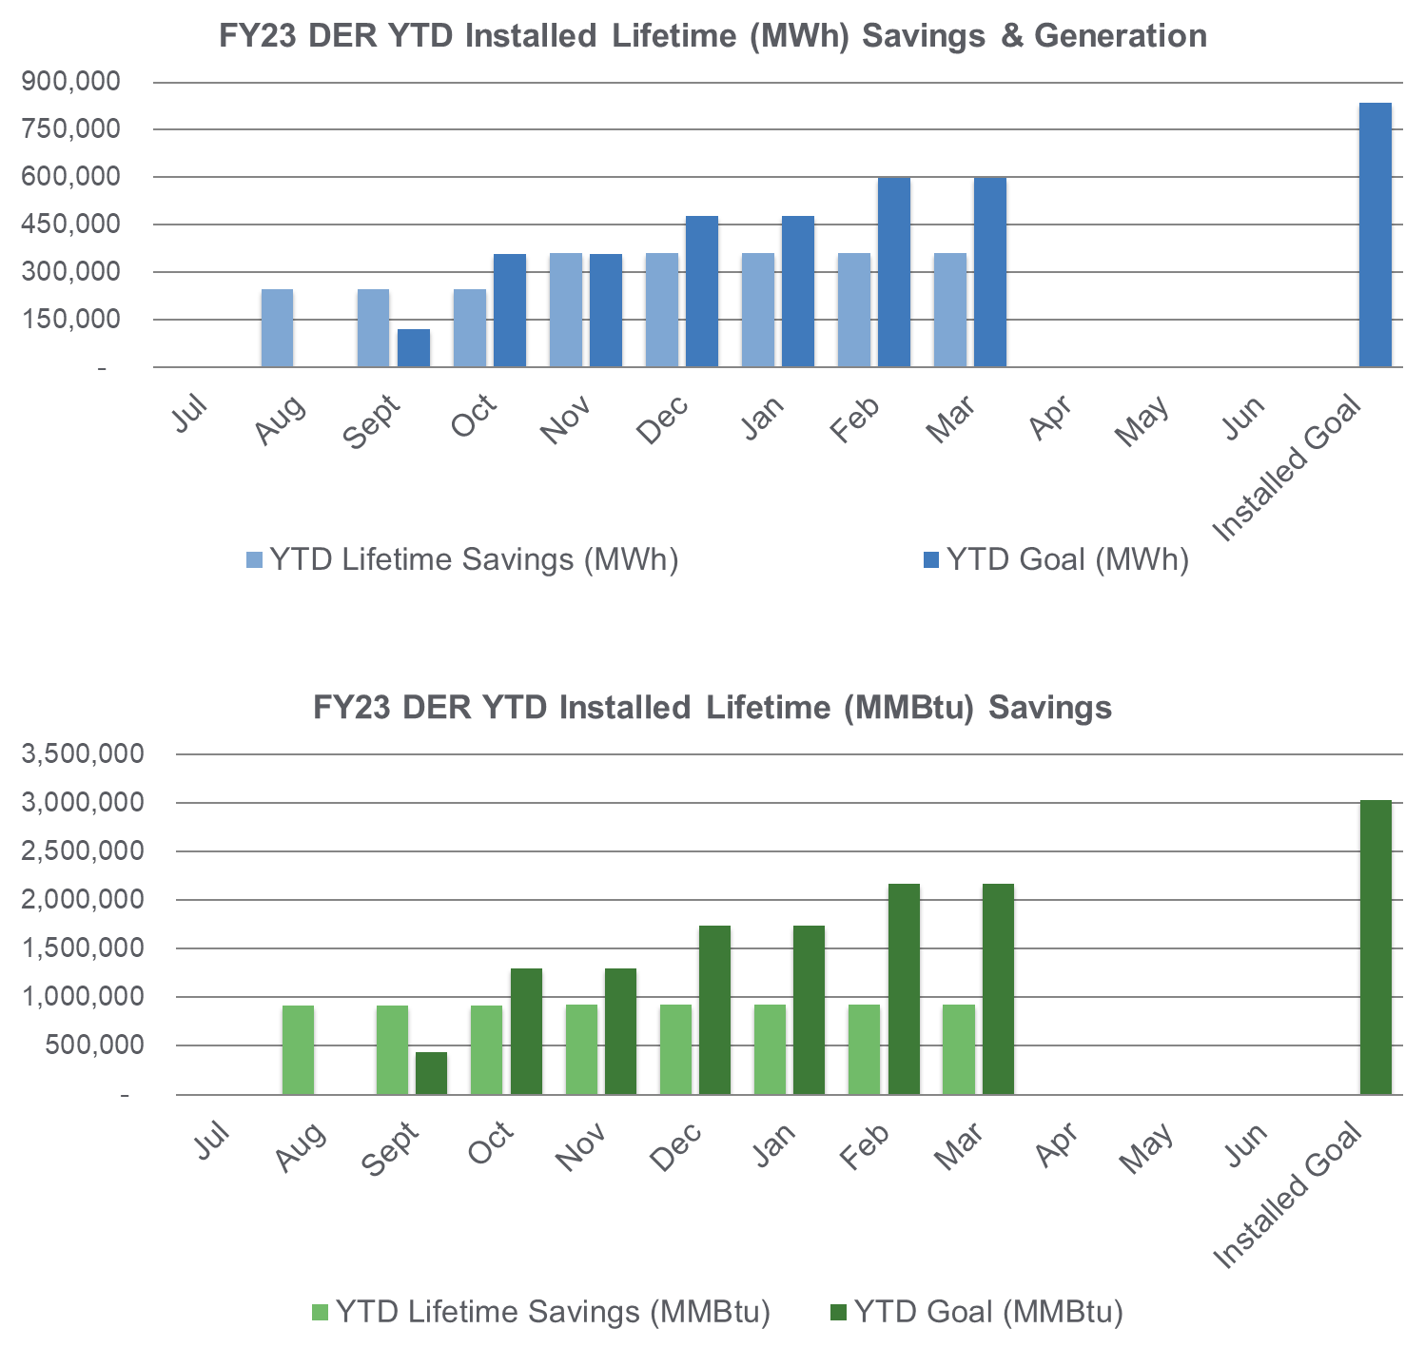
Distributed Energy Resources
CHP and Fuel Cells
FY23 Incentive Budget: $20,803,955
Program Highlights
Received: 0 applications this month 1 YTD
Approved: 0 applications this month 2 YTD
Completed: 0 installations this month 7 YTD

Slide 14
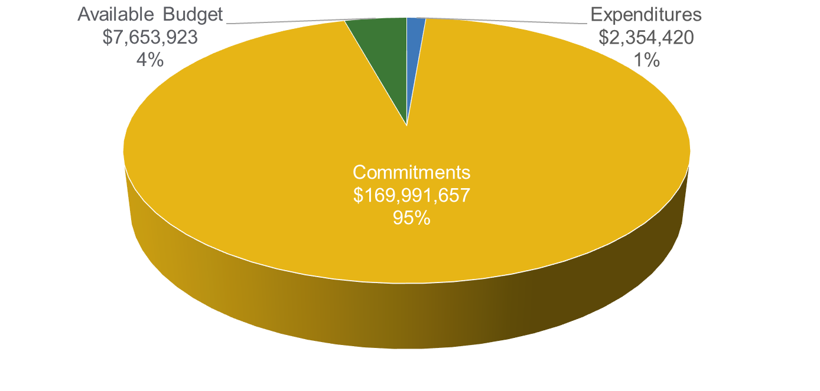
School & Small Business Stimulus Program
FY23 Incentive Budget: $180,000,000
Program Highlights
Received: 0 applications this month 147 YTD
Approved: 25 applications this month 197 YTD
Completed: 13 installations this month 35 YTD
Note: This program is a multi-year continuing grant and not based on a fiscal year.

Slide 15
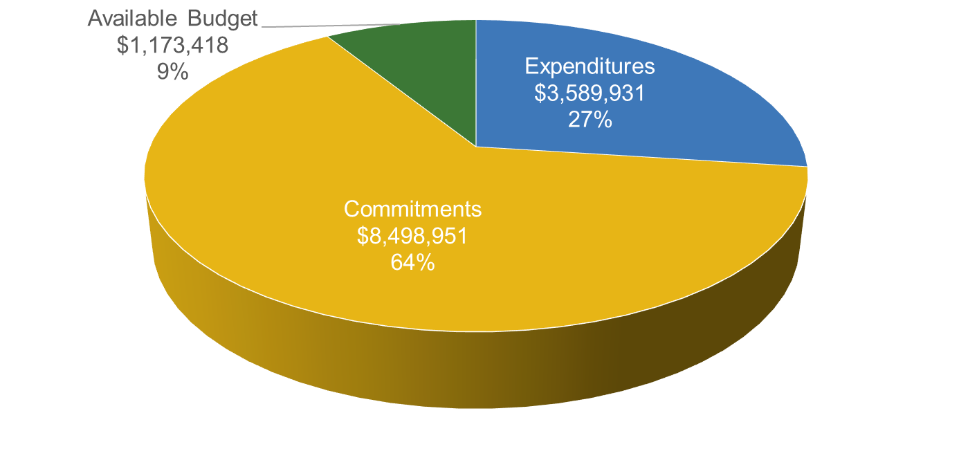
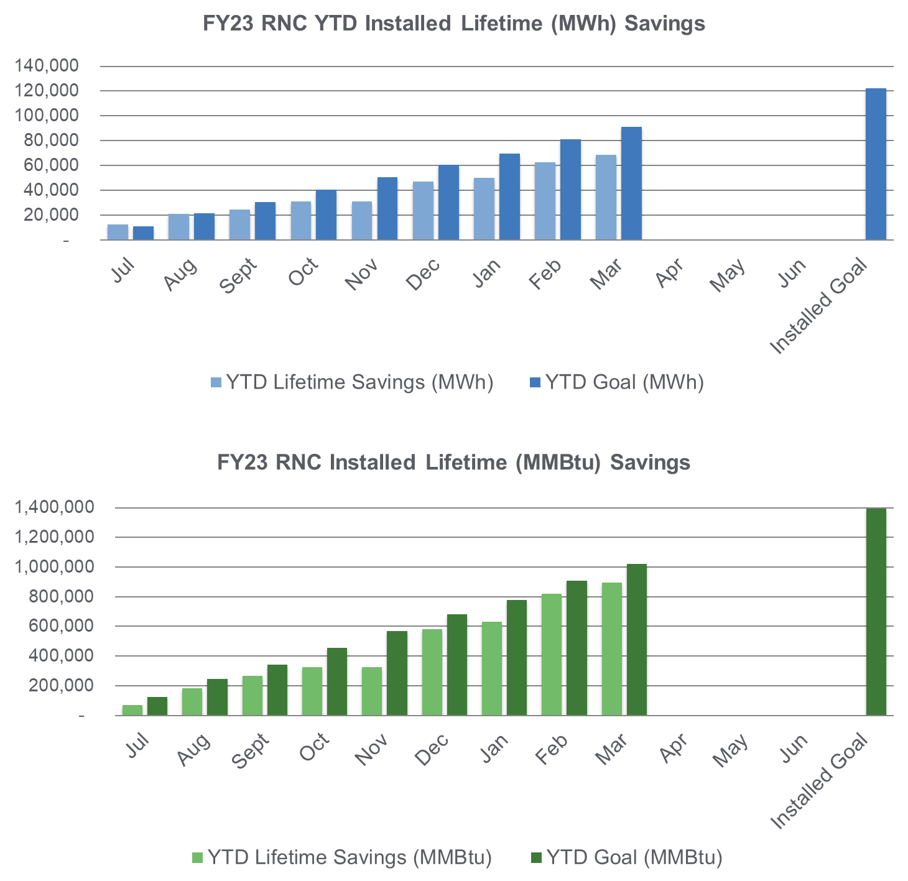
New Construction Programs
Residential New Construction
FY23 Incentive Budget: $13,262,300
Program Highlights
Site Registrations Received/Enrolled: 524
Site Registrations Approved: 520
Incentive Applications Received: 326
Incentive Applications Approved: 164
Projects Cancelled: 20

Slide 16
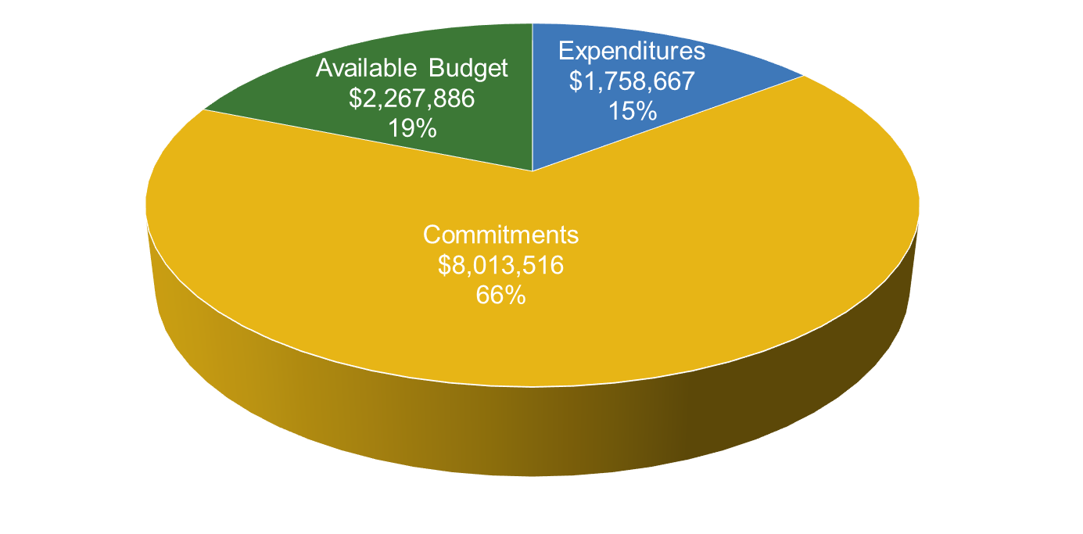
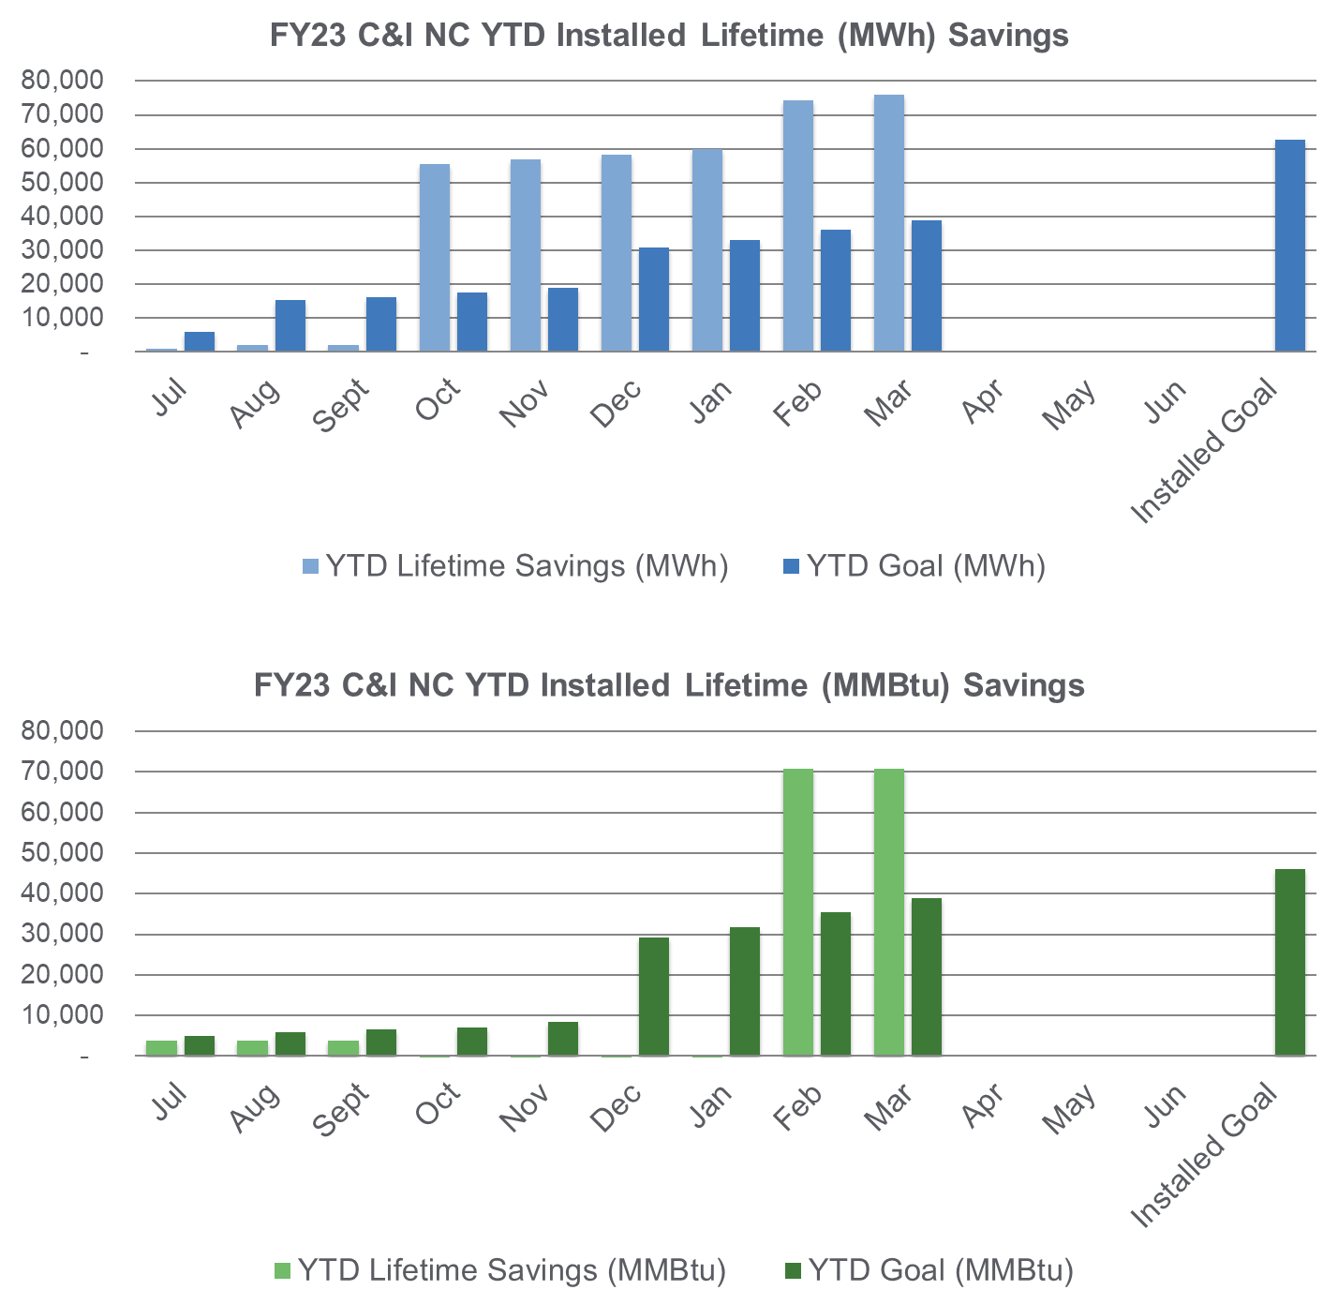
New Construction Programs (cont.)
C&I New Construction: P4P NC and C&I NC
FY23 Incentive Budget: $12,040,069
Program Highlights
Received: 2 enrollments this month 46 YTD
Approved: 2 projects this month 48 YTD
Paid: 2 applications this month 35 YTD
16

Slide 17
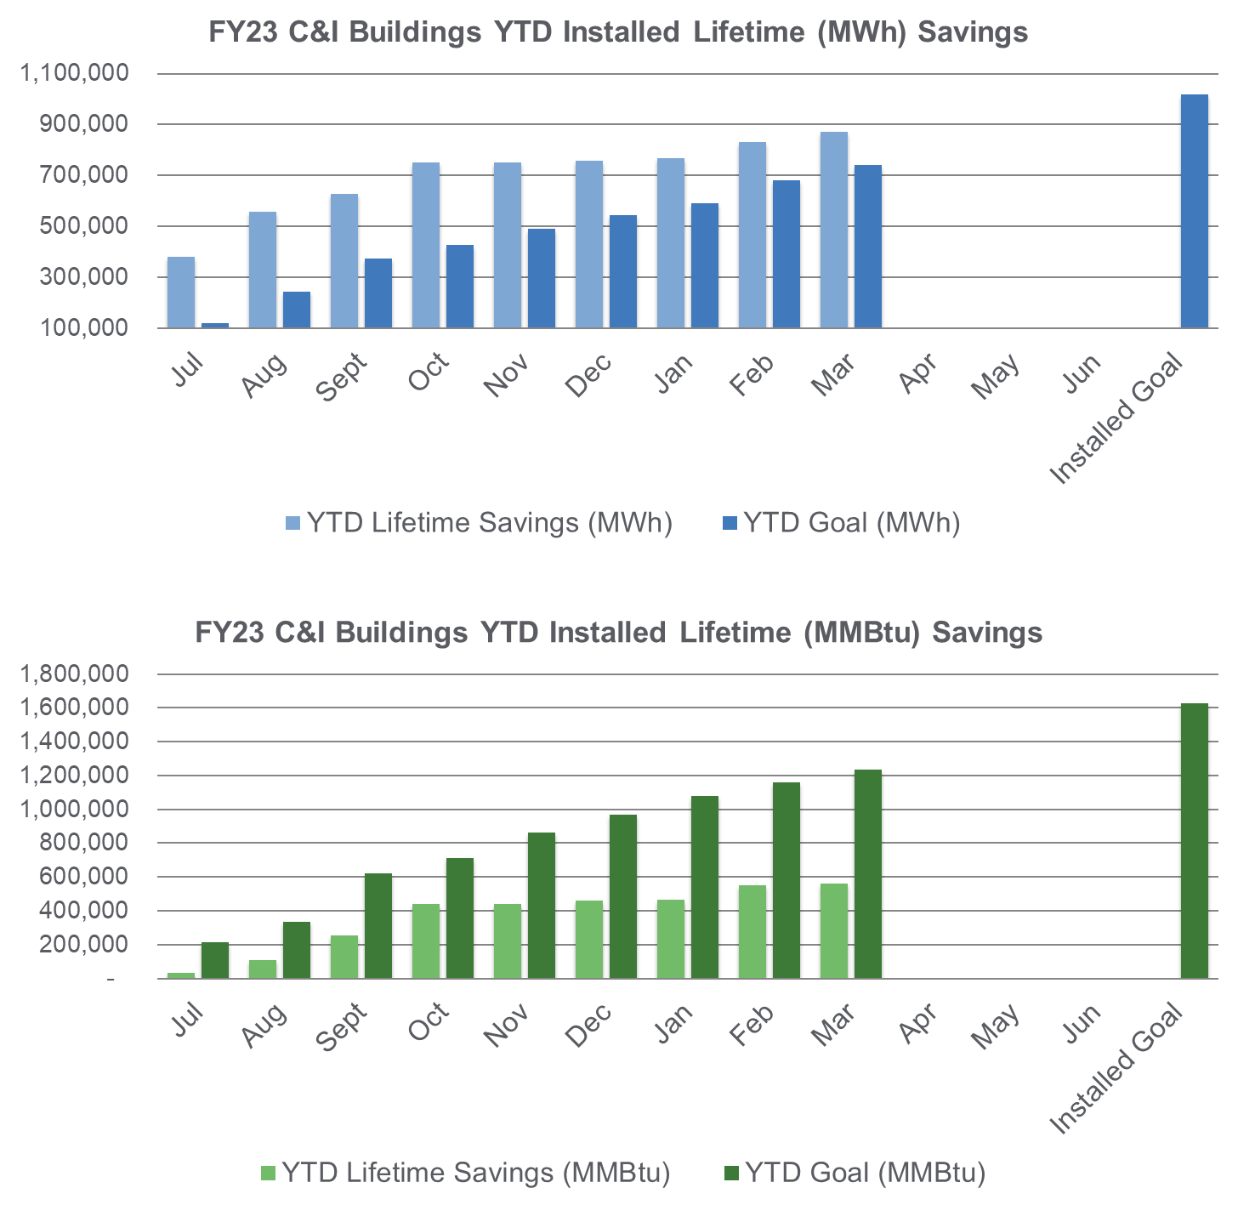
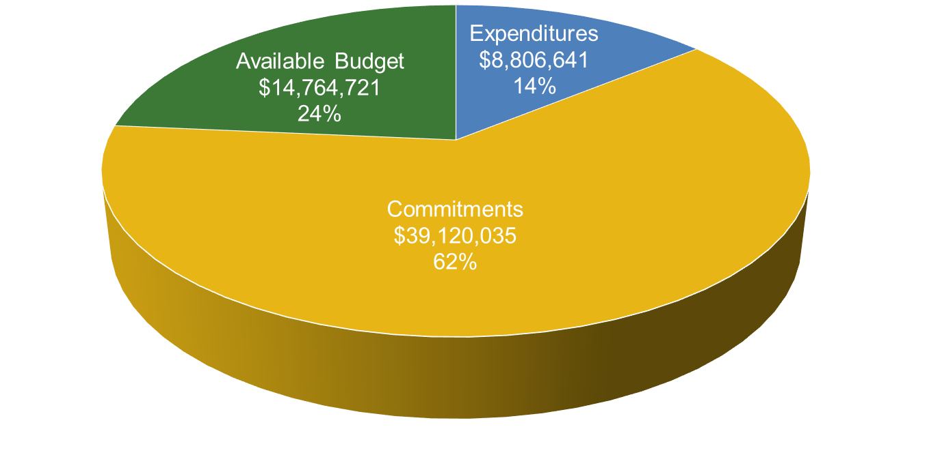
Commercial & Industrial Programs
C&I Buildings: Retrofit, CTEEP, P4P EB, LEUP
FY23 Incentive Budget: $62,691,396

Slide 18
C&I Buildings – Program Highlights
Large Energy User Program
Received: 0 applications this month 7 YTD
Approved: 0 Final Energy Efficiency Plans this month 4 YTD
Paid: 0 applications this month 7 YTD
Retrofit (Close-Out Program: transitioning to Utilities)
Received: 0 applications this month 1 YTD
Approved: 0 applications this month 8 YTD
Paid: 17 applications this month 137 YTD
Pay for Performance Existing Buildings (Close-Out Program: transitioning to Utilities)
Received: 0 applications this month 0 YTD
Approved: 11 Energy Reduction Plans 26 YTD
Completed: 2 projects this month 6 YTD
Customer Tailored Energy Efficiency Pilot (Close-Out Program: transitioning to Utilities)
Received: 0 new enrollments this month 0 YTD
Approved: 0 applications this month 5 YTD
Paid: 9 applications this month 66 YTD
Held: 0 scoping session meetings with customers this month 0 YTD

Slide 19
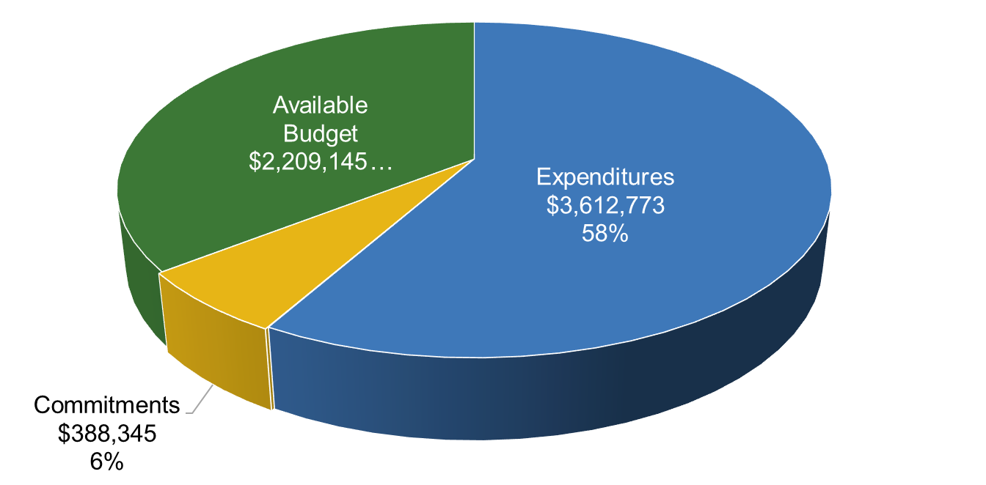
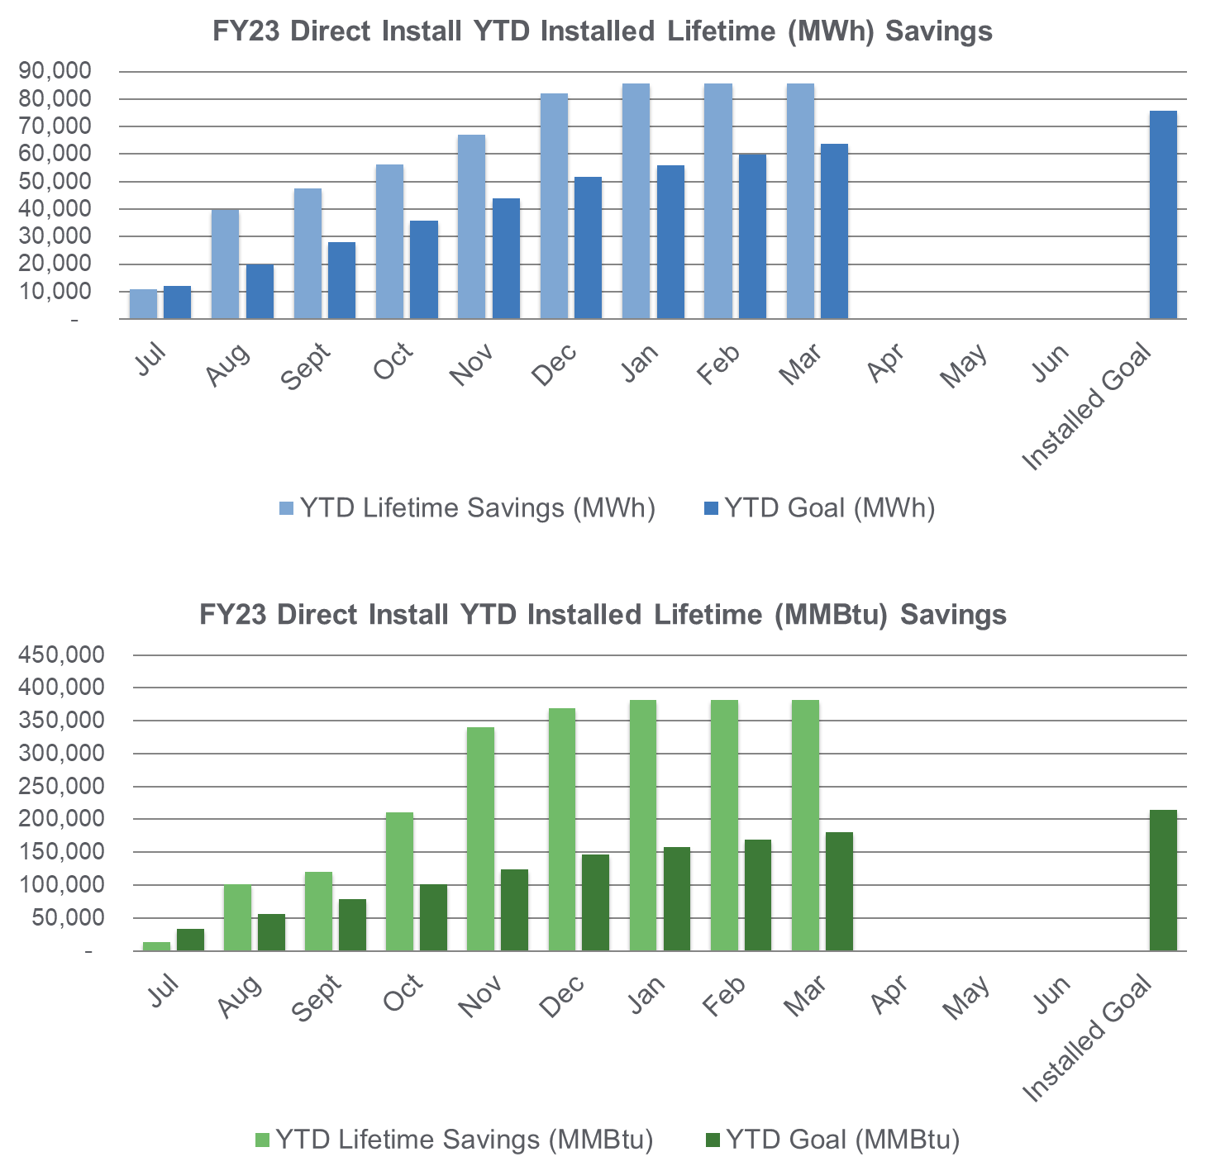
Direct Install (Close-out Program: transitioning to Utilities)
FY23 Incentive Budget: $6,210,263
Program Highlights
Received: 0 enrollments this month 0 YTD
Approved: 0 applications this month 0 YTD
Paid: 0 applications this month 80 YTD

Slide 20
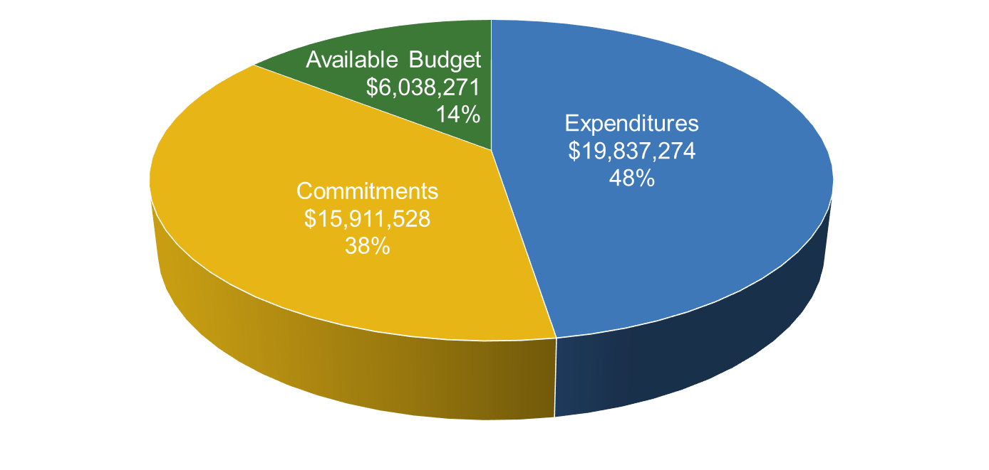
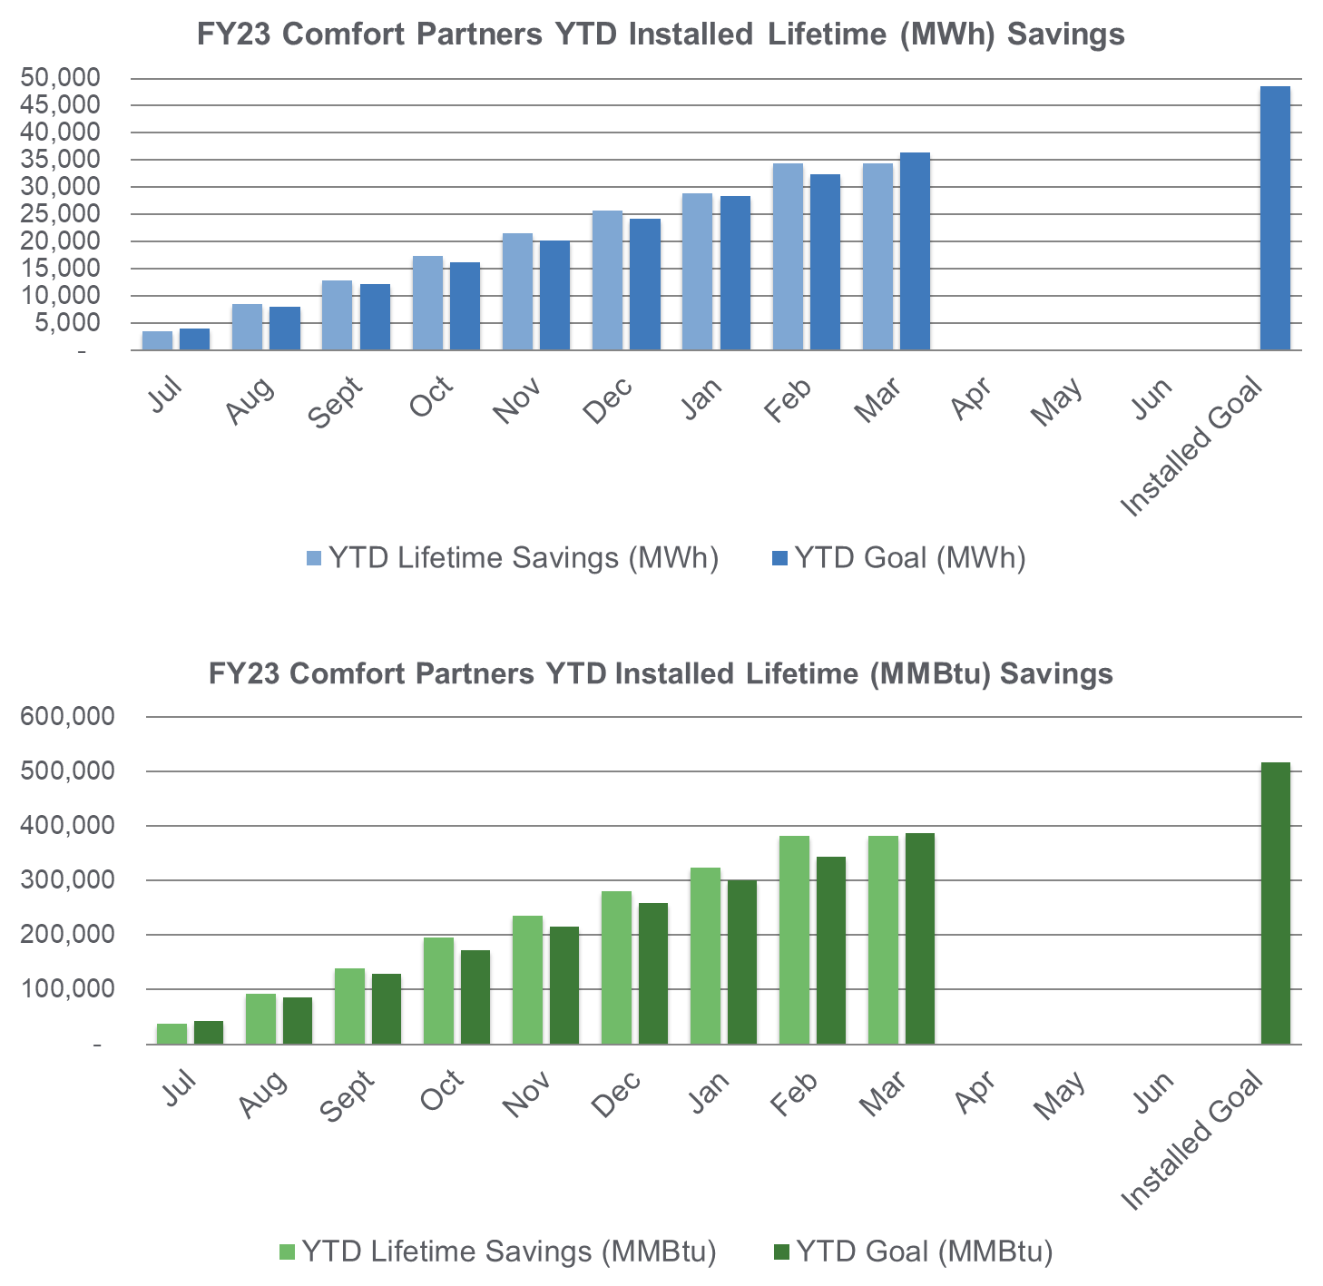
Comfort Partners
BPU/Utility Managed
FY23 Incentive Budget: $41,787,072
Program Highlights
Completed: | 406 projects this month | 2,886 YTD
20
20
Notes:
Stacy

Slide 21


Utility Updates
NJ Energy Efficiency Stakeholder Meeting
April 20, 2023
Notes:
Rachael
Happy Earth month!

Slide 22

General Reminders
Reach out to utilities where you may be interested in doing business
Sign up for any contractor updates if that option is available
Build your understanding of utility specific elements (e.g. financing options, online forms)
Some programs have specific contractor requirements and may require a Participating Contractor Agreement
Explore information utilities have posted online and reach out if you have questions
  Contact info for all utilities is available on the New Jersey Clean Energy Program (NJCEP) Transition page

Slide 23

Program Updates- Contractor Updates
Recurring Contractor meetings provide program updates and secure feedback on programs. Get Involved!
  Home Performance with ENERGY STAR® contractors mtg. April 20th 11 AM
  HVAC contractor mtg. April 27th 11 AM
  Reach out to your utility if you are interested in attending future meetings
Contractors do not need to wait for meetings if they have questions

Slide 24
Program Updates- Program Implementation
Utilities have communicated the impacts of the Department of Energy (DOE) Cooling Standard changes with contractors and changes have been implemented in Snugg Pro (software used for Home Performance with ENERGY STAR® (HPwES)).
Utilities responded to the DOE Request for Information on the Inflation Reduction Act (IRA) programs
  Strong interest in ensuring that the programs complement, rather than compete with existing utility programs to avoid customer/contractor confusion
On February 22, 2023, the US DOE notified all HPwES sponsors that they plan to sunset the HPwES program
  Rationale is tied to belief that new programs under both the Bipartisan Infrastructure Action and the Inflation Reduction Act will be transformative in nature so HPwES will no longer be necessary
  NJ Utilities continue to review and discuss and have the opportunity to provide feedback on their proposed timeline for transition. Met with the HPwES contractors in March to gather input from participating contractors
There is no immediate change to the HPwES Program
Notes:
These are reminders- no new information

Slide 25

Program Updates: PSE&G
Limited Time Offer: $100 Rebate for Recycling Your Old, Working Refrigerator or Freezer during our Swing Into Spring Recycling Event! Available between April 1 to June 30, 2023*
Appliance Recycling Drop-Off Event on April 22nd, 9 a.m. – 1 p.m. at Lowe’s Home Improvement, 150 Rt 17 North, East Rutherford.
  $35 rebate when you recycle a window AC unit or dehumidifier
  Must be in working condition, Limit of 4 units
  Available to PSE&G Electric Customers only
Look for special deals to celebrate Earth Month on the PSE&G online marketplace!
PSE&G- Increased focus on stakeholder engagement to grow Programs:
  Held in-person Trade Ally breakfast on March 29th to brief attendees on the Infrastructure Investment and Jobs Act (IIJA) and Inflation Reduction Act (IRA) and recognize top 2022 performers. Over 150 registrants.
  Residential Trade Ally Networking Event held on April 13th. Over 100 registrants.
  *A $100 rebate for each refrigerator or freezer—plus an additional $35 rebate for each room air conditioner or dehumidifier picked up at the same time. Free pickup and haul-away. Environmentally responsible recycling and disposal. PSE&G customers visit: https://homeenergy.pseg.com/recycling

Slide 26

Program Updates: PSE&G Home Energy Assessment Tool
A Home Energy Assessments is a GREAT first step to determine how you can save energy and money and increase comfort in your home!
Several Program pathways offer assessments: Comfort Partners, Home Weatherization, Quick Home Energy Check-up (QHEC) and HPwES
With all offerings a certified energy efficiency advisors may provide expert recommendations that could save you up to 30% on your energy costs.* Advisors examine:
    Insulation levels
    Air leakage around windows and doors
    Lighting and appliances
    Heating and cooling systems
    Water heating equipment
    Health and safety concerns identified during the assessment
Additionally, you may have several energy-efficient products installed at no cost—and depending on your needs, you may qualify for other energy-saving upgrades, also at no cost
Not Sure How to Get Started?
Try the PSE&G Home Energy Assessment Tool! Answer a few questions to find out which PSE&G home energy assessment is right for you!
Visit: Home-energy-assessment-tool
* energy.gov

Slide 27

Program Updates- Rockland Electric
Trade Ally Breakfast
  April 19th at the Sheraton Mahwah Hotel
  Networking, recognition and 2022 awards
  Trade Ally Portal presentation and discussion
Earth Month synergy to save energy and dollars
  Online marketplace store smart thermostat rebates
  Large homepage banner promotion on Marketplace
Earth Month Promotion and Awareness
  Email campaign for demand response (DR) education and enrollment
    $5 Smart Thermostat sale with DR enrollment in Smart Saver
    Bill insert with QR code
      Promoting clean heating and cooling, energy saving on the online marketplace, electric vehicles, and appliance recycling

Slide 28


Program Updates- Other Utilities
Other utilities running Earth Day themed promotions on their marketplace
  New Jersey Natural Gas
  JCP&L
  South Jersey Gas
  Elizabeth Town Gas
  Atlantic City Electric
NJNG planning the 20th Annual Ocean Fun Days event
  May 20th Island Beach State Park
  May 21st New Jersey Sea Grant Consortium at Sandy Hook
  Energy Scavenger Hunt, including the BPU
ACE to represent at the ACUA 31st Annual Earth Day Festival in Egg Harbor Township
  The celebration will include free, fun and educational activities & entertainment for everyone with more than 150 vendors, crafters, food and exhibitors
More info available at www.oceanfundays.org
ACUA - Home

Slide 29
Thank You

Slide 30
Compilation Report
Notes:
Mike A

Slide 31
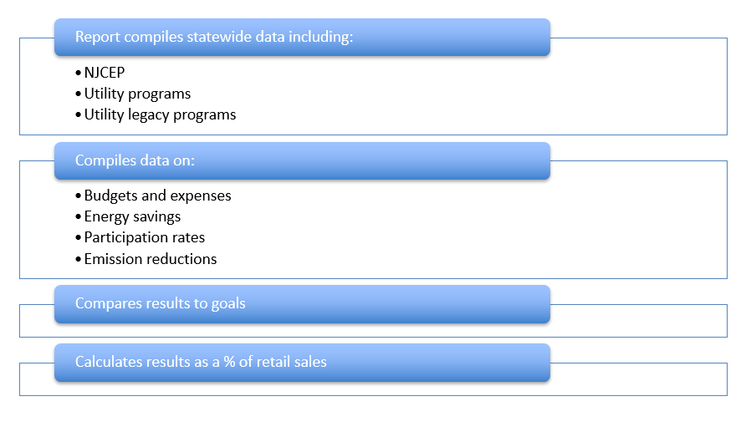
Compilation Report https://njcleanenergy.com/library -> Financial and Energy Saving Reports
Statewide Compilation Report:
https://www.njcleanenergy.com/main/public-reports-and-library/financial-reports/clean-energy-program-financial-reports

Slide 32
Statewide Compilation Report – FY22 Results

Slide 33
FY23 True-up Budget
Notes:
Mike A

Slide 34
FY23 True-up Budget
Request for Comments issued February 17, 2023
Informational Session was held March 3, 2023
Comments were due March 10, 2023
BPU Approval – April 12, 2023
Notes:
Sherri

Slide 35
New Construction Program /
Garden State Challenge Pilot Update
Notes:
Mike A

Slide 36
New Construction Program / Garden State Challenge Pilot Update
Next Steps
Finalize program design with Board Staff
Release for public comment as Compliance Filing update
Notes:
Sherri

Slide 37
Triennium 2 Timeline
Notes:
Stacy

Slide 38
Triennium 2 Straw Proposals
Updated Slide
Programs Straw Proposal (Programs, Workforce, Flexibility, EE Resource, Filing and Reporting Requirements, etc.)
Notice of Stakeholder Meetings | 3/23/2023
Release Straw Proposal for Public Comment | 3/31/2023
Virtual Stakeholder Meeting (1-2:30) | 4/6/2023
Comment Deadline | 4/28/2023
EM&V Straw Proposal (EM&V Framework, NJCT, TRM)
Release Straw Proposal for Public Comment | 4/12/2023
Virtual Stakeholder Meeting (1-2:30) | 4/18/2023
Comment Deadline | 4/28/2023
Goals & Targets Straw Proposal (Goals, QPI/PIM, Energy Savings Carryover) Building Decarb Start-up and Demand Response Programs – Straw Proposals
Release Straw Proposals for Public Comment | TBA
Virtual Stakeholder Meeting | TBA
Comment Deadline | TBA
Notes:
Rupa

Slide 39
General Q&A
To submit questions in advance for next month: EnergyEfficiency@bpu.nj.gov
Notes:
Stacy

Slide 40
Items of Interest
Notes:
Stacy
Opportunity to share EE updates (no business promotions) (ask stakeholders to raise hands)

Slide 41
Next Meetings
Notes:
Stacy

Slide 42
Energy Efficiency Stakeholder Meetings
NJCleanEnergy.com/StakeholderGroups/Energy-Efficiency
3rd Thursday of the Month, 1-2:30pm
May 18, 2023
June 15, 2023
July 20, 2023
August 17, 2023
September 21, 2023
October 19, 2023
(no November meeting)
December 21, 2023
Notes:
Stacy

Slide 43

More Information
Visit
NJCleanEnergy.com
NJCleanEnergy.com/StakeholderGroups/Energy-Efficiency
CONTACT
EnergyEfficiency@bpu.nj.gov
866.NJ.SMART (657.6278)
EE Listserv
NJCleanEnergy.com/LISTSERVS
@NJCleanEnergy
Notes:
Stacy

